Slide 1
A framework for evaluating pavement vulnerability to shallow groundwater rise in coastal Alabama
2024 National Hydraulic Engineering Conference
Biloxi, Mississippi – Aug 29, 2024
Authors: Bruno J. de O. Sousa¹,
Daniel B. Wright², Bret M. Webb³, José G. Vasconcelos¹
Presenter: Bruno Sousa
¹Department of Civil and Environmental Engineering, Auburn University, Auburn, Alabama.
²Department of Civil and Environmental Engineering, University of Wisconsin-Madison
³Department of Civil, Coastal, & Environmental Engineering, University of South Alabama

Slide 2
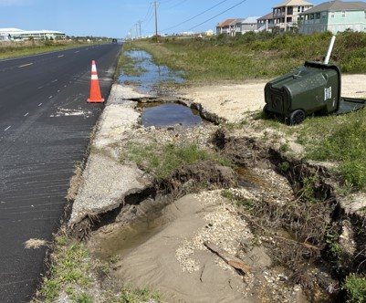
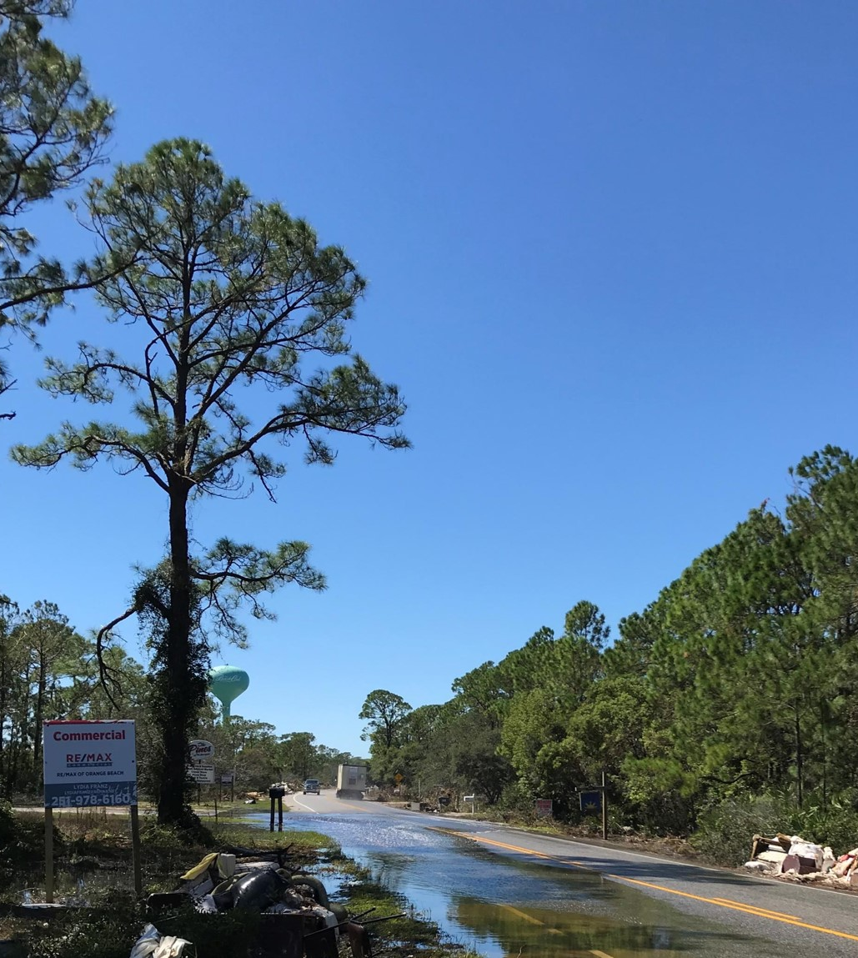
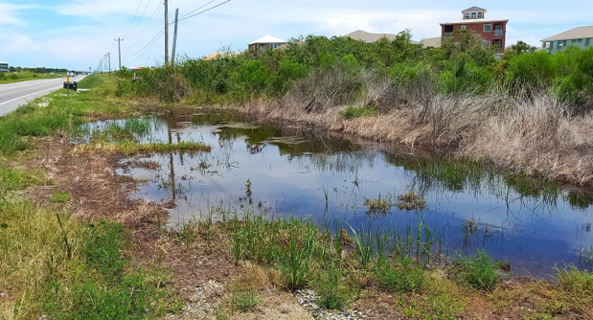
Context
Study area: Alabama State Route 180.
Mobile Bay to the north, Gulf of Mexico to the south.
Vulnerability to flooding and high water tables.
Part of an effort to apply Nature-based solutions to improve coastal roadway resiliency
Notes:
AL-180 serves as an evacuation route connecting Fort Morgan Peninsula to Dolphin Island.

Slide 3
Context
Surface flooding.
High water tables may impact pavements*:
Complex groundwater evaluations.
Surface depression and holes.
Disintegration.
Increase compressive strain.
*Chen & Wang (2023); Titus-Glover et al. (2019)

Slide 4
Objectives
This research intends to produce an intuitive framework to evaluate the exposure of AL-180’s pavement to elevated shallow groundwater levels (SGWL).
The framework is based on accumulated rainfall, proximity to water bodies, tidal level fluctuations, drawdown characteristics, and nearby roadway drainage.
Notes:
AL-180 serves as an evacuation route connecting Fort Morgan Peninsula to Dolphin Island.

Slide 5
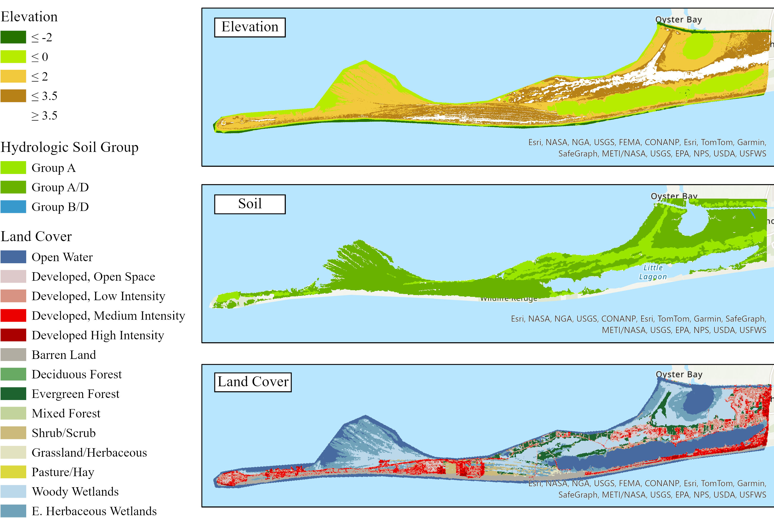
Study Area Characteristics
Main Land Cover Classes: Open Water, Woody Wetlands, Emergent Herbaceous Wetlands, Developed, Low and Medium Intensity, Barren Land (Sand).
Predominant Soil: Sand.
Mean Annual Rainfall: 1581 mm (62 inches).
No streams in the peninsula
Notes:
100-meter buffer to include additional visible features in aerial images.

Slide 6
Methods: Monitoring
3 groundwater monitoring wells
15 min Groundwater levels
HOBO water level loggers

Slide 7
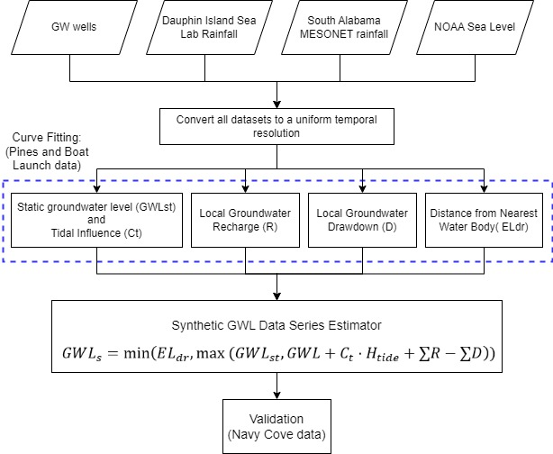
Methods – Study Delineation

Slide 8
Methods – Groundwater Level Estimator

Slide 9
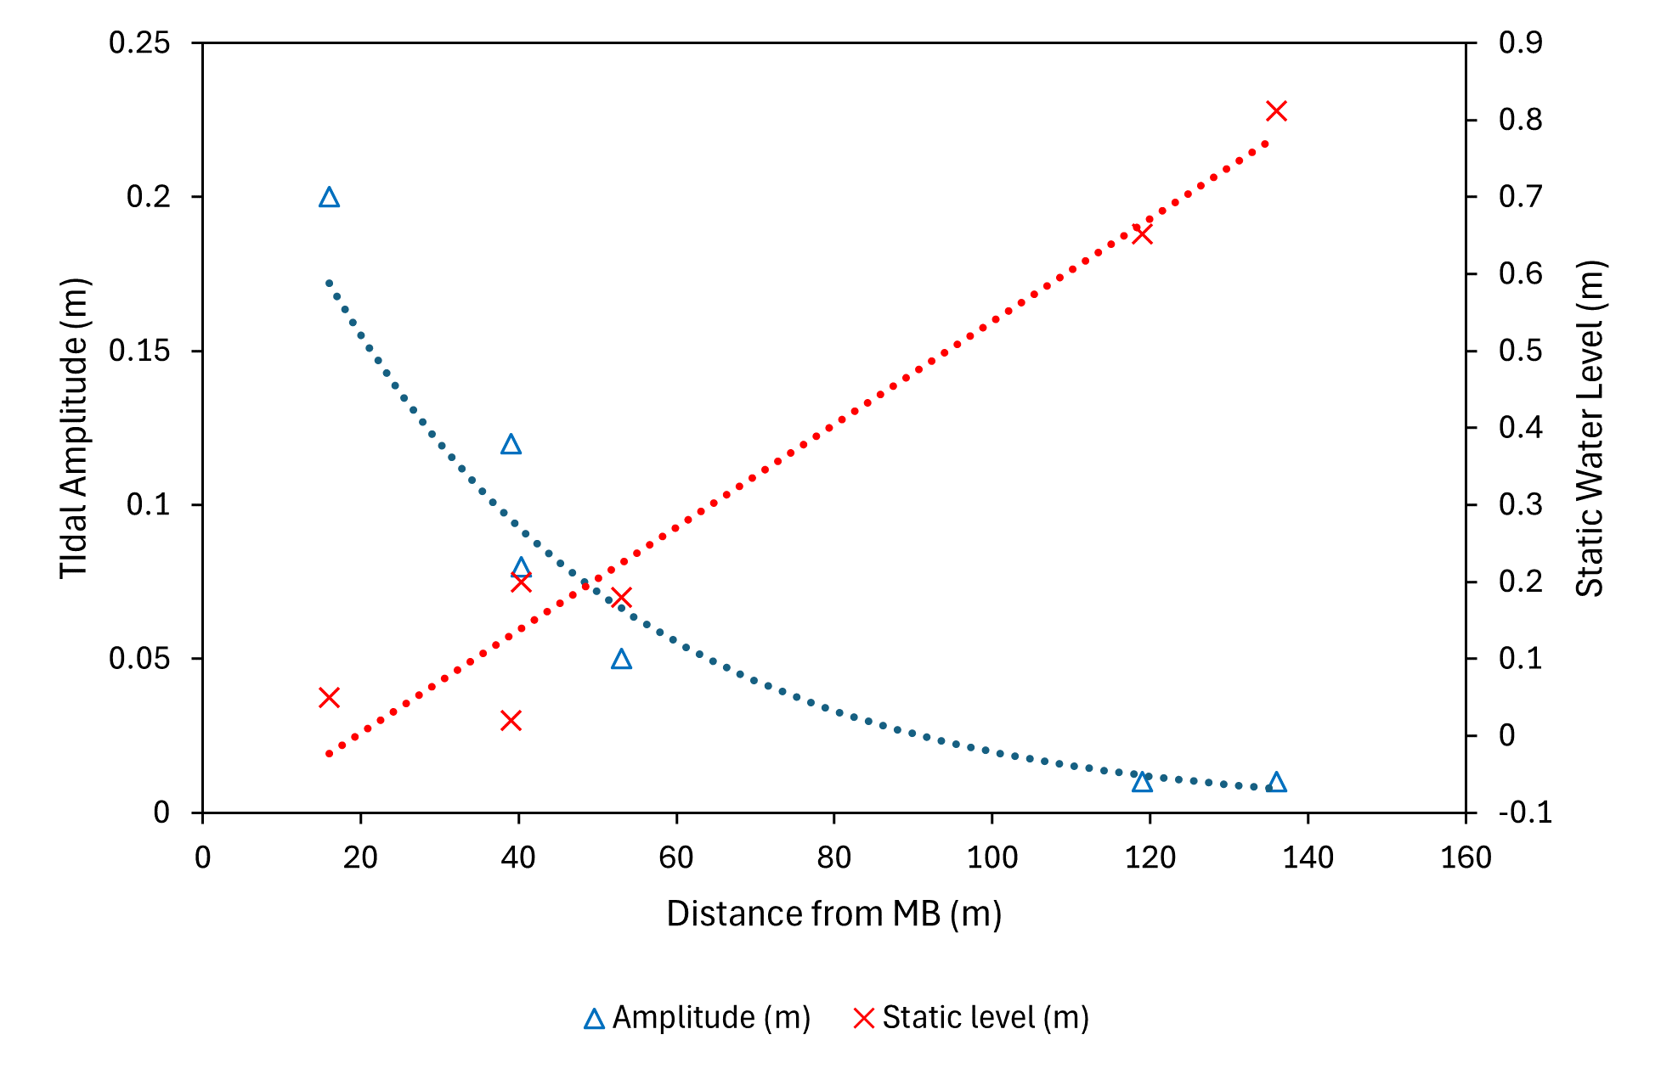
Methods – Calibration
Static Water Level
Tidal amplitude effect
${GWL}_{st}=0.0037d+0.0356$
$C_{T}=0.2597e^{−0.026d}$

Slide 10
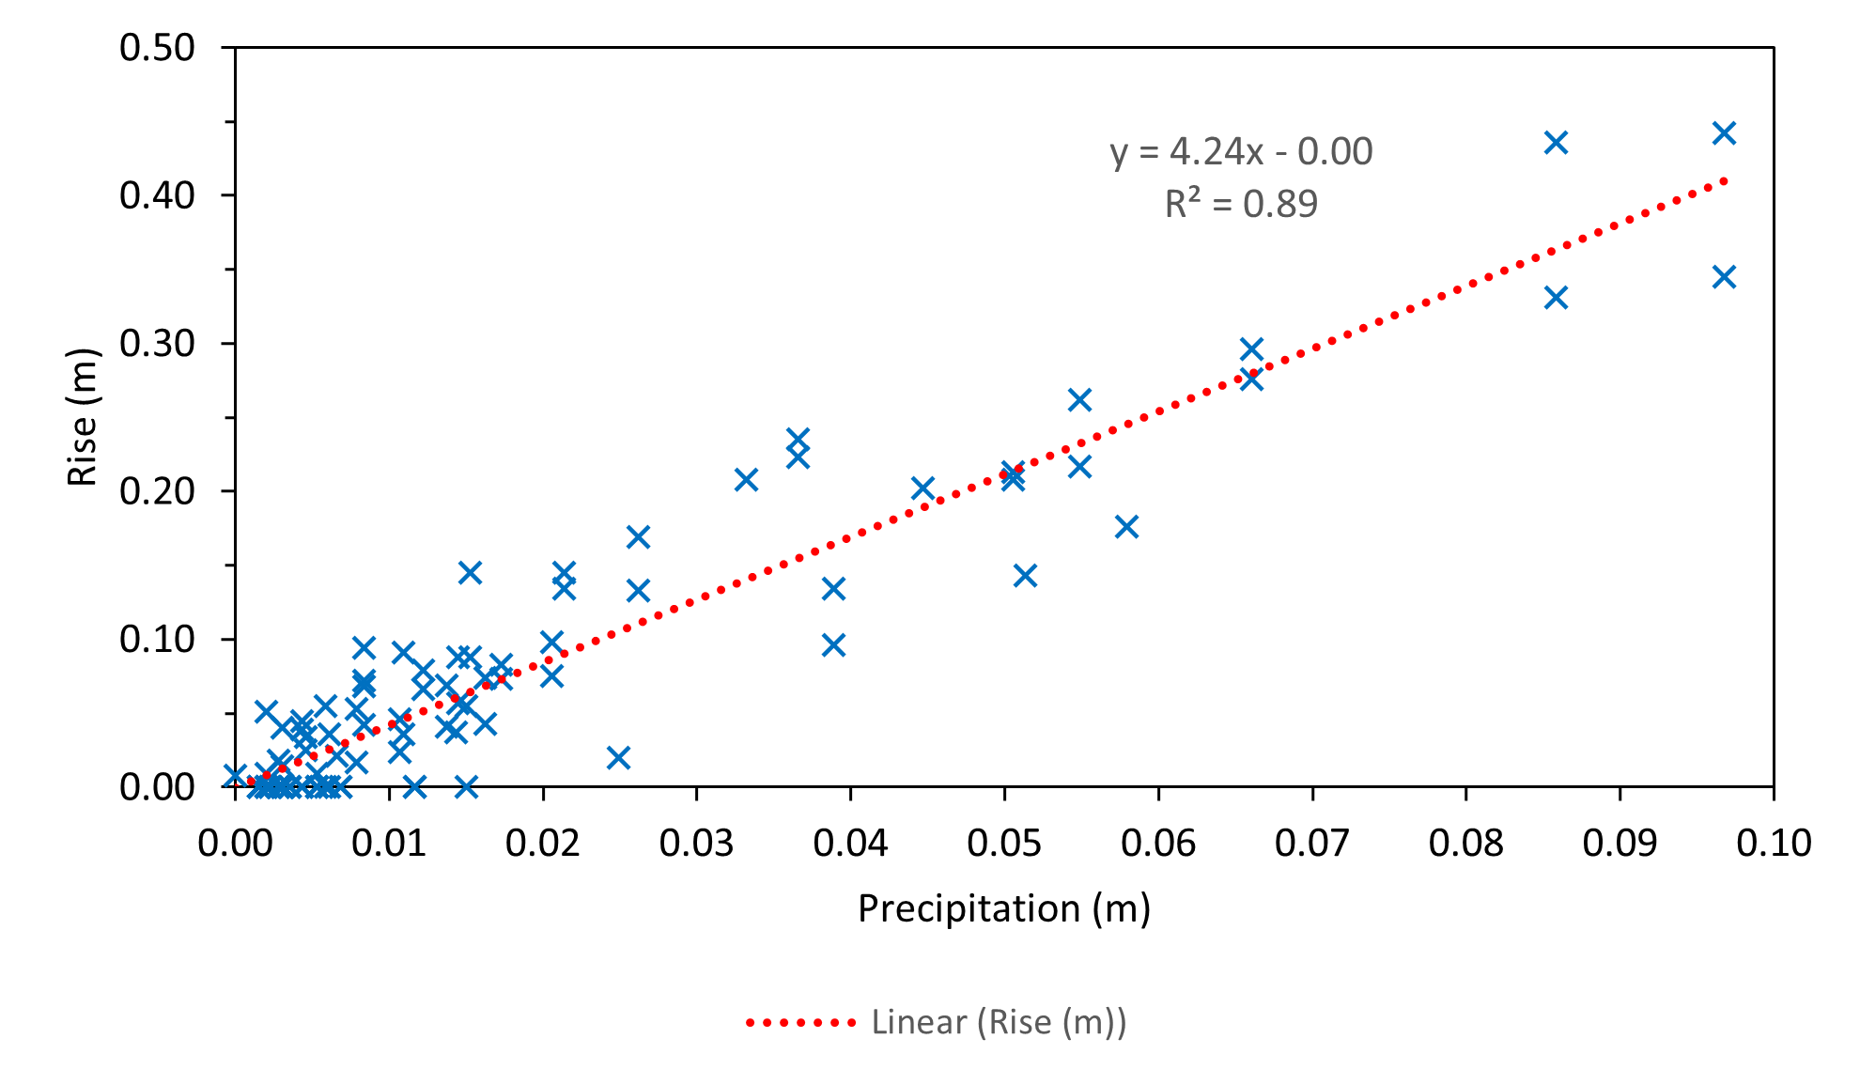
Methods – Calibration
Groundwater level rise
Rainfall response
$R=C_{r}⋅P$

Slide 11
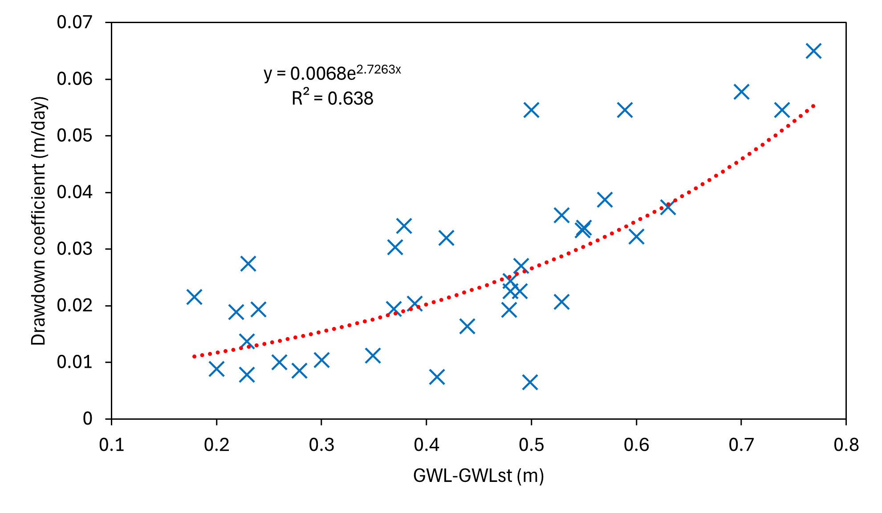
Methods – Calibration
Drawdown as an exponential function.
$D_{C}=0.0068e^{−2.73(GWL−{GWL}_{st})}$

Slide 12
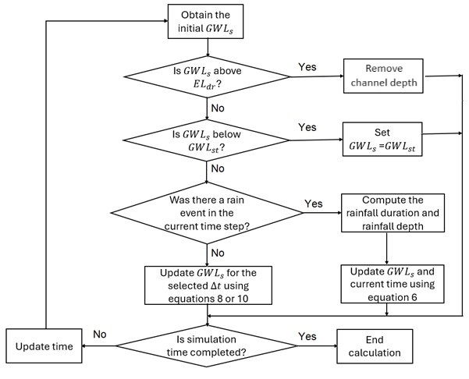
Methods : Calculation steps
Notes:
Tem o original?

Slide 13
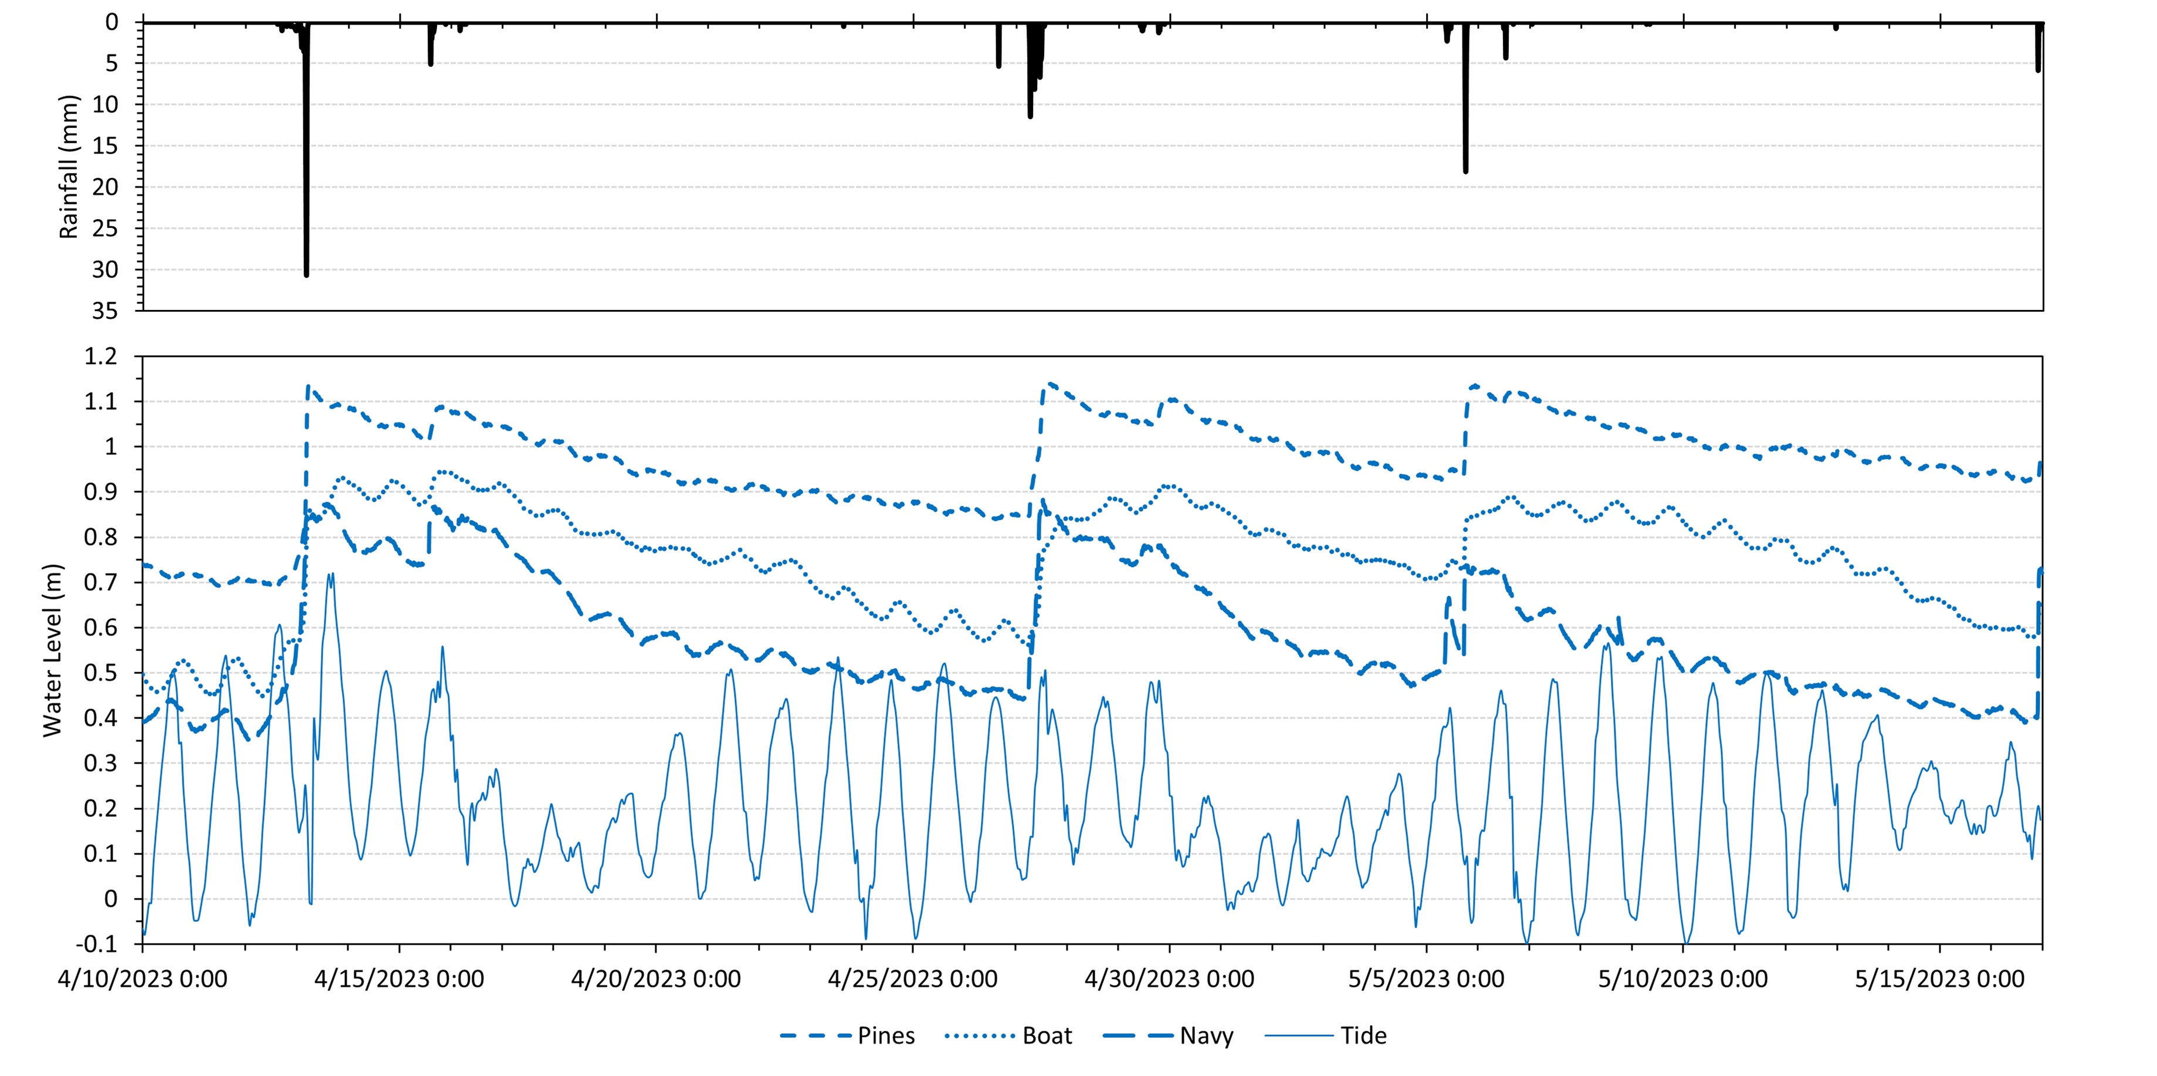
Results – Groundwater Response

Slide 14
Results – Calibration (The Pines)

Slide 15
Results – Calibration (Boat Launch)

Slide 16
Results – Validation (Navy Cove)

Slide 17
Results – Validation (Navy Cove)

Slide 18
Results – Evaluation
 | RMSE (m) | NSE
The Pines | 0.07 | 0.76
Boat Launch | 0.12 | 0.69
 | 0.1* | 0.75*
Navy Cove | 0.1 | 0.5
*Without the effect of the drainage channel.

Slide 19
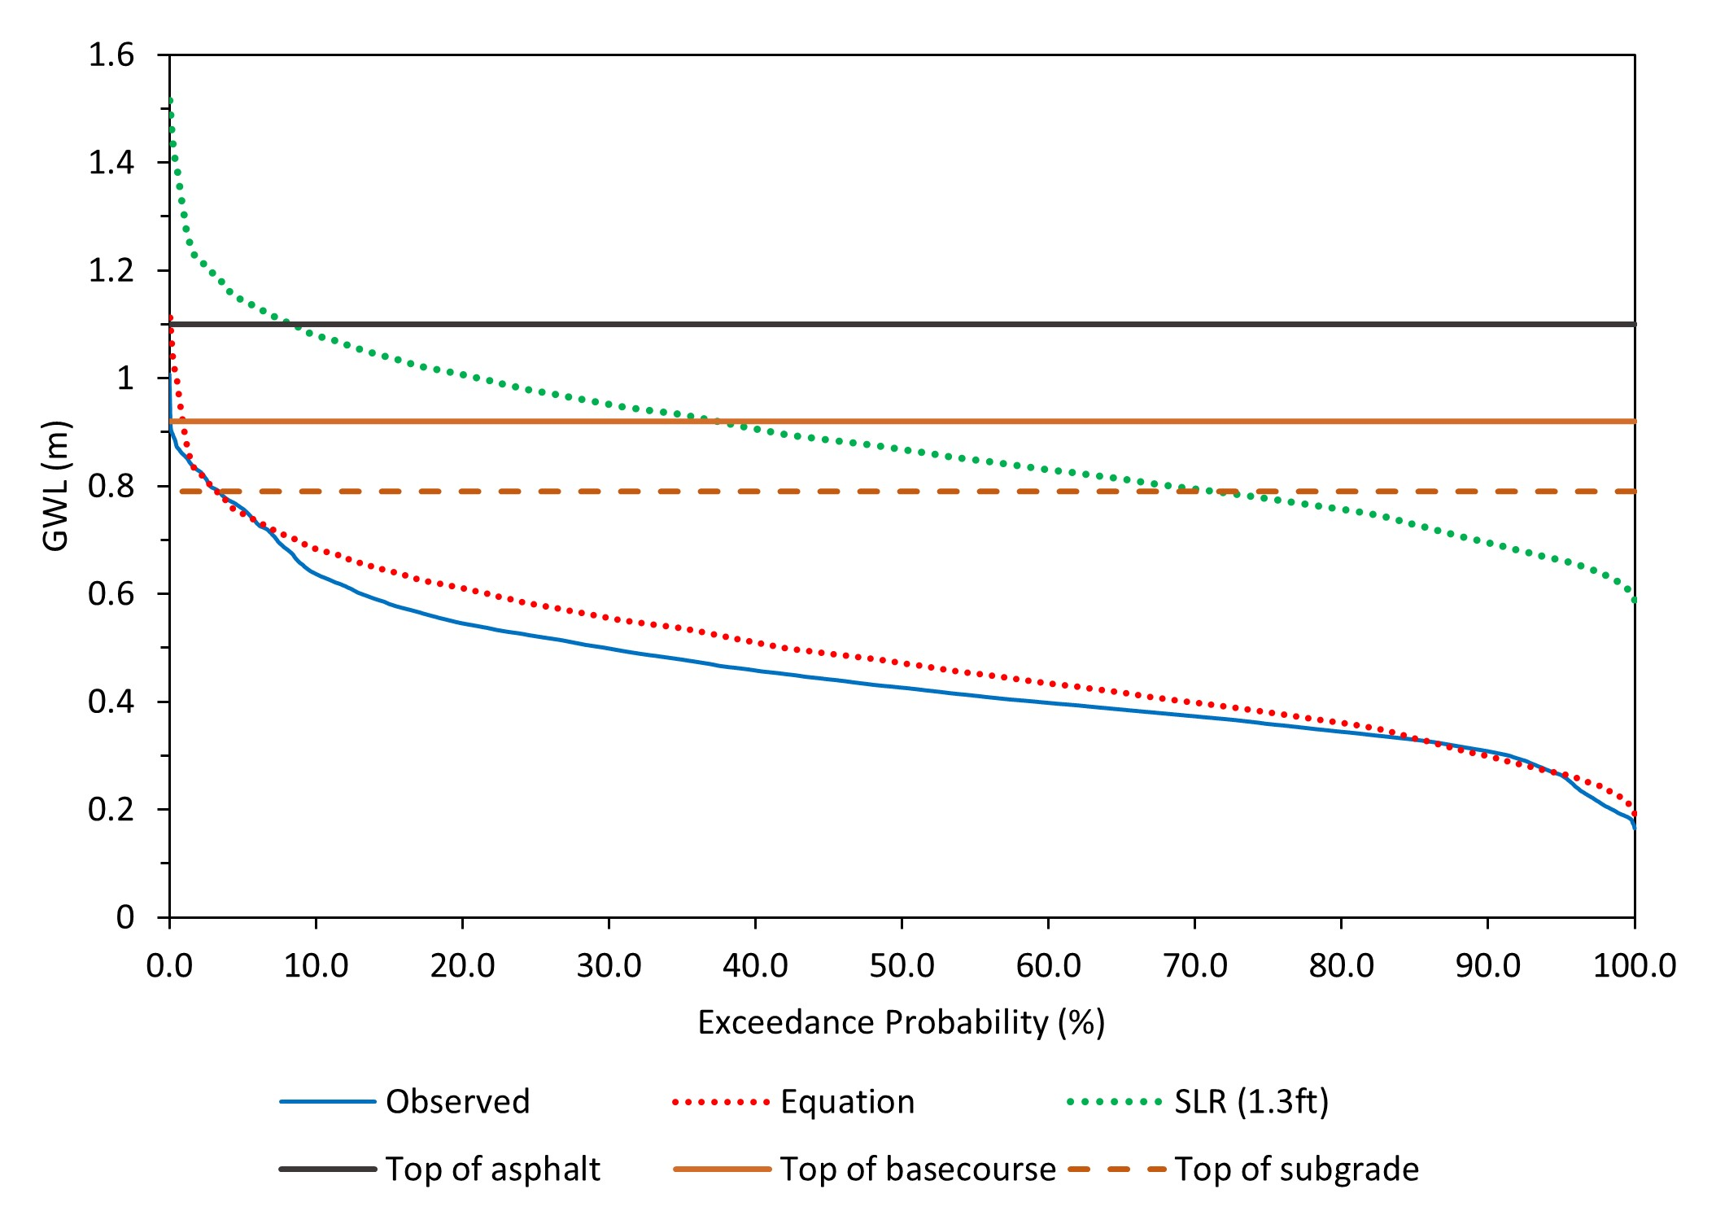
Results – GWL Exceedance Probability (Navy Cove)

Slide 20
Results – Pavement Saturation (Navy Cove)
NOW
SLR (0.4 m*)
GW table
*0.4 m of sea level rise, which is equivalent to NOAA’s Intermediate High in 2050 or Low in 2100

Slide 21
Future Research Direction
Hydraulic Conductivity
Evapotranspiration
AL-180 groundwater resilience index
Improve Static Level
Expand results

Slide 22
Acknowledgments
Effects of Sea Level Rise (ESLR) program - National Oceanic and Atmospheric Administration (NOAA)
Federal Highway Administration (FHWA)
Alabama Department of Transportation (ALDOT)

Slide 23
References
Chen, X., & Wang, H. (2023). Transportation Geotechnics Impact of sea level rise on asphalt pavement responses considering seasonal groundwater and moisture gradient in subgrade. Transportation Geotechnics, 40(April), 100992. https://doi.org/10.1016/j.trgeo.2023.100992
Titus-Glover, L., Darter, M. I., & Von Quintus, H. (2019). Impact of Environmental Factors on Pavement Performance in the Absence of Heavy Loads (Issue March).

