Slide 1


Tchh update - 2024
Charles Hebson, P.E.
Chair TCHH
MaineDOT
National Hydraulic Engineering Conference
Beau Rivage Conference Center, Biloxi MS
8/27/2024

Slide 2

Objective of tchh
Tchh - A CREATURE OF AASHTO
A technical committee of the Committee on Design (COD)
provide a focal point and working group with expertise in hydrology and hydraulics to develop AASHTO guidelines and policies for drainage and hydraulic design of transportation facilities.

Slide 3
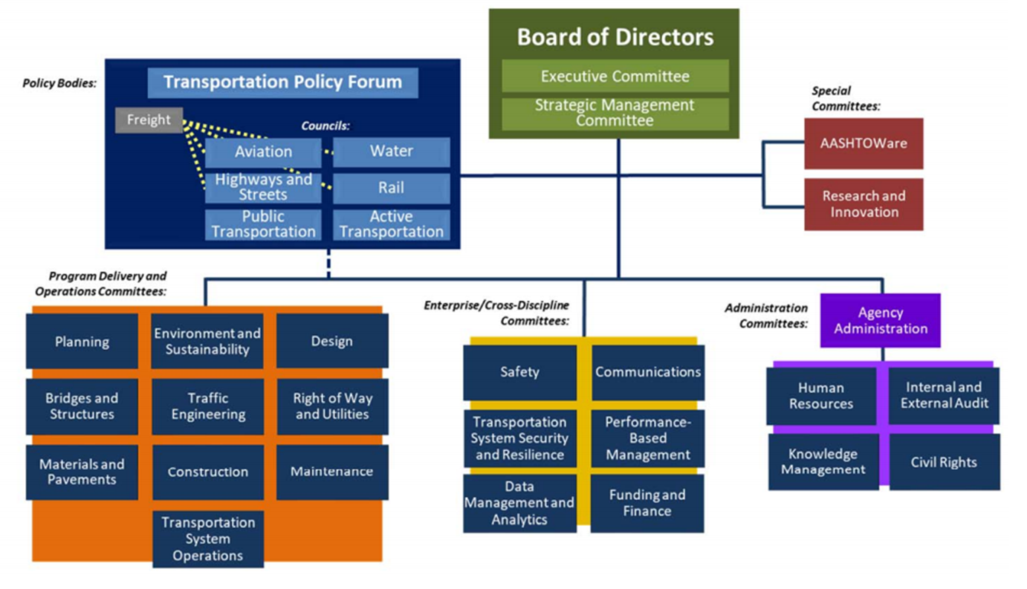
AASHTO ORGANIZATION

Slide 4
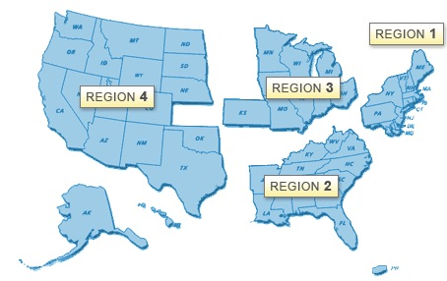

tchh Membership
5 Members per region
  20 members total
FHWA & AASHTO Liaisons
Additionally
  Associate members
    Other DOT-ers
  Friends
Currently 6 vacancies
  Soon to be filled

Slide 5
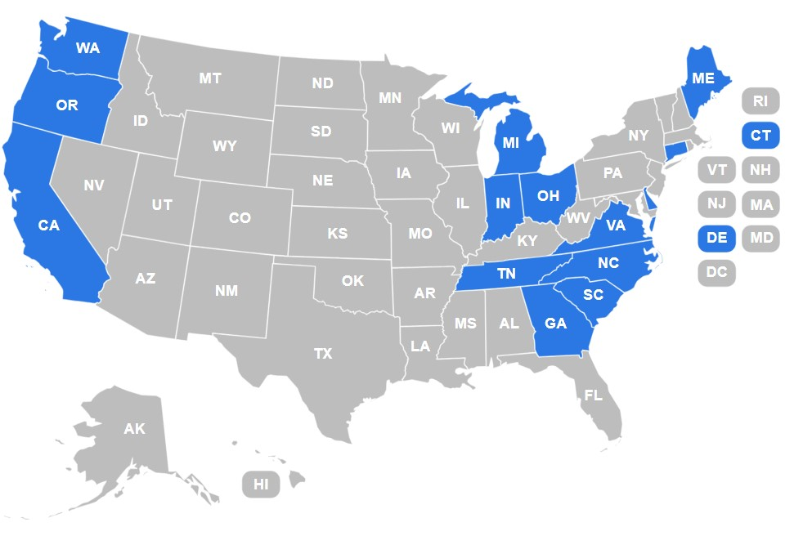
Current distribution of voting members

Slide 6
Structure & organization
Officers
  Chair
  Vice-Chair
  Secretary
Select Work Groups / Subcommittees
  Research
  HydroLink Newsletter
  NHEC
  Executive
  Concerns of States
  Aquatic Organism Passage
And other task-specific work groups as needed

Slide 7
MEETINGS
1 In-Person
  NHEC & AASHTO Committee on Design (COD) in alternating years
2 Virtual meetings
TRB
  Not an “official” meeting but regularly attended by many members
Work Group (Subcommittee) meetings as necessary

Slide 8

Past nhec locations
2020

Slide 9
Duties & obligations of members
Attend meetings
  Voting members required in-person
DO WORK !!!
  ALL members – including Friends & Associates

Slide 10
The work
Participate
  Work on TCHH subcommittees
Research
  Suggest, develop ideas
  Create Research Needs Statements & Problem Statements
  Serve on research panels
Communicate
  Prepare, obtain articles for HydroLink Newsletter
Advocate
  Promote research ideas with your agency
  Importance of state DOT participation in and support of TCHH, NHEC etc
Exchange Ideas
  Concerns of States
Coordination with Other Committees
  TRB AKD50
  AASHTO committees

Slide 11


AASHTO DRAINAGE MANUAL (ADM) UPDATE major ongoing tchh project for past several years
Highway Drainage Guidelines - 2007
Previous Publication 1987, 1992
The AASHTO Drainage Manual – 2014
Two Volumes – Policy & Procedures
Previous Publication – 1991, 2005

Slide 12
AASHTO DRAINAGE MANUAL UPDATE
NCHRP 24-50 (TRB)
Heavy TCHH Involvement
project formulation & advocacy
panel members
TCHH review
NCHRP Project is complete
Contractor presentations
prior & current NHEC
TCHH
But not done yet …
TRB delivers ADM files to AASHTO
TCHH review / edit / revision
COD review
Return to TCHH
resolve COD comments
TCHH finalizes
AASHO publishes – 1 more year?

Slide 13
