Slide 1
SENSITIVITY OF THEORETICAL SCOUR TO MODELING AND PARAMETERIZATION ALTERNATIVES FOR BRIDGES IN HEC-RAS 2D
Shams Al-Amin, PhD, PE, CFM, ENV SP | sal-amin@vhb.com
August 28, 2024

Slide 2
Agenda
Fundamentals of HEC-RAS 2D sub-grid bathymetry
Overview of different modeling approaches
Comparison of velocity gradients
Comparison of flow patterns
Comparison of scour
1
2
3
4
5

Slide 3
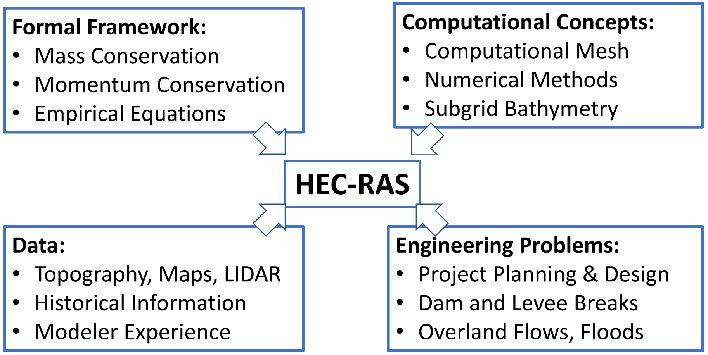
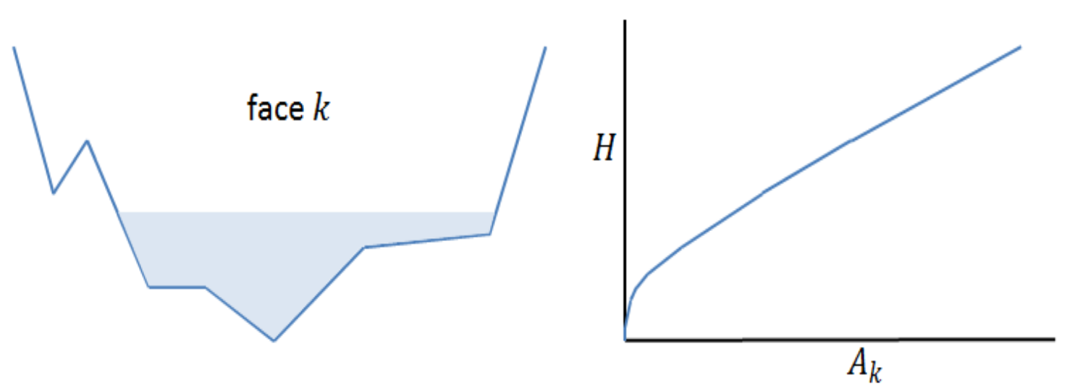
HEC-RAS Sub-Grid Bathymetry
Captures the details of the sub grid terrain through hydraulic properties table
Hydraulic properties are developed for each cell & each cell face
Allows for larger computational cells without losing too much of the details of underlying terrain
“All models are wrong, but some are useful”

Slide 4
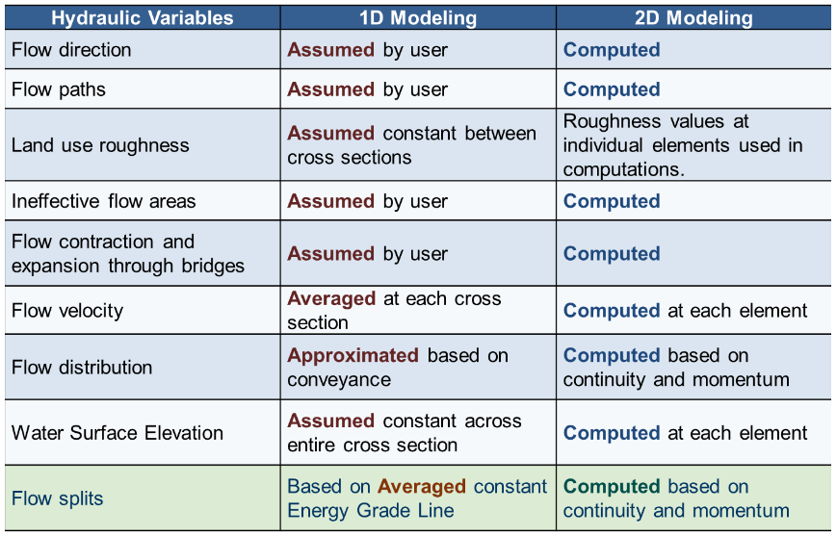
1D vs 2D Hydraulic Modeling

Slide 5
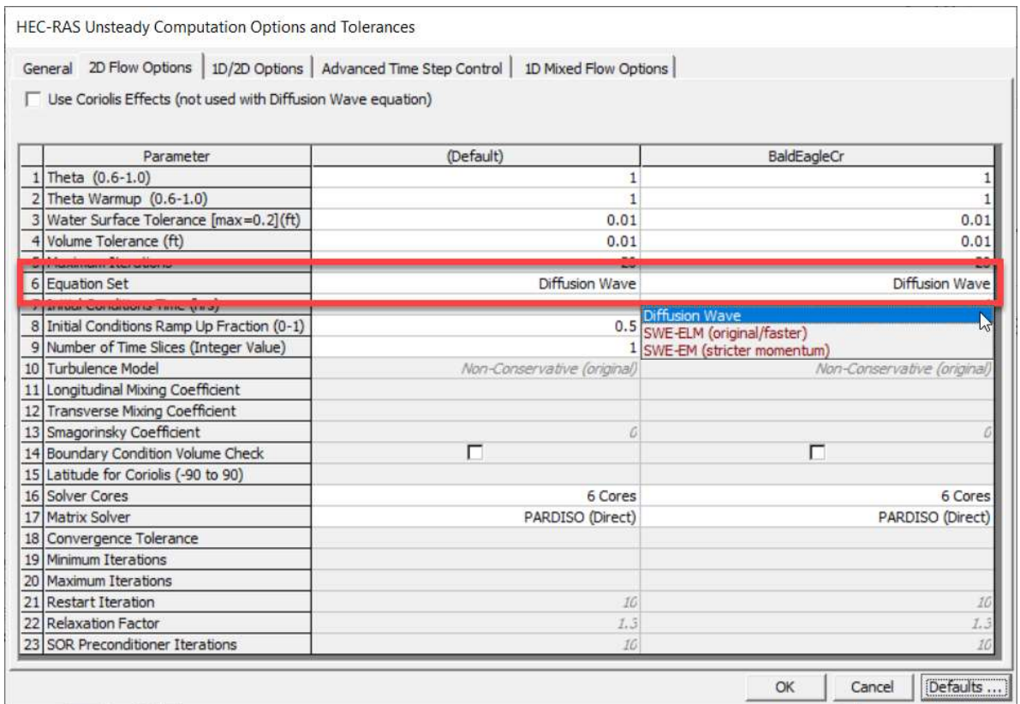
SWE vs DWE
Shallow Water Equation Applications
Flows with dynamic changes in acceleration
Wave impacts or tidal influences
Detailed solutions around obstructions, bridges, or bends
Coriolis, mixing, or wind influences
High-resolution and detailed results
Diffusion Wave Applications
Flow driven mainly by gravity and friction
No waves or tidal influence
Approximate flood extent estimate
Quick estimations or preliminary model runs
Notes:
Mass Conservation (Continuity)
Full Momentum Conservation
Gravity and friction
Hydrostatic Pressure
Acceleration (local and convective)
Turbulent eddy viscosity (optional)
Wind forces (optional)
Coriolis term (optional)
Diffusion Wave
Gravity and friction
Hydrostatic Pressure

Slide 6
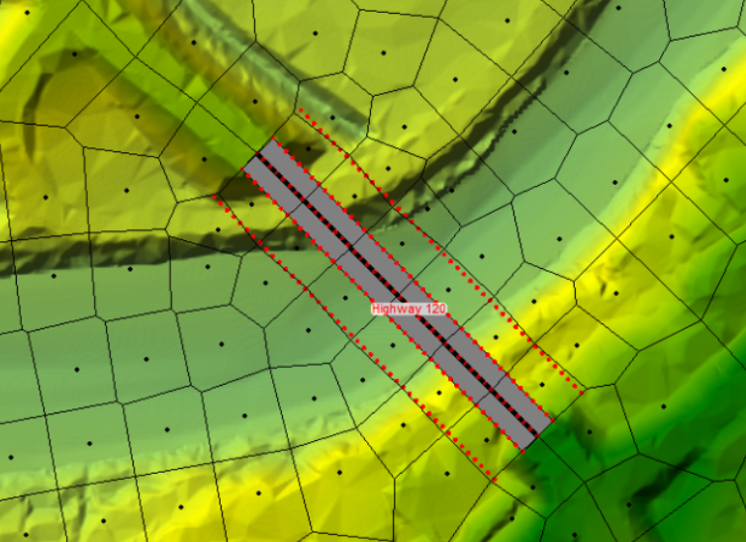
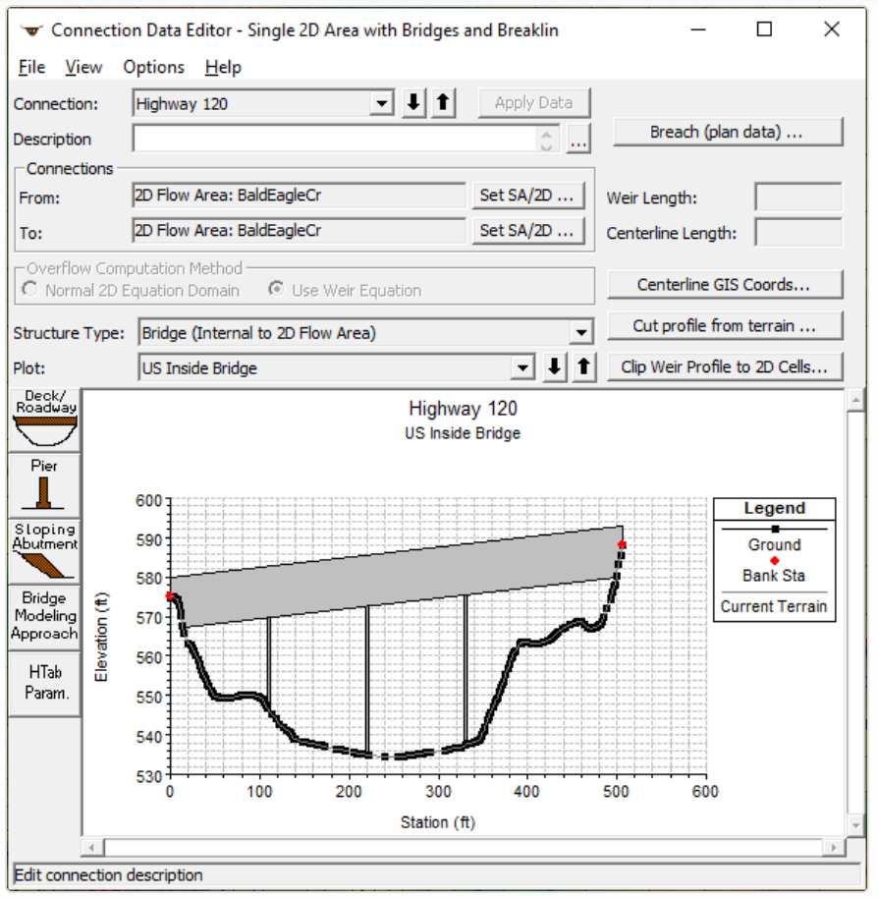
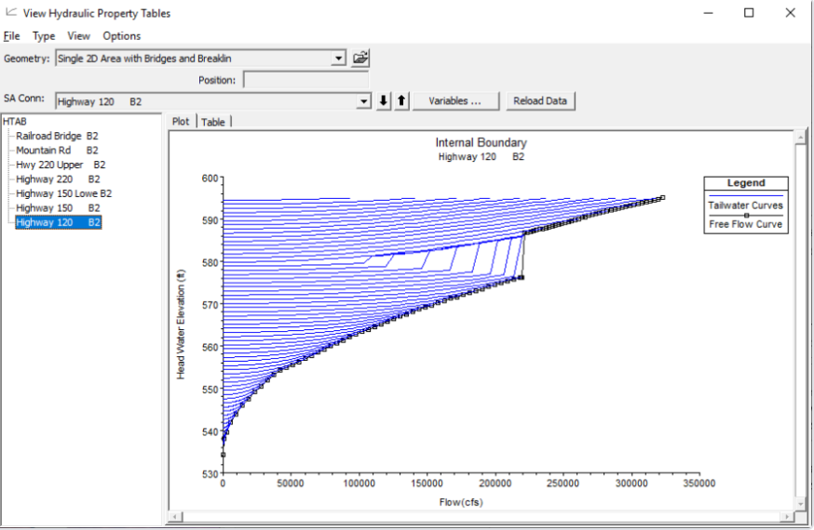
Bridge Structures inside 2D Flow Areas
SA/2D Connection for bridges in 2D Flow Areas
Headwater-Tailwater Rating Curves
Hydraulics at bridge faces are solved in 2D
Capabilities to model additional hydraulic structures (culverts, gates, weirs, dam breaches)

Slide 7
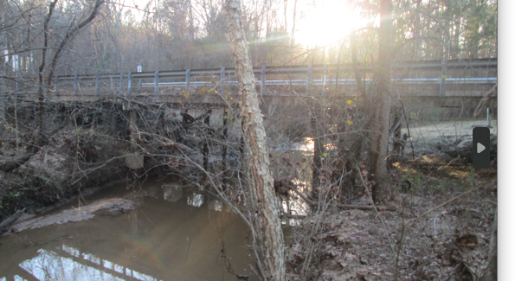
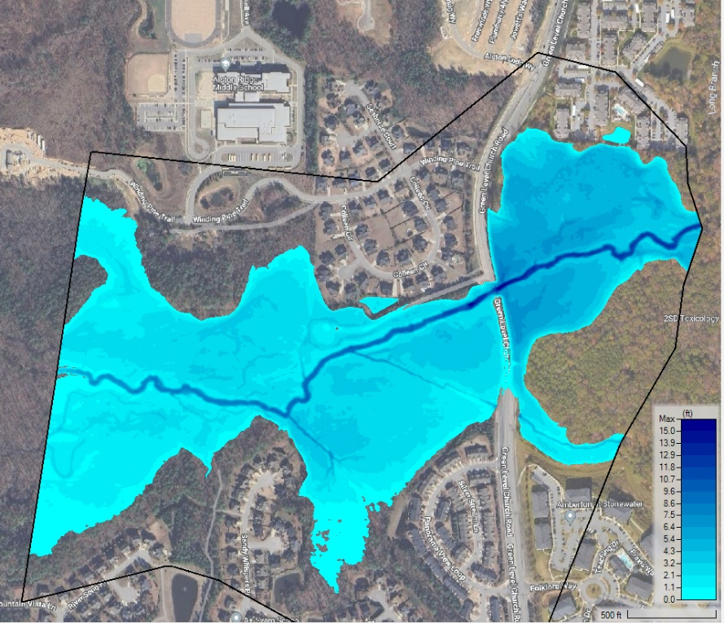
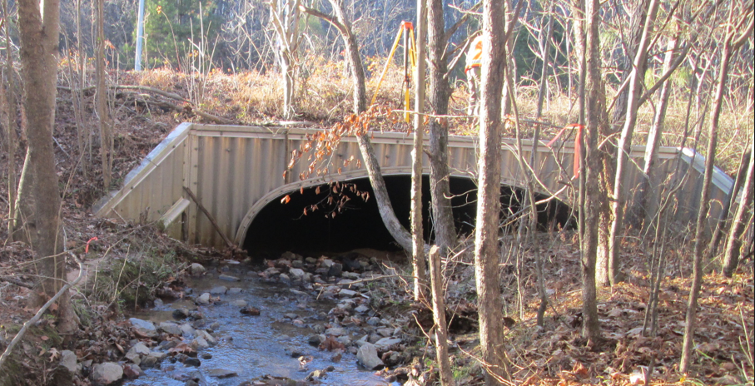
Case Study
Wake 61 Bridge Replacement Project, NCDOT
Replacement of an existing NCDOT bridge on SR 1630 (Green Level Church Rd) over Kit Creek in Wake County.
Bridge concrete deck with concrete on timber caps and piles (3@+/-30’, OAL= 91’)
Corrugated Metal Box Culvert 16.0’ x 6.1’
Multiple opening analysis in 1D
Thanks to division 5 and Hydraulics unit, NCDOT

Slide 8
Setting up the 2D Model
Developing a Terrain Model and Geospatial Layers
Development of the 2D Computational Mesh
Boundary and Initial Conditions for 2D Flow Areas
Running a Model with 2D Flow Areas
Viewing 2D or 1D/2D Output using HEC-RAS Mapper

Slide 9
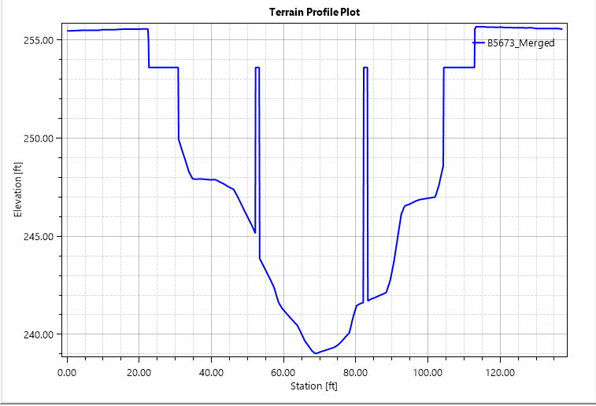
Terrain Modification Approach
Piers and abutments added as terrain modifications
No SA/2D connection
Terrain

Slide 10
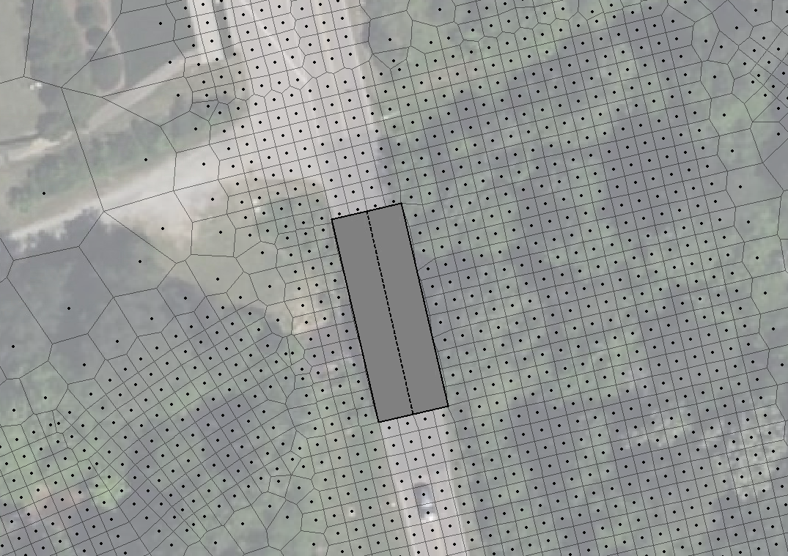
SA/2D Approach
Piers and abutments added as terrain modifications
SA/2D connection

Slide 11
Hybrid Approach
Piers added as terrain modifications
SA/2D connection with abutments

Slide 12
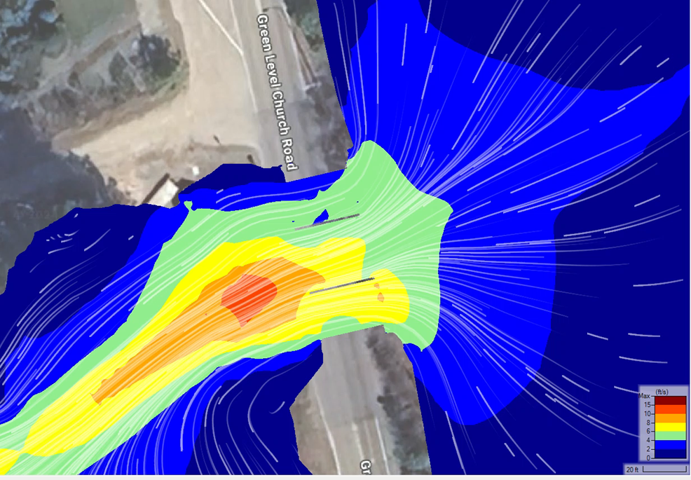
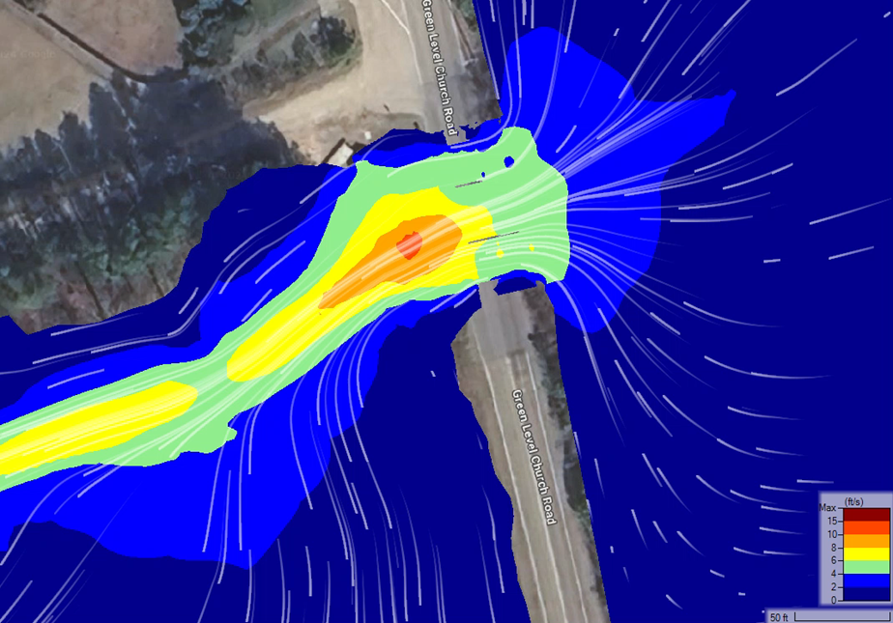
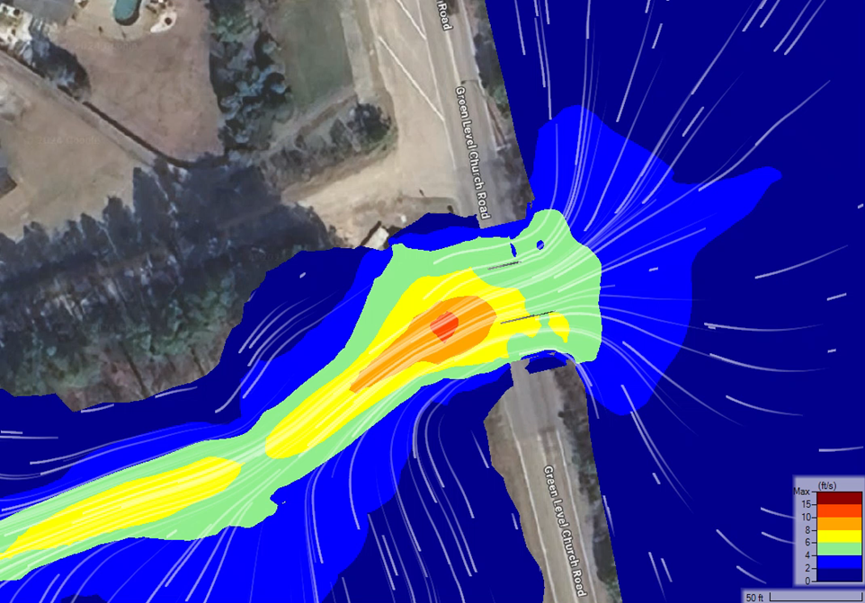
Comparison of Velocity Maps- 100-yr Event
Terrain Modification
SA/2D
Hybrid

Slide 13
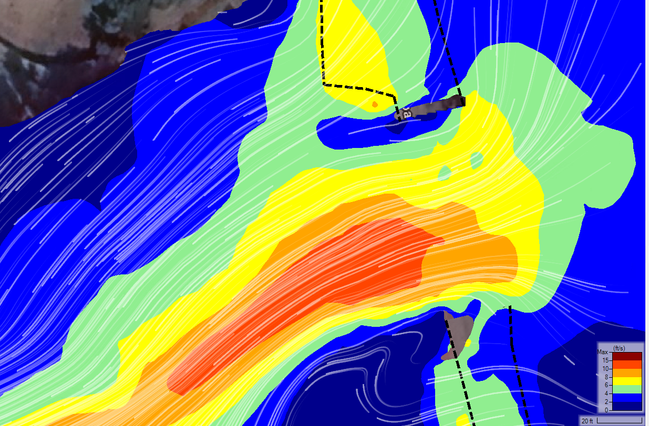
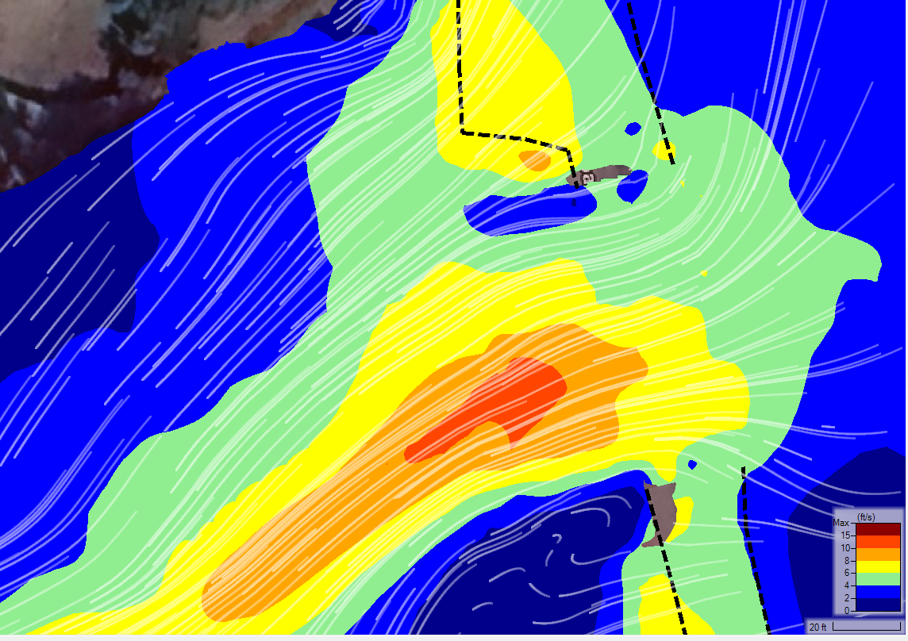
Comparison of Velocity Maps- 500-yr plus Event
Terrain Modification
SA/2D
Hybrid

Slide 14
Comparison of Pier Scours
Pier Scour Depth (ft)
Reasonably robust when not in pressure and/or weir flow condition
SA/2D more appropriate when in pressure and/or weir flow. Difference may vary based on bridge modeling approach selection.
Reasonably robust in modeling details for SA/2D approach
Approach | 100 -yr | 500plus-yr
Terrain Only | 5.1 | 5.9
SA/2D | 4.8 | 5.3
Hybrid | 4.9 | 5.3
Notes:
Correction factor for pier nose shape K2
Correction factor for angle of attack of flow K3
Correction factor for bed condition K4
Correction factor for armoring of bed material a
Pier width

Slide 15
Comparison of Contraction Scours
Contraction Scour Depth (ft)
Contraction scours are comparable
Pressure flow and live bed scour condition
Difference in stage/flow hydrograph and rating curve between SA/2D approach
Approach | 100 -yr | 500plus-yr
Terrain Only | 1.9 | 2.7
SA/2D | 2.4 | 2.7
Hybrid | 1.9 | 2.3
Notes:
Laursen's (1960) live-bed scour
Average depth in the main channel or floodplain at the approach sectionfeet (meters)y0
Average depth in the main channel or floodplain at the contracted section before scourfeet (meters)Q1
Flow in the main channel or floodplain at the approach section, which is transporting sedimentcfs (m3/s)Q2
Flow in the main channel or floodplain at the contracted section, which is transporting sedimentcfs (m3/s)W1
Bottom width in the main channel or floodplain at the approach section. This is approximated as the top width of the active flow area in HEC-RAS.

Slide 16
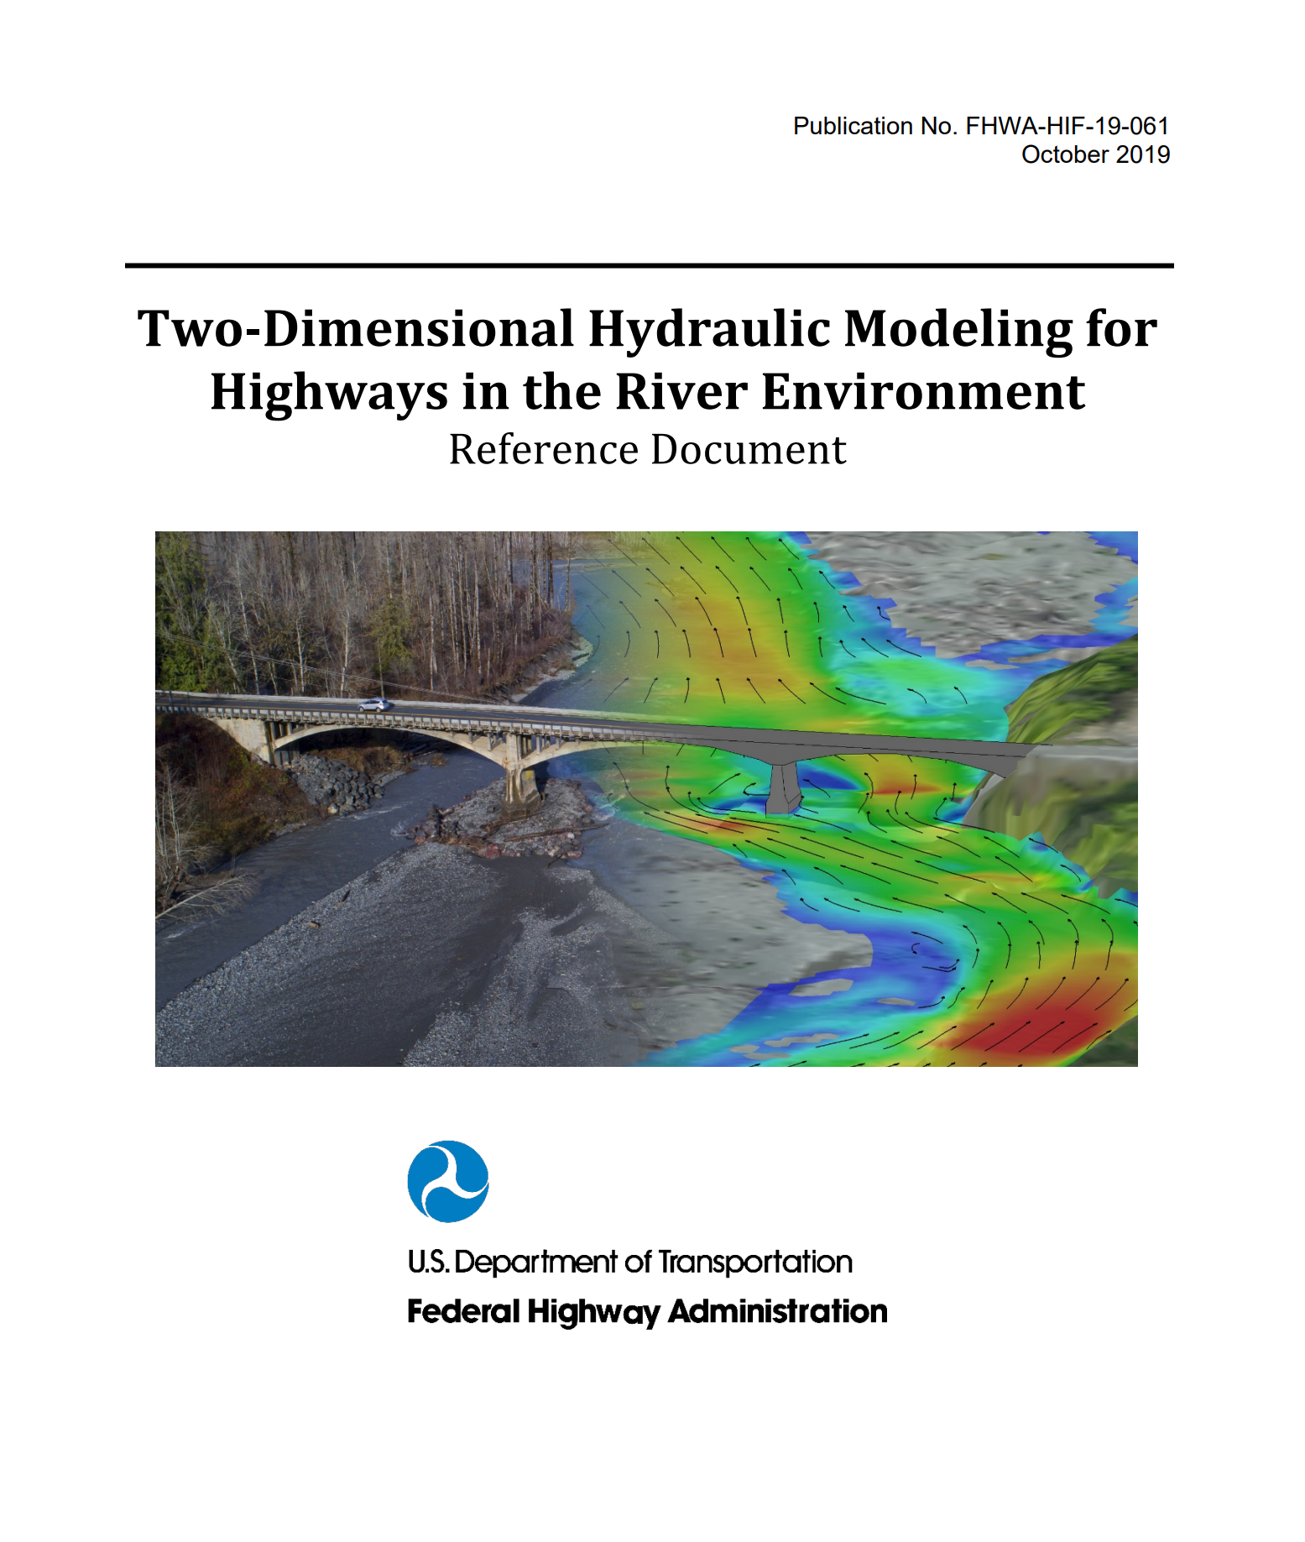
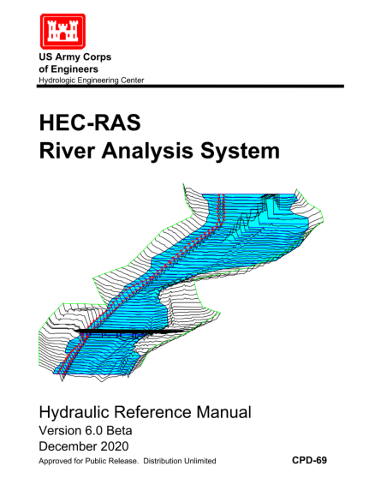
Available Guidance Materials
Two-Dimensional Hydraulic Modeling for Highways in the River Environment (FHWA)
HEC-RAS User Manual (USACE)
HEC-RAS Mapper User Manual (USACE)
HEC-RAS Hydraulic Reference Manual (USACE)
1
2
3
4
Notes:
https://www.fhwa.dot.gov/engineering/hydraulics/pubs/hif19061.pdf
https://www.hec.usace.army.mil/confluence/rasdocs/rasum/latest
https://www.hec.usace.army.mil/confluence/rasdocs/rmum/latest

Slide 17
Thank you!
Shams Al-Amin, PhD, PE, CFM, ENV SP | sal-amin@vhb.com

