Slide 1
Selection and Application of Manning’s Roughness Values in Two-Dimensional Hydraulic Models: Results from NCHRP 24-49
Ali Mahdavi Mazdeh, Ph.D., Lyle Zevenbergen, P.E. Casey Kramer, P.E. and Xiaofeng Liu, Ph.D., P.E.

Slide 2
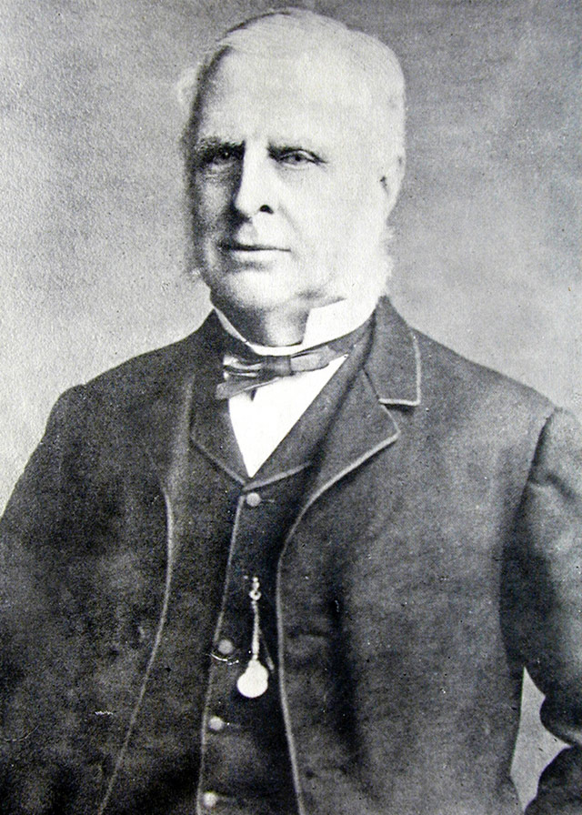
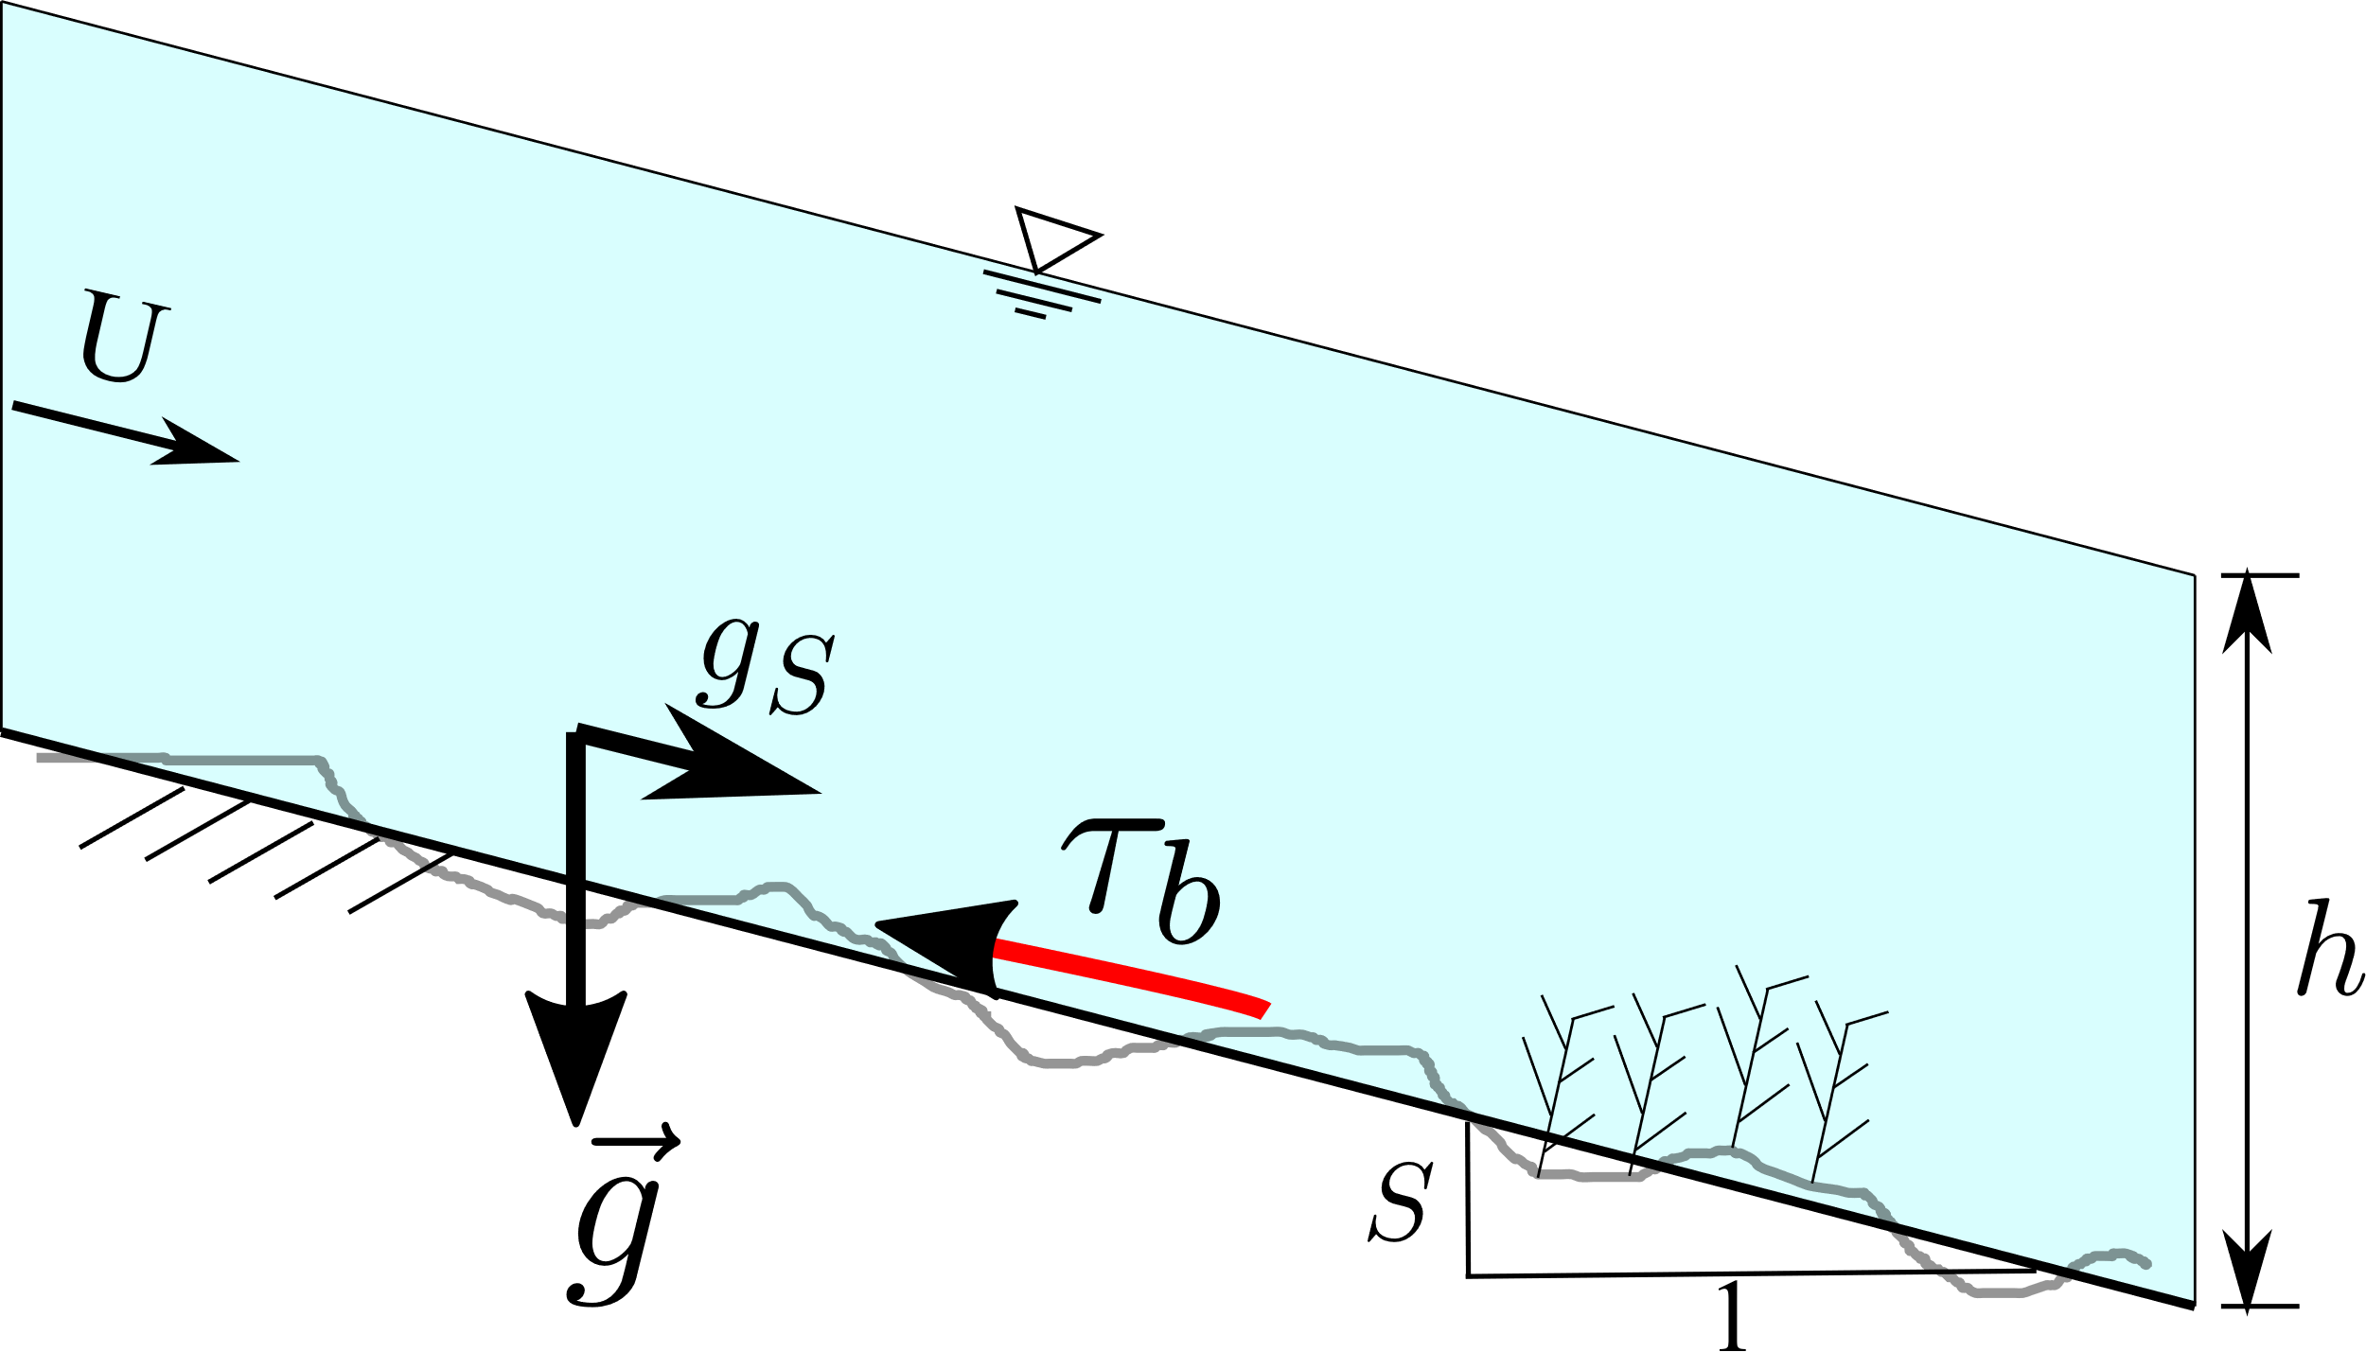
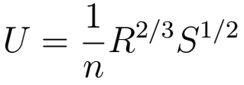
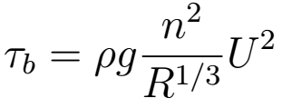
What is Manning’s n?
Uniform flow and flow resistance
Robert Manning
1816-1897
Image: wikipedia

Slide 3
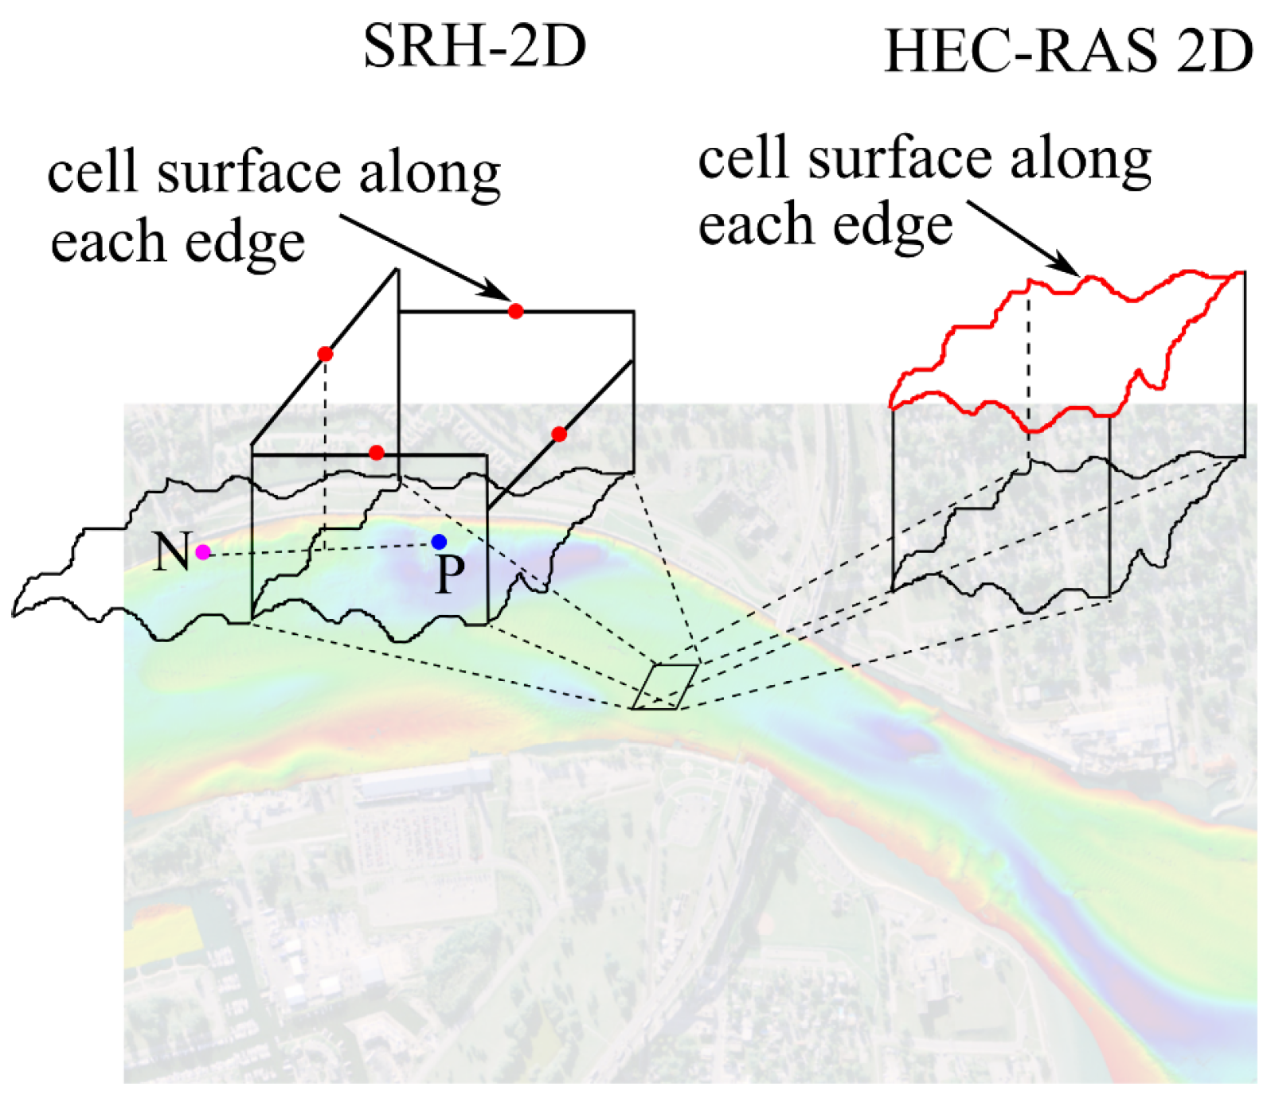
Is the problem solved?
Lots of confusion and misconceptions on Manning’s n
Manning’s n the same in 1D and 2D models?
Manning’s n the same in different 2D models?
How does HEC-RAS subgrid terrain affect Manning’s n?
How does turbulence model affect Manning’s n?
…

Slide 4
What is Manning’s n?
Lack of clear definitions of Manning’s n in different contexts
In physical world
In numerical modeling world

Slide 5
What is Manning’s n?
In physical world:
Manning’s n is a parameter to quantify flow resistance induced by different factors, such as grain roughness, bedforms, vegetation, channel irregularity, etc.
Total flow resistance:

Slide 6
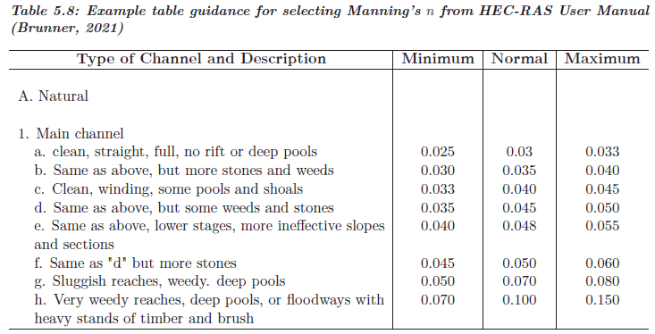
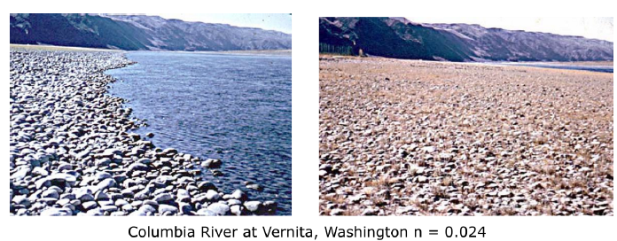
What is Manning’s n?
In physical world:
How to get the (total) Manning’s n?
Tabular method
Photographic method
Quantitative method
USGS online photo guide for Manning’s n

Slide 7
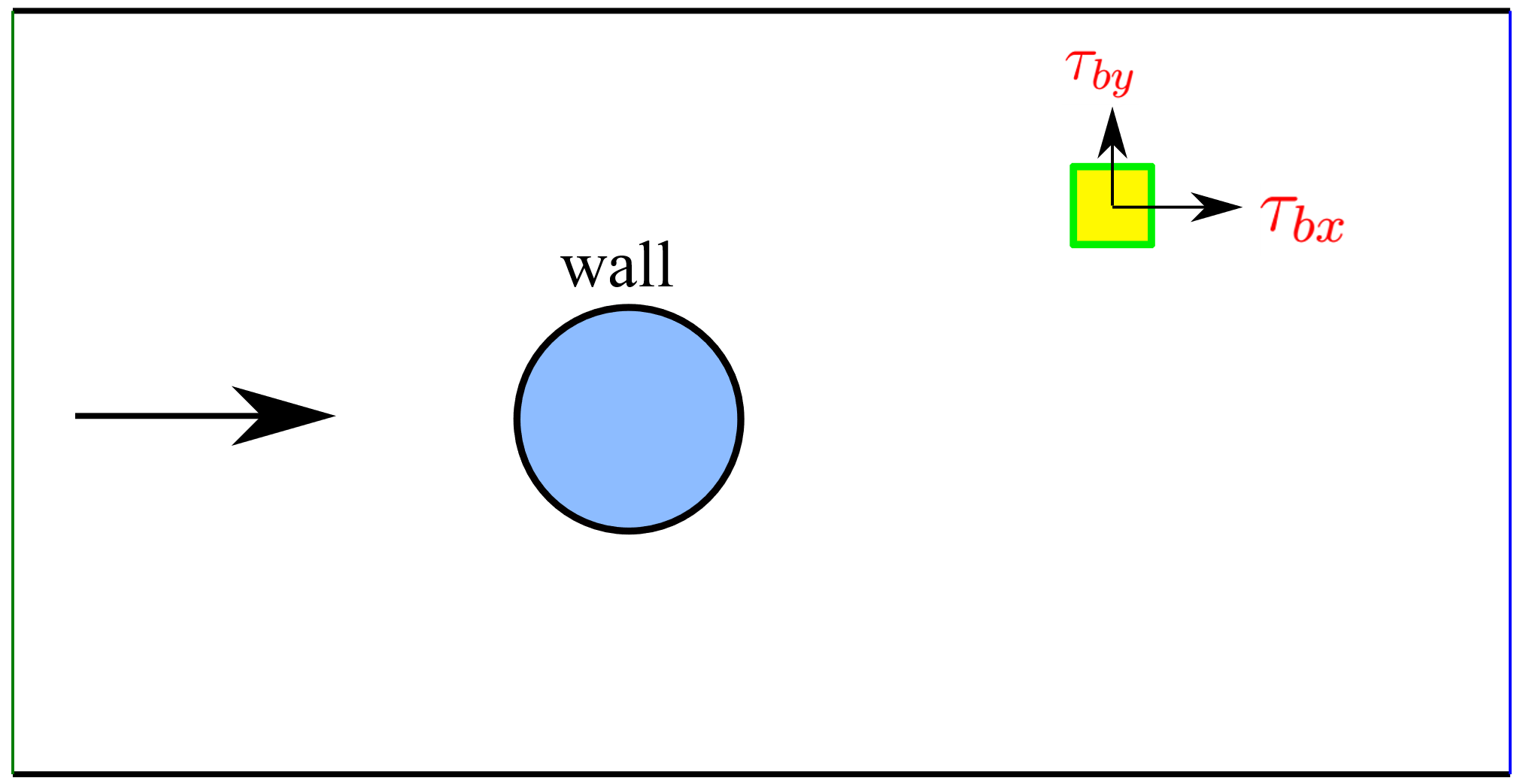
What is Manning’s n?
In numerical modeling world:
Models such as SRH-2D and HEC-RAS 2D solve 2D shallow water equations
Can we directly use Manning’s n
from textbook?

Slide 8
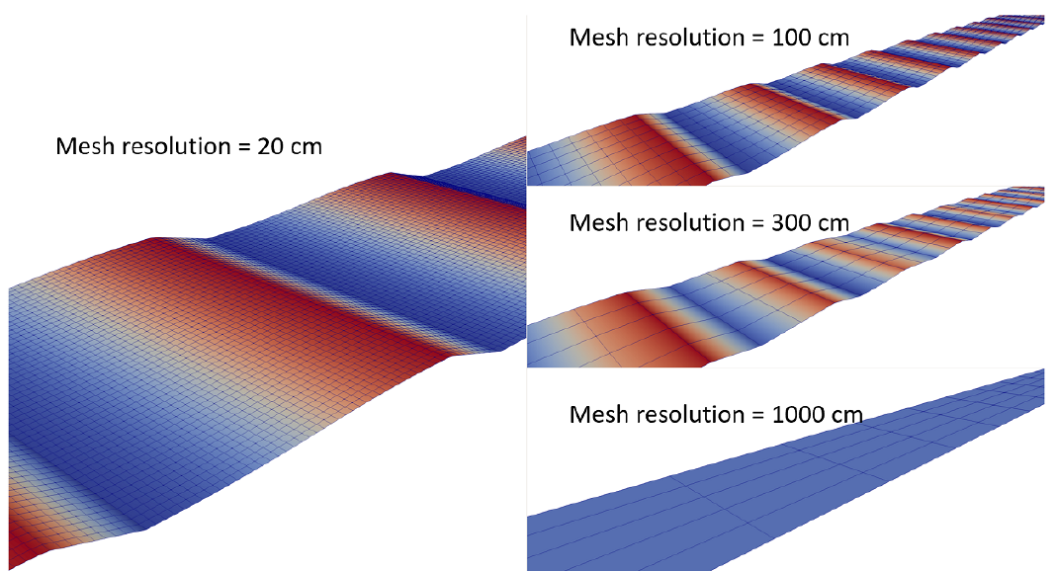
What is Manning’s n?
In numerical modeling world:
Part of flow resistance factors are resolved by terrain and mesh

Slide 9
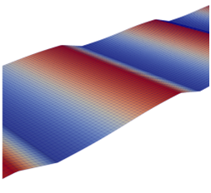
What is Manning’s n?
In numerical modeling world:
Part of flow resistance factors are resolved by terrain and mesh
The rest is unresolved ← specified in 2D models!

Slide 10
What is Manning’s n?
In numerical modeling world:
Total flow resistance = Resolved flow resistance + Unresolved flow resistance
is a physical AND numerical parameter!

Slide 11
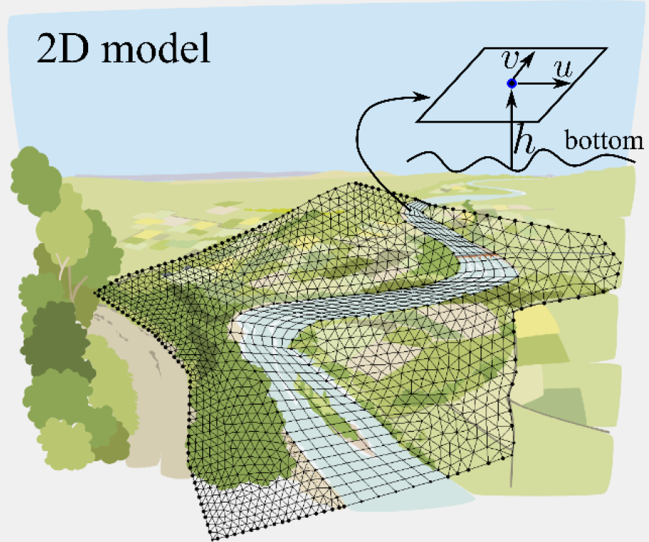
What is Manning’s n?
In numerical modeling world:
n_{unresolved} is what needs to be specified in 2D models
n_{unresolved} depends on many factors:
Terrain and mesh resolutions
Whether key hydraulic controls are captured
Model’s numerical schemes
Subgrid terrain treatment
Turbulence models
…

Slide 12
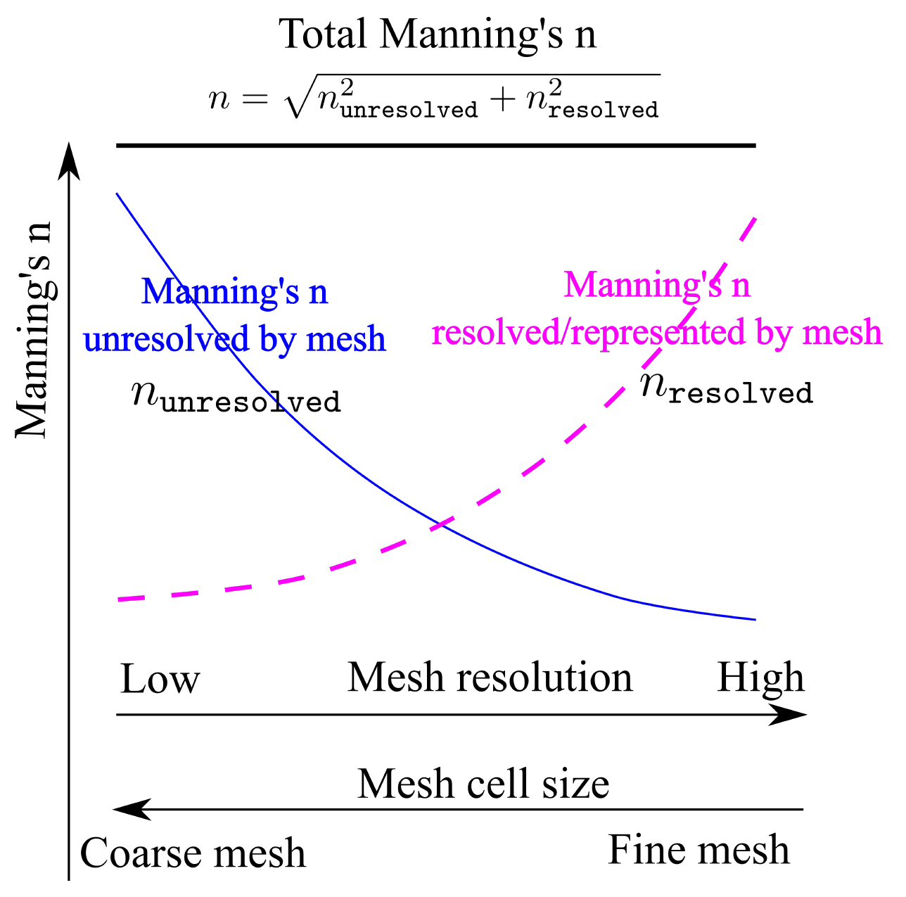
How to get unresolved Manning’s n?
Terrain/mesh resolution vs. resolved/unresolved Manning’s n
Working hypothesis

Slide 13
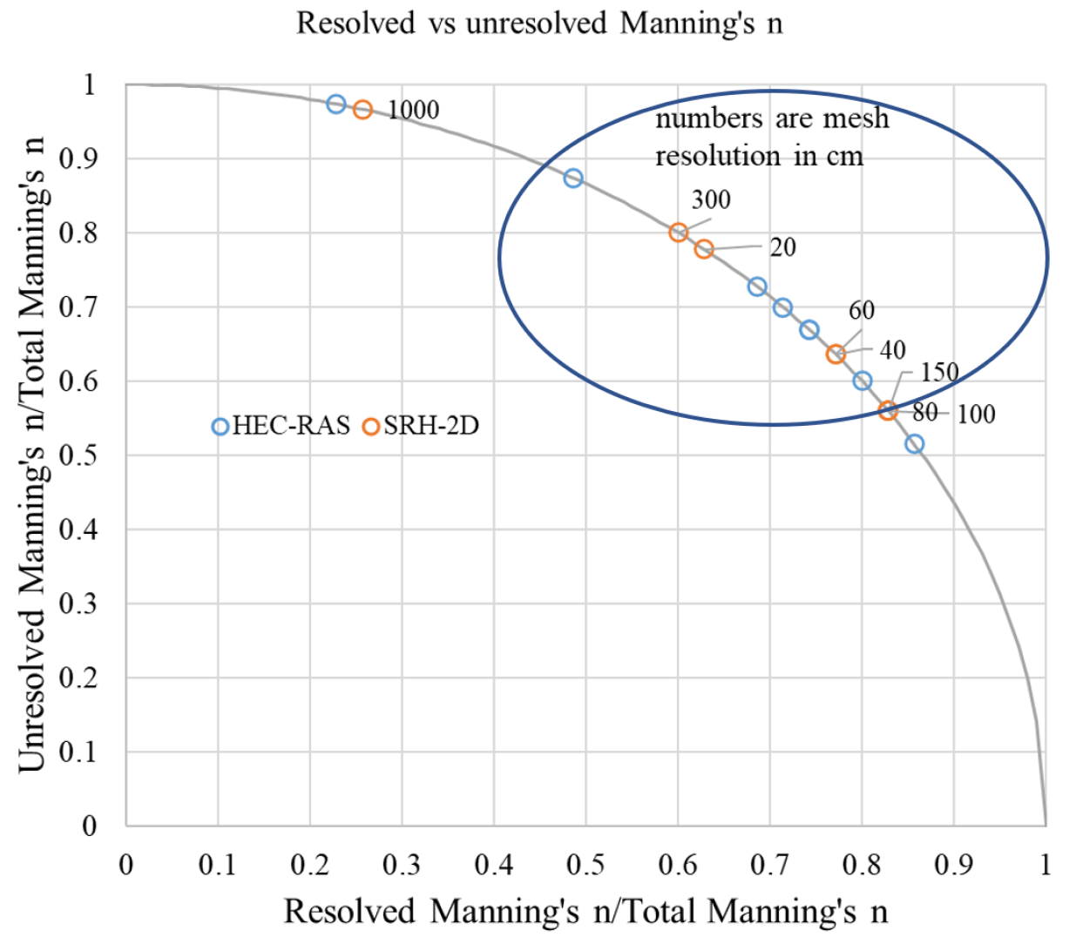
How to get unresolved Manning’s n?
“Quarter-circle” method
Details in NCHRP 24-49 Project Report

Slide 14
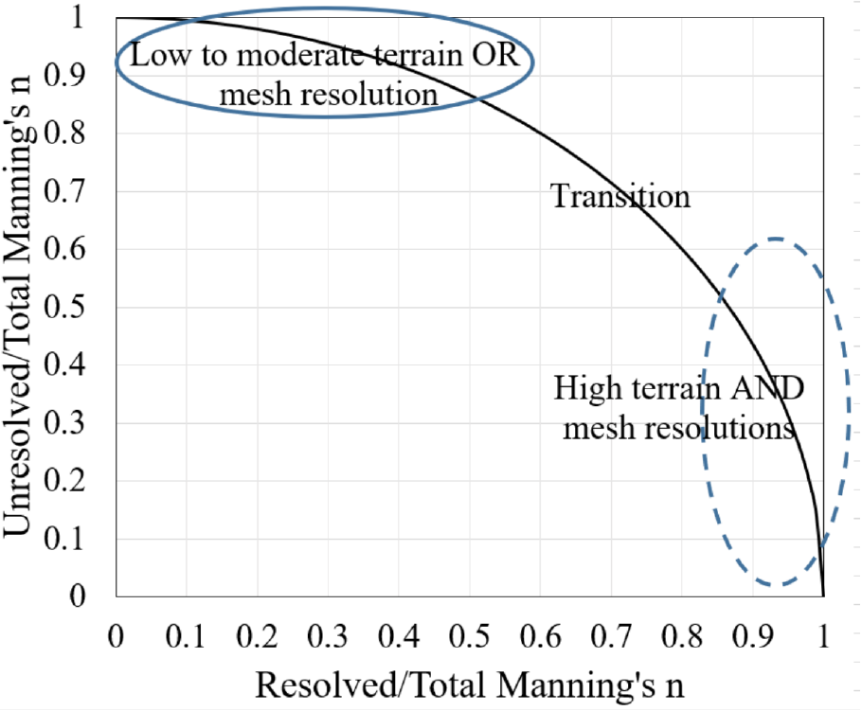
How to get unresolved Manning’s n?
“Quarter-circle” method
Details in NCHRP 24-49 Project Report

Slide 15
How to get unresolved Manning’s n?
For each roughness zone, determine resolved vs. unresolved Manning’s n
For low to moderate resolution terrain and mesh:
For medium resolution terrain and mesh:
For high resolution terrain and mesh:
Details in NCHRP 24-49 Project Report

Slide 16
More specific questions
Manning’s n in 1D vs. 2D models?
Effect of HEC-RAS 2D’s subgrid terrain treatment?
Same Manning’s n in SRH-2D and HEC-RAS 2D?
Importance of Manning’s n for different flow profiles?
Manning’s n used for sediment transport?
…

Slide 17
More specific questions
Should we reduce Manning’s n when transitioning from 1D to 2D?
Answer: Not necessarily.
Reason: There are other parameters in 1D such as contraction/expansion coefficients.

Slide 18
More specific questions
Does HEC-RAS 2D’s subgrid terrain treatment reduce Manning’s n?
Answer: Likely, but not definitely.
Reason(s): Slope (gravity) term does not use subgrid terrain.

Slide 19
More specific questions
Same Manning’s n in SRH-2D and RAS 2D?
Answer: No.
Reason(s): Modeling approach differences in subgrid terrain treatment, turb. models, numerical schemes, etc.

Slide 20
More specific questions
How important is Manning’s n anyway?
Answer: Depends on flow profiles and domain length.
Reason(s): Manning’s n is
less important in deeper water than in shallow water depth.
less important in short distance.

Slide 21
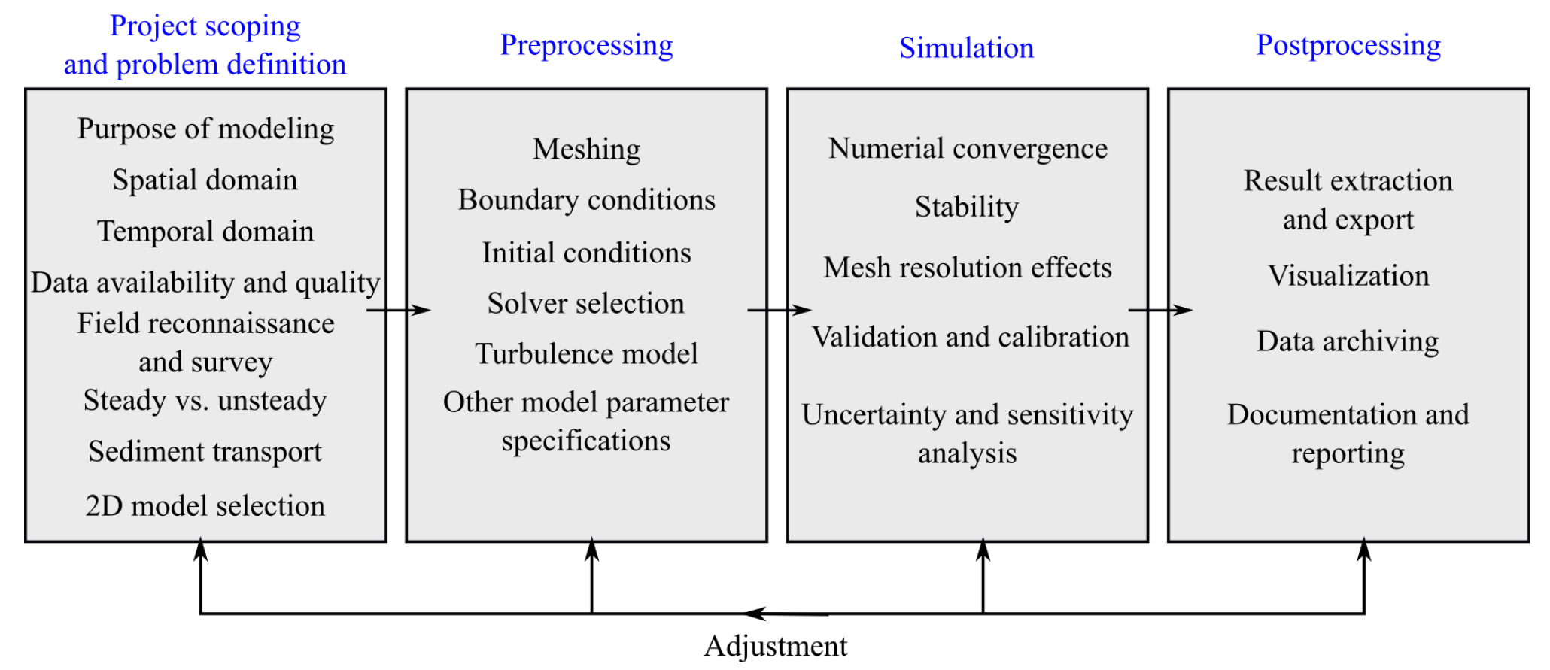
Manning’s n: A good 2D model is key
Best practices for 2D hydraulic modeling
Details in NCHRP 24-49 Project Report

Slide 22
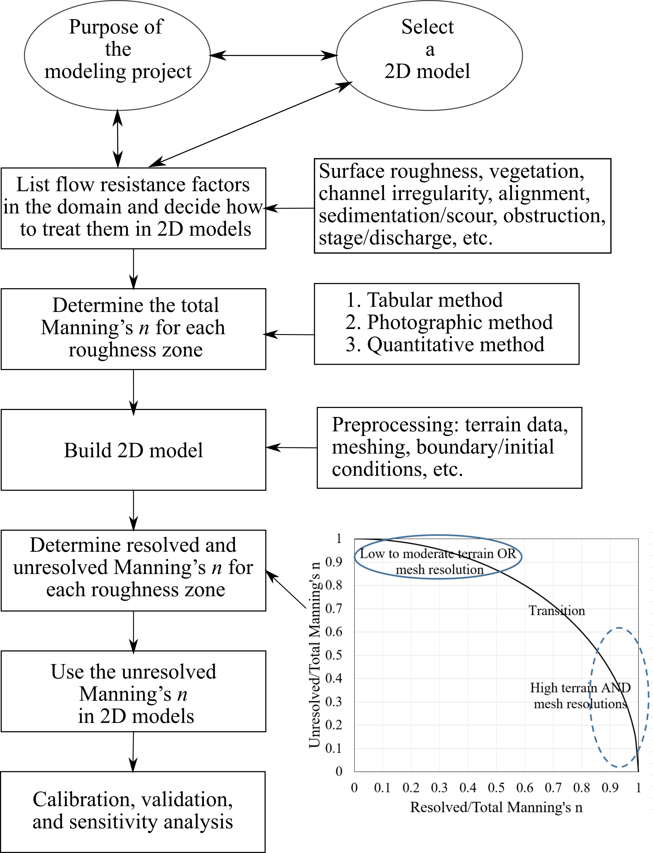
Manning’s n guidelines
A decision-making process
Details in NCHRP 24-49 Project Report

Slide 23
Further details
X. Liu, A., Mazdeh, L. W., Zevenbergen, and C. M., Kramer (2024). Selection and Application of Manning's Roughness Values in Two-Dimensional Hydraulic Models. NCHRP Research Report 1077
https://www.trb.org/Publications/Blurbs/183186.aspx

Slide 24
Take-home message
Manning’s n specified in 2D models should be n_{unresolved}
or
“Quarter-circle method”
“Roulette method”

Slide 25
More specific questions
In physical world
In numerical models

