Slide 1
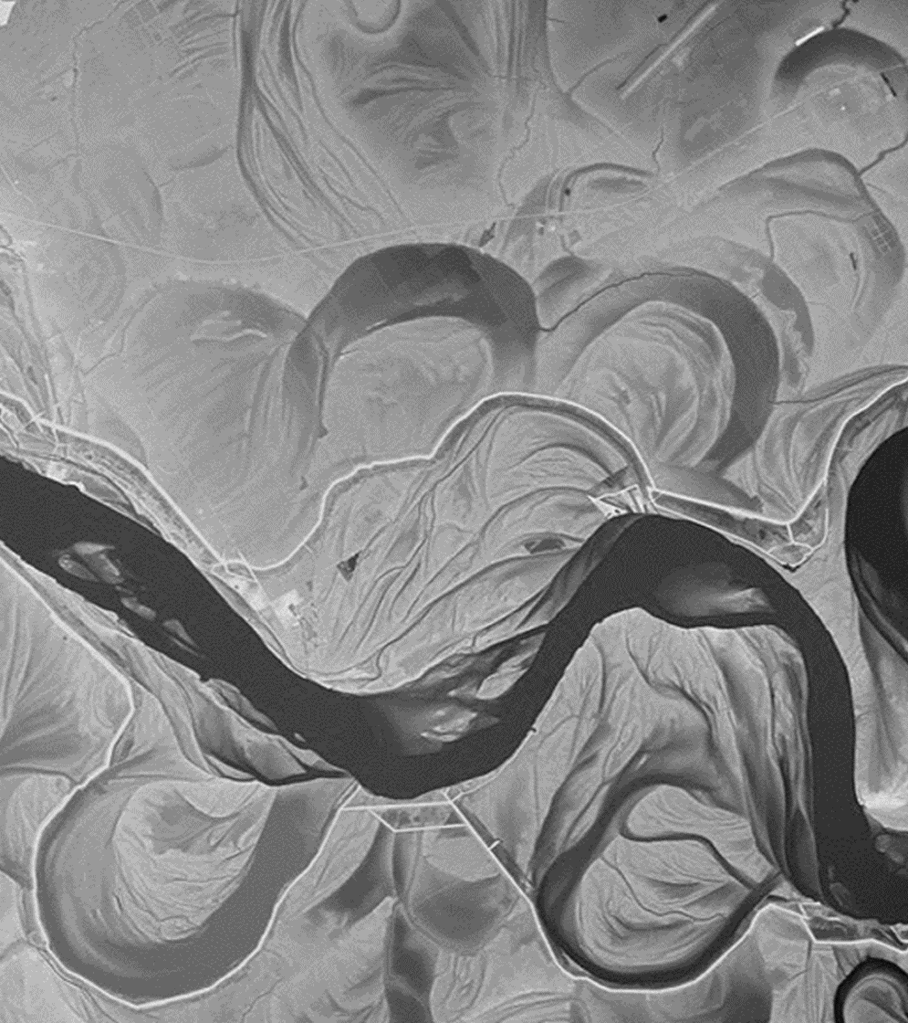
Future River Analysis & Management Evaluation (FRAME): A new forecasting tool for long-term morphologic response in river channels.
Charlie Little, PE, Sr. Hydraulic Engineer
Blake Mendrop, PE, PLS, Principal
National Hydraulic Engineering Conference
8/28/2024

Slide 2
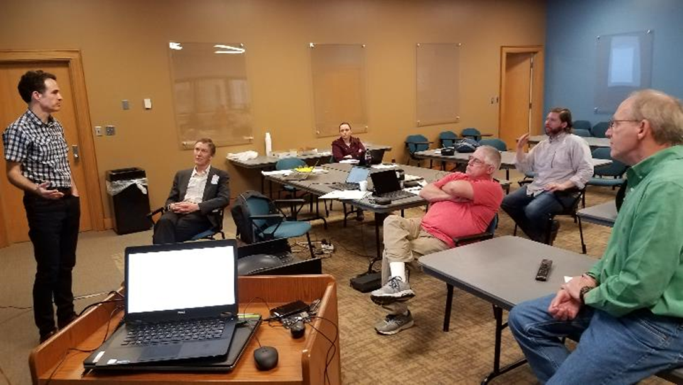
FRAME Development Team Members
David Biedenharn, Travis Dahl, Chris Haring ERDC-CHL
Colin Thorne, University of Nottingham (UK)
Phil Soar & Pete Downs, University of Portsmouth (UK)
Amanda Cox, St. Louis University
Charlie Little, Mendrop Engineering

Slide 3
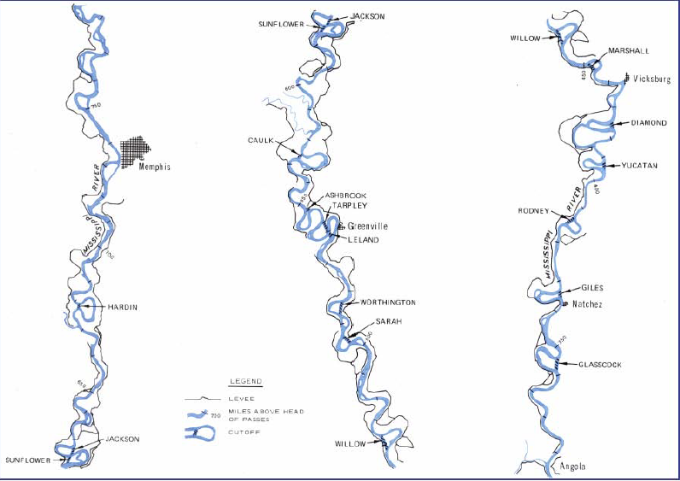
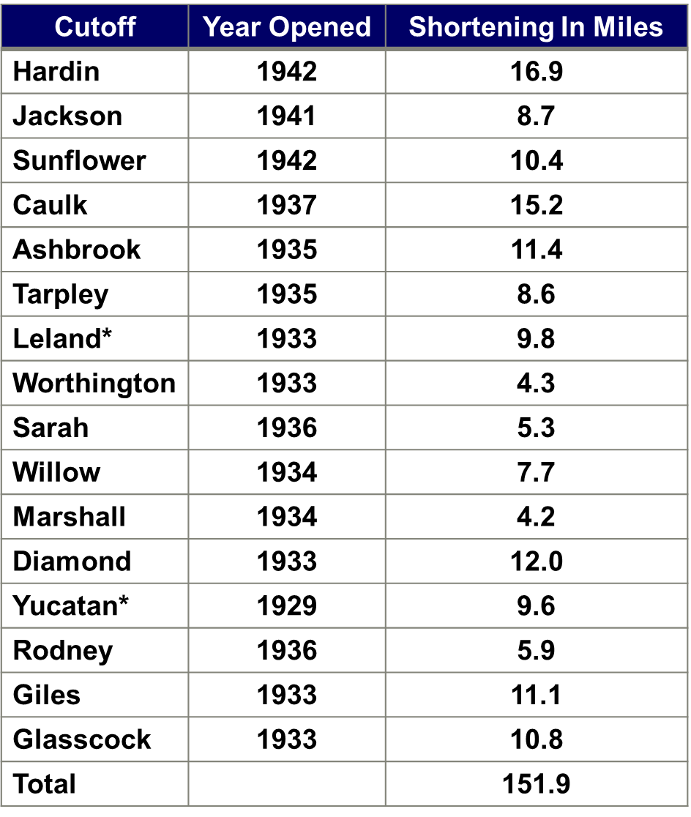
Why FRAME? Example: MS River Cut-offs

Slide 4
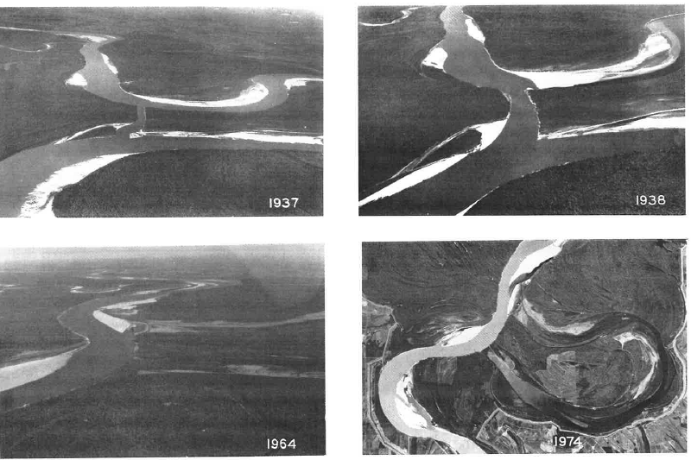
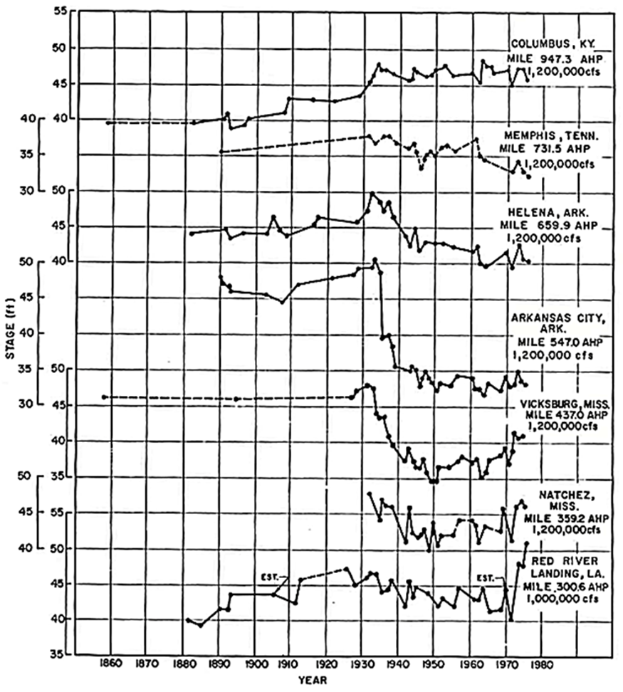
Complex Response: Dimension, Pattern, and Profile

Slide 5
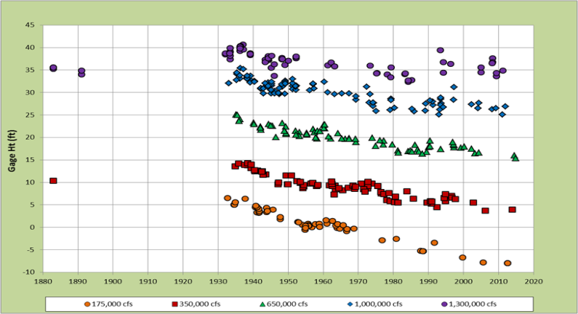
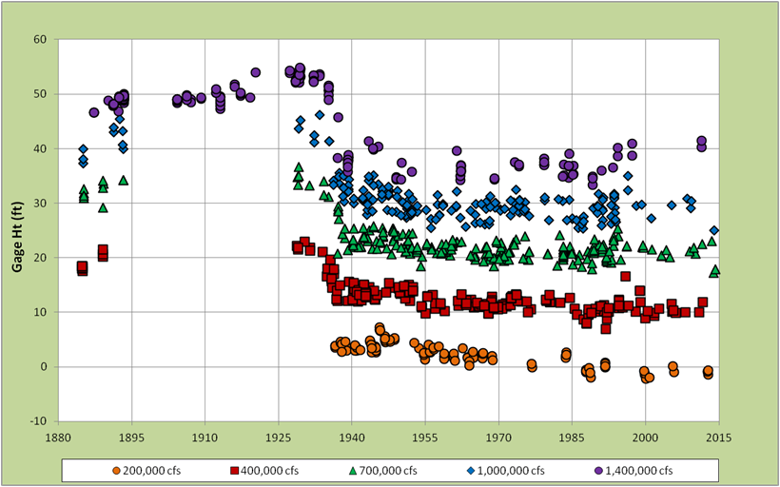
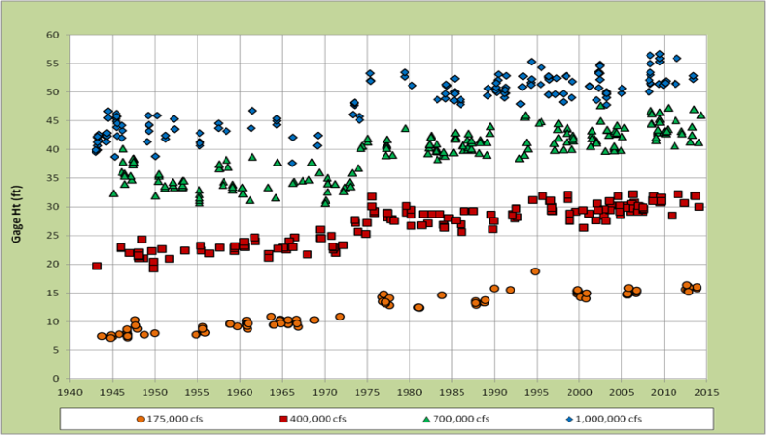
Broad-Scale Complex Response
Memphis
Arkansas City
Red River Landing

Slide 6
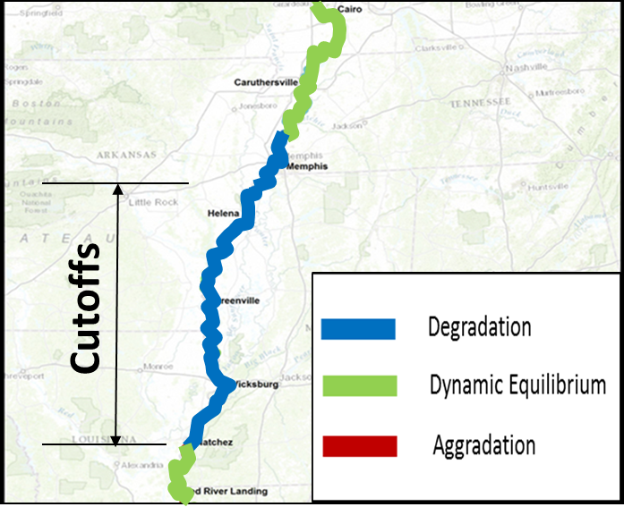
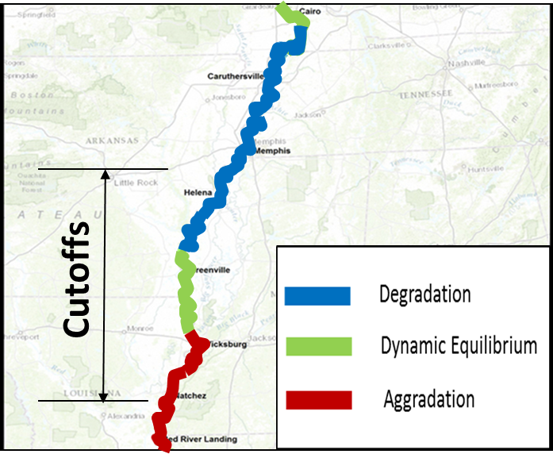
Forecasting Complex Response???
1940s Initial Response to Cutoffs
Present-day Response to Cutoffs

Slide 7

FRAME: Vision
Scan the long-term horizon
Annual/decadal outputs
Reveal potential morphological responses to management actions and climate change
Strategic decision making to avoid undesirable futures and steer towards a preferred future

Slide 8
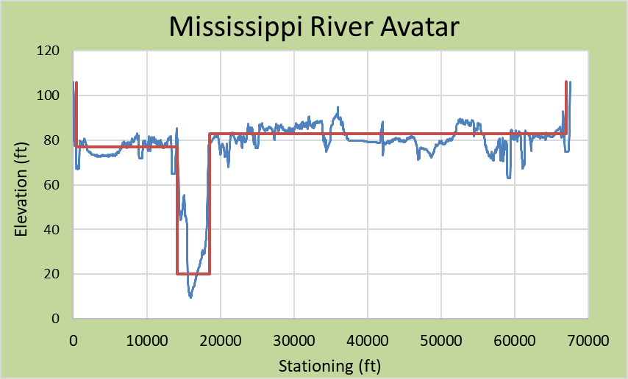
FRAME Philosophy/Concepts
FRAME is being designed with river managers and planners in mind, so that its outputs will offer exploratory insights into plausible river futures and their potential impacts on key river functions
Develop a fast, reduced complexity hybrid model:
  hydraulic and sediment transport calculations
  Geomorphic rules for river evolution
Simplified Cross-Sections (Avatars)
Built with uncertainty in mind
Provide insight into future river response for the broader system over hundreds of years

Slide 9
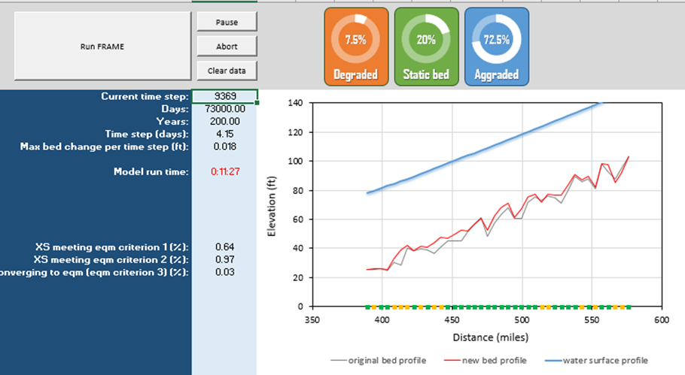
FRAME: What is it?
Conventional 1-D hydraulic and sediment transport modeling
Broad-scale network of representative cross sections
Simple two-layer scheme for bed material mixing
Hiding-exposure factor for sediment transport

Slide 10
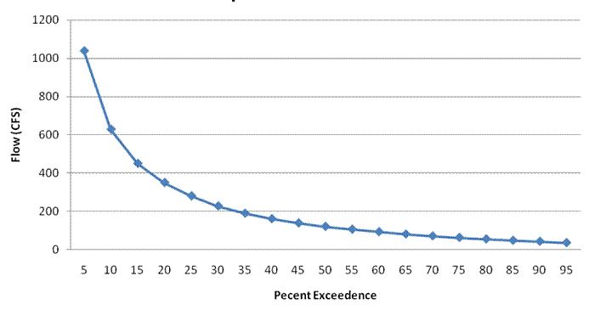

FRAME: Hydrology
Annual flow duration curves (AFDC) rather than time-stepping through sequences of hydrographs
Sub-annual hydraulic and sediment mixing time-steps for incremental adjustments and model stability
Each time-step is a time-compressed replicate of the annual flow duration curve
Notes:
Next hydrology.
A unique feature and departure from existing models is the use of AFDCs
So the hydrological time-step is one year

Slide 11
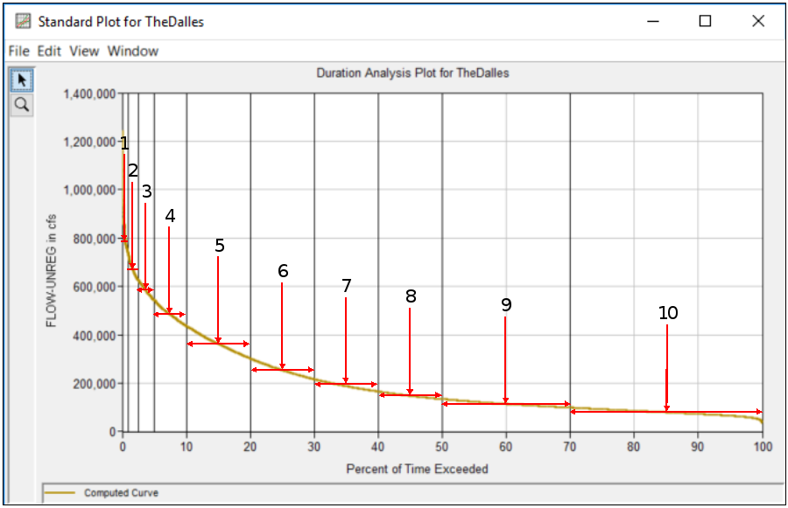
FRAME: Hydrology
Discrete discharges in AFDC are modeled in parallel
Frequency-weighted sediment load for each particle size calculated by integrating the discharge classes over each time step
Exner equation determines degree of channel change
Notes:
Next hydrology.
A unique feature and departure from existing models is the use of AFDCs
So the hydrological time-step is one year

Slide 12

FRAME: Morphology
Simplified cross-sectional geometries (avatars)
Reach-scale representation for system-scale responses
Avatar width: morphologic bank-full width preserved
Avatar depth: invert set to satisfy bank-full conveyance of full cross section
Avatar overbank: simplified in similar manner
Notes:
Channel morphology in FRAME is currently represented via a rectangular shape (avatar) that preserves the morphological bankfull width and with an invert level that satisfies bankfull conveyance of the full cross section. This representation facilitates far faster processing than detailed cross section geometries and acknowledges that attempting to predict the intricate nature of channel morphology over a period of multiple decades would be a spurious exercise.
Faster processing – plus 100 years from now its somewhat erroneous to think we can forecast the detailed nature of the cross section geometry.
System-scale not local factors with only a local morphological response
Overbank geometry also simplified.
Alternative avatar designs are currently being explored that incorporate a shape factor and might better preserve thalweg elevation.

Slide 13
FRAME: Morphology
Year 1
Year 2
Year 3
Year 100
Notes:
Channel morphology in FRAME is currently represented via a rectangular shape (avatar) that preserves the morphological bankfull width and with an invert level that satisfies bankfull conveyance of the full cross section. This representation facilitates far faster processing than detailed cross section geometries and acknowledges that attempting to predict the intricate nature of channel morphology over a period of multiple decades would be a spurious exercise.
Faster processing – plus 100 years from now its somewhat erroneous to think we can forecast the detailed nature of the cross section geometry.
System-scale not local factors with only a local morphological response
Overbank geometry also simplified.
Alternative avatar designs are currently being explored that incorporate a shape factor and might better preserve thalweg elevation.

Slide 14
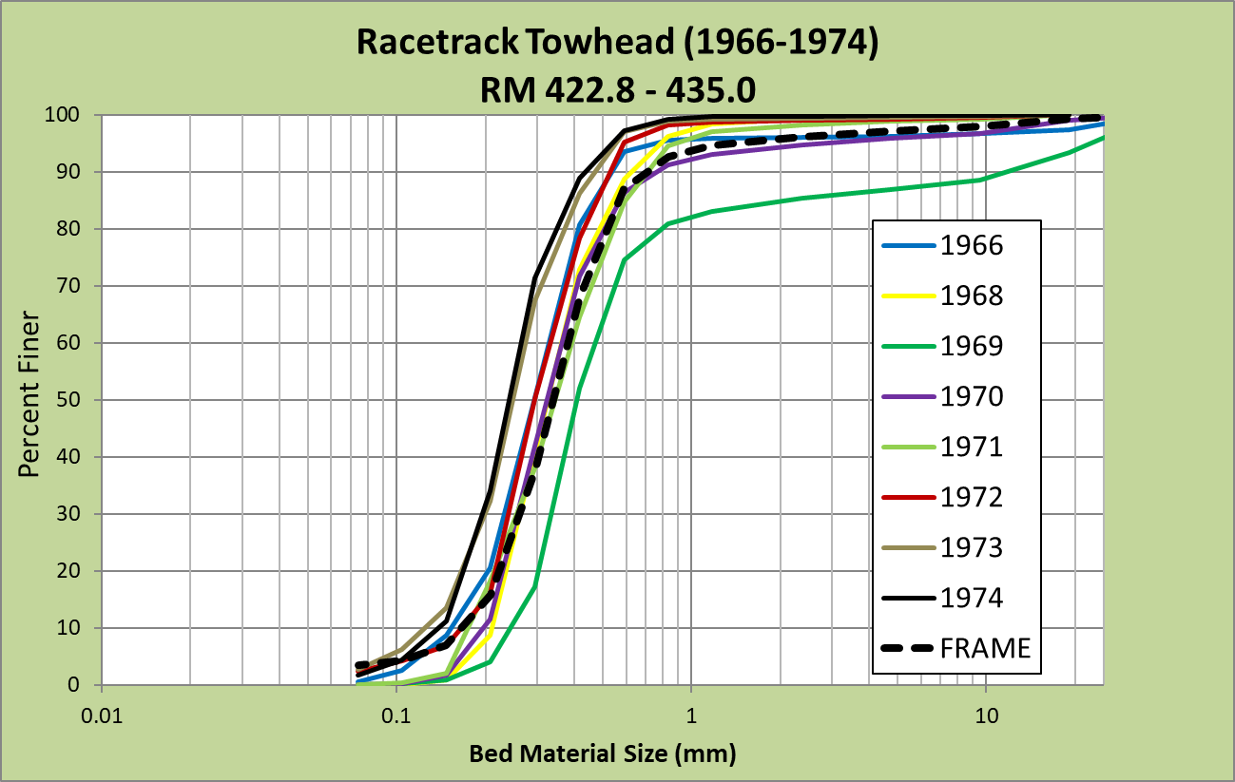
DIVIDER TITLE IN ARIAL BLACK
FRAME: Bed Material

Slide 15
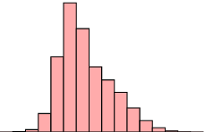
The sediment balance
Avatar
Flow
Particle size
1
2
3
4
5
6
Sediment yield for each FRAME reach calculated on a
grain size class basis.
Integrated effect of all flow classes in annual flow duration curve.
Notes:
Sediment yield for each FRAME reach is calculated on a grain size class basis. In this simple schematic there are just 6 reaches.
The total yield for each grain size class is the integrated effect of all flow classes in annual flow duration curve.

Slide 16
The sediment balance
1
2
Sediment
‘Transfer’
3
Sediment ‘Source’
(bed scour)
Sediment ‘Sink’
(Bed level raising)
4
5
6
Changes in bed level occur at each cross section in
response to the mass sediment balance by grain size between
adjacent reaches over the model time step.
Accounts for porosity, reach length, armouring & bed material sorting.
Notes:
Then, changes in bed level occur at each cross section in response to the mass sediment balance by grain size between
adjacent reaches over the model time step.
The approach accounts for porosity, reach length, it includes an armouring function and bed material within two bed layers is re-sorted after each time step.
So far we’ve focused on bed level change (and in the Lower Miss, the banklines are locked in place, so that’s fine). But moving forward, we’ll be adding functionality for widening.

Slide 17
FRAME: Rules-based System
Morphological rules to side-step computationally intense methods and uncertain processes
Controlled by calibration dials:
  Tributary inputs
  Restricted bed erosion
  Management interventions
  Etc…
Notes:
Channel morphology in FRAME is currently represented via a rectangular shape (avatar) that preserves the morphological bankfull width and with an invert level that satisfies bankfull conveyance of the full cross section. This representation facilitates far faster processing than detailed cross section geometries and acknowledges that attempting to predict the intricate nature of channel morphology over a period of multiple decades would be a spurious exercise.
Faster processing – plus 100 years from now its somewhat erroneous to think we can forecast the detailed nature of the cross section geometry.
System-scale not local factors with only a local morphological response
Overbank geometry also simplified.
Alternative avatar designs are currently being explored that incorporate a shape factor and might better preserve thalweg elevation.

Slide 18



FRAME: Management
Developed with practitioners in mind
Diversion channels
Dike fields (& channel geometry changes)
Grade control structures
Sediment attenuation
Meander bend cut-offs (straightening & restoration)
Notes:
Useful output parameters, as Pete Downs will talk about…
FRAME is being developed with river managers and strategists in mind where indicative results offer ‘exploratory’ insights into plausible river futures and their potential impacts; a new tool that is capable of performing multiple runs over annual, decadal and centennial time-periods with flexibility for changing inputs and boundary conditions quickly and expediently during and between model runs, providing the visioning needed to justify appropriate management
interventions and mitigation measures.
Diversions are treated as inputs (or outputs) and can be assigned to any cross section with simple rules for setting flow at either a fixed rate or a percentage of the main channel discharge. Critically, diversions can be set to come on-line and begin having an impact at a specified future year and, optionally, once a minimum operating discharge has been exceeded in the main channel
Calibration- orientated Rules associated with
Input-output diversions
Dike fields (obstructions to flow and temporary storage of sediment)
Grade control structures

Slide 19
DIVIDER TITLE IN ARIAL BLACK
FRAME: Scenario Forecast
Scenario-model ensembles of river futures
Turn management interventions on/off at any future year
Design sequences of flow duration curves:
  Historical years
  Probabilistic years
  Scaled to account for climate change

Slide 20
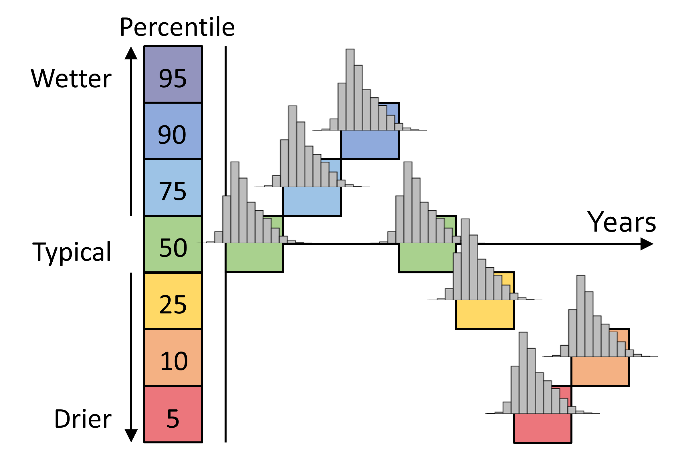
DIVIDER TITLE IN ARIAL BLACK
FRAME: Scenario Forecasting

Slide 21
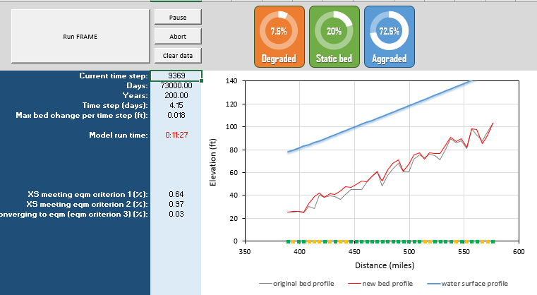
DIVIDER TITLE IN ARIAL BLACK
FRAME: Status
FRAME tool working with limited functionality on
  Mississippi River
  Kaskaskia River
  Sabougla Creek
Presently being applied to small stream restoration efforts
Initial development of a decision support tool – RUBRIC (Rules-Based morphological Response in Channels)

Slide 22
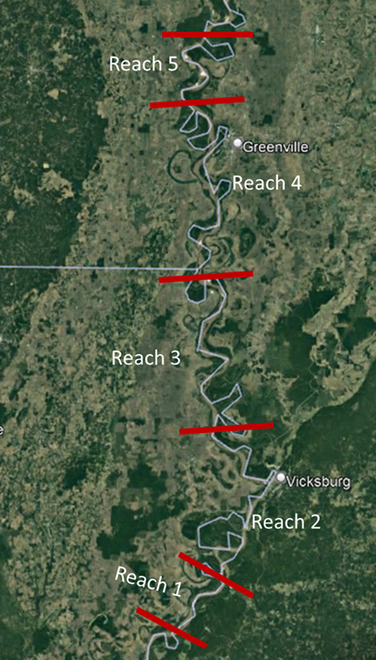
FRAME: MS River Test Application
RM 576 – RM 389
2003 Hydrographic Surveys
1963-2013 Annual Durations Repeated
Scenarios Run (200 years)
  Diversions
  Climate Change
  Cutoffs
  Re-Meandering
  Base Level Lowering
  Effects of Bed Material Size
  Dike Impacts (Geomorphic Rules)

Slide 23
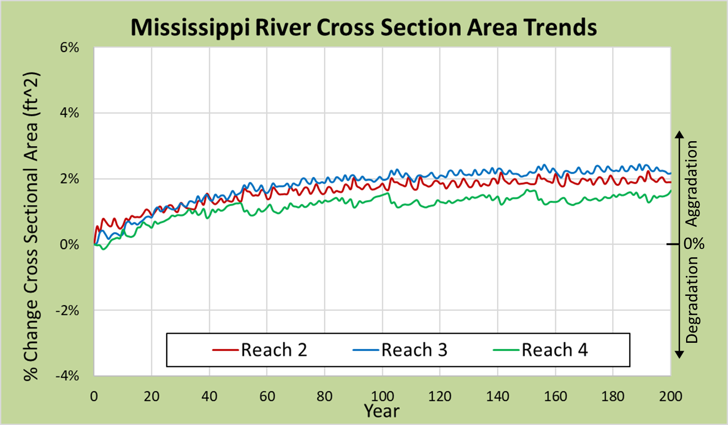

FRAME: Base Condition Results

Slide 24
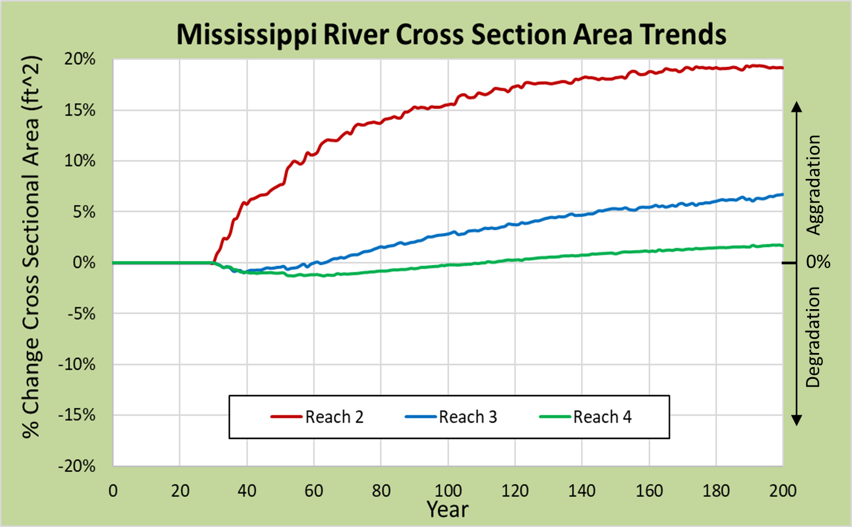
FRAME: Diversion, 30% Water, No Sediment, Year 30

Slide 25
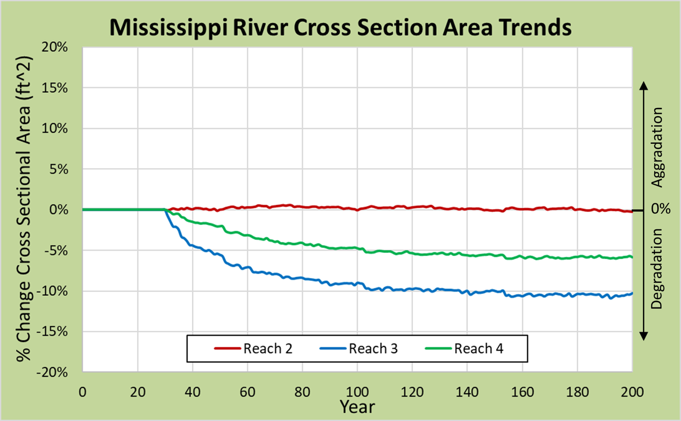
FRAME: Diversion, 30% Water, Sed. Div. Coef. 2, Year 30

