Slide 1
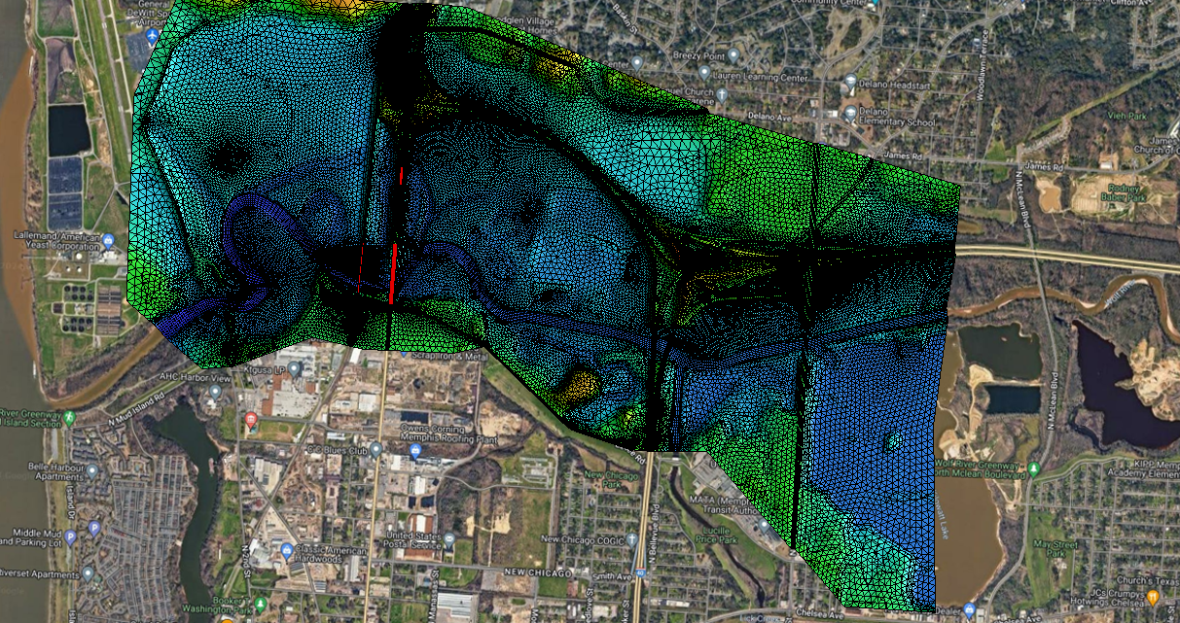
Two-Dimensional Modeling of the Lower Wolf River
Amanda Whitlock
TN Dept of Transportation – Hydraulic Design Section
Notes:
Good afternoon. Before I begin with my presentation on the development of an SMS 2D model of the Lower Wolf River, I want to do a quick recap from a morning session you may or may not have seen.

Slide 2
Meanders and Migrations:
A Century on the Wolf River
Wesley Peck, DJ Wiseman
TDOT Hydraulic Design Section
Notes:
In case you missed it, this morning a couple of my colleagues presented about the Wolf River in Memphis, TN – how it has changed throughout the 1900s and into the 2000s, showing evidence of its continued migration over the years.
When a project came up for an overflow bridge replacement on Thomas Street – in the Lower Wolf Corridor - Wesley saw the opportunity for our office to develop a 2D model to accompany his upcoming NHEC presentation and for analyzing this portion of the Wolf River.

Slide 3
Notes:
For some quick context, for those not familiar with the Memphis area - in the background, you will see the Mississippi River, along the TN/AR state line. The meandering river you see flowing into it is a portion of the lower Wolf River. Moving downstream to upstream along the Wolf, we cross Whitney Avenue (N 2nd Street), then an Illinois Central Railroad bridge, and then here in the foreground we see Thomas Street and the bridge over the Wolf River. The hydraulic design of this particular bridge was done by Wesley Peck circa 2005-2006 and constructed circa 2012-2013. (For scale, it’s about 650’ upstream of the railroad bridge.)
Thomas Street is our area of focus, currently, as replacement of the nearby Thomas Street overflow bridge is in the works – but in developing this hydraulic model, we hope to observe, as well, what is happening at the newer Thomas Street bridge over the Wolf River in addition to the other structures – both downstream and upstream.
But let’s begin to delve into the 2D model and the process to get to where we’re at with it, currently. (And before I move ahead, let me preface this presentation by letting you know that I am not yet an expert with SMS2D AND the information presented here is still a work in progress.)

Slide 4
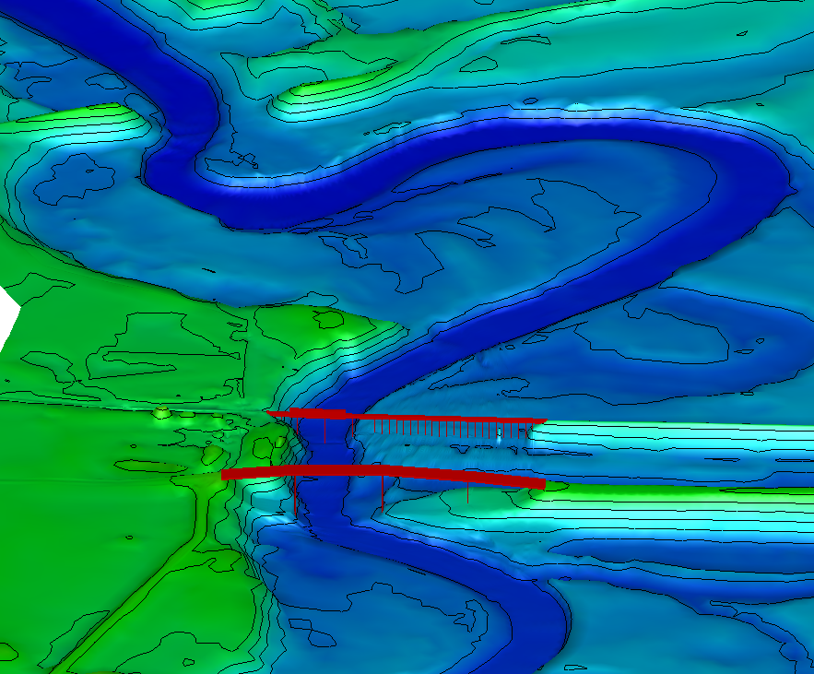
Notes:
Here’s a 2D version of the same basic view from Wesley and DJ’s presentation title page – with Thomas Street and the railroad bridge in the foreground, and if we zoom out just a little…..

Slide 5
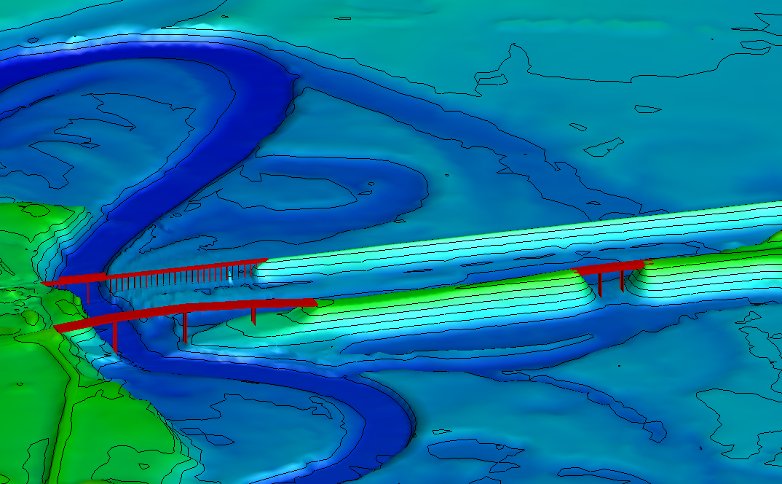
Notes:
We can now see that overflow bridge that is going to be replaced. This is the main area of focus for our model at this point.
The modeling didn’t begin here, in SMS2D, though. Due to tight project scheduling, this project was initially modeled in HEC-RAS 1D. So, we’ll start there…

Slide 6
USACE Memphis District Model of the Wolf River: HEC-RAS 1D
Notes:
Because this a FEMA-regulated area, we figured there was an existing model out there somewhere, so we contacted the City of Memphis to see what they might have available. They provided us with a HEC-RAS 1D model they were using for some hydrologic studies of their own.

Slide 7
USACE Memphis District Model of the Wolf River: HEC-RAS 1D
Projection File
Notes:
Opening the file, I saw what we sometimes call a “sticks and lines” model – the way they used to be (albeit much more detailed.) The model we received did not have an accompanying projection file so it was not georeferenced into the existing terrain or onto any base map.

Slide 8
USACE Memphis District Model of the Wolf River: HEC-RAS 1D
Projection File
Length
Notes:
Their model extended more than 56 miles and included tributaries. We were really just interested in the area near Thomas Street, so we knew we would need to crop the model down and focus on our particular area of interest.

Slide 9
USACE Memphis District Model of the Wolf River: HEC-RAS 1D
Projection File
Length
Bridges
Notes:
Next, I began to scroll through the cross sections and Bridge Data input, to review the structures.

Slide 10
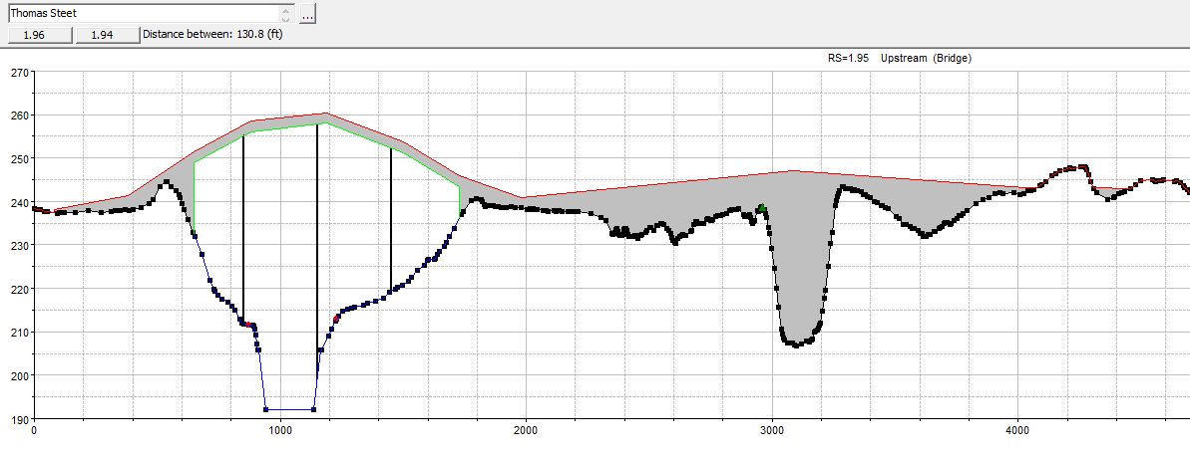
USACE Memphis District Model of the Wolf River: HEC-RAS 1D
Projection File
Length
Bridges
Omitted
Details
Notes:
As I began to scroll through, I noticed missing structures – including the overflow bridge I would be analyzing. And pulling the old bridge plans for the structures within our area of interest, I found some discrepancies between the existing bridges (span arrangements, pier sizes, skews, bridge decks/grades, etc.) and what was provided in the model.
I decided that with the amount of changes that would be needed, I would begin developing my own model – using what I could from the Corps model but making it “my own.”

Slide 11
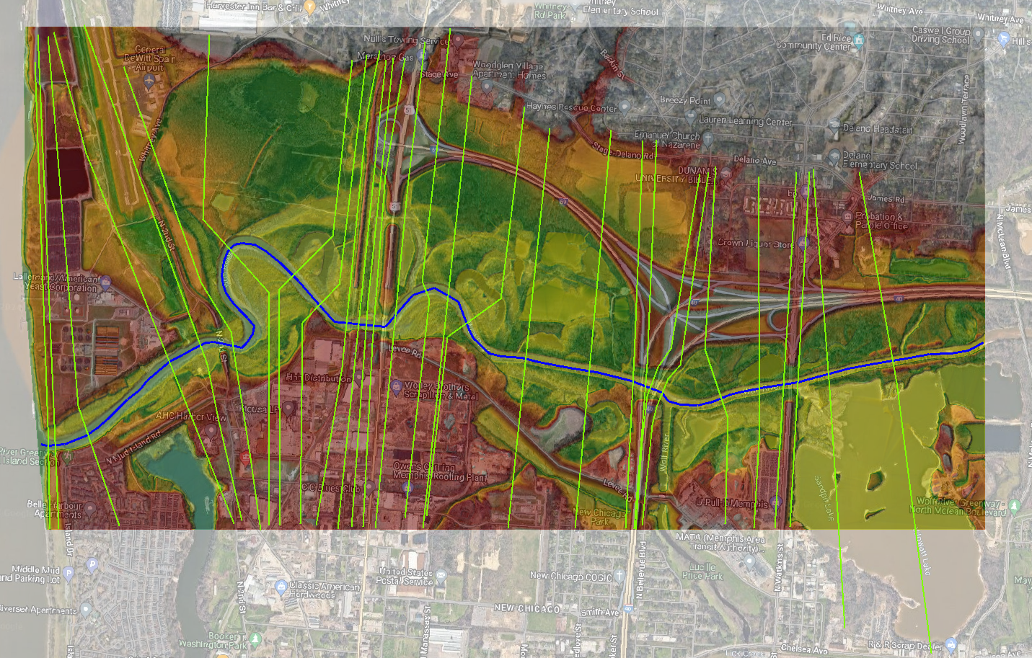
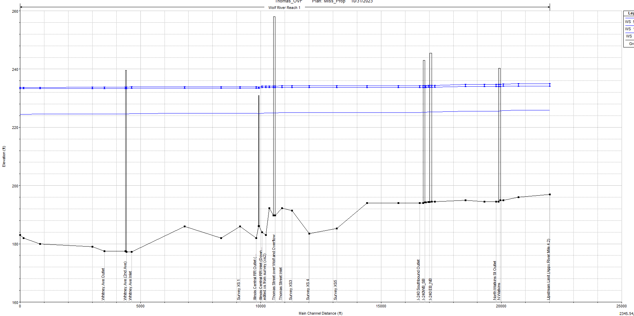
TDOT Model
of the
Lower Wolf River:
HEC-RAS 1D
Notes:
What resulted was a model which implemented the same river reach and basic cross sections, but cut from a terrain developed from the most recent LiDAR and survey data surrounding the Thomas Street overflow bridge, and the bridge data was input based on the bridge plans we have available in-office. This 1D model covered a little more than 4 miles from the confluence with the Mississippi River and used a multiple opening analysis to analyze the overflow bridge along Thomas Street.
When the analysis was complete and the hydraulic layout was provided for final design, it opened up time to allow for the development of a 2D model.

Slide 12
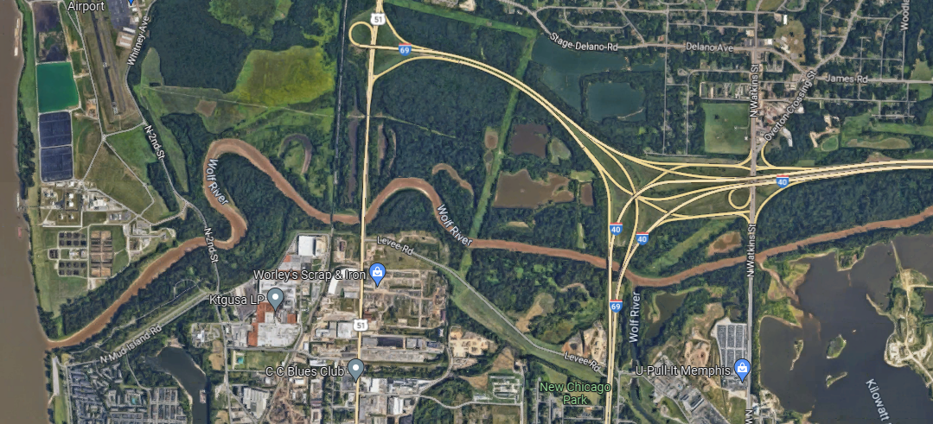
Aerial View of the Lower Wolf River Corridor
Approximately 4 miles
Notes:
Sticking to the same 4-ish mile corridor and using the terrain developed for the 1D model, a mesh was generated in SMS 2D.

Slide 13
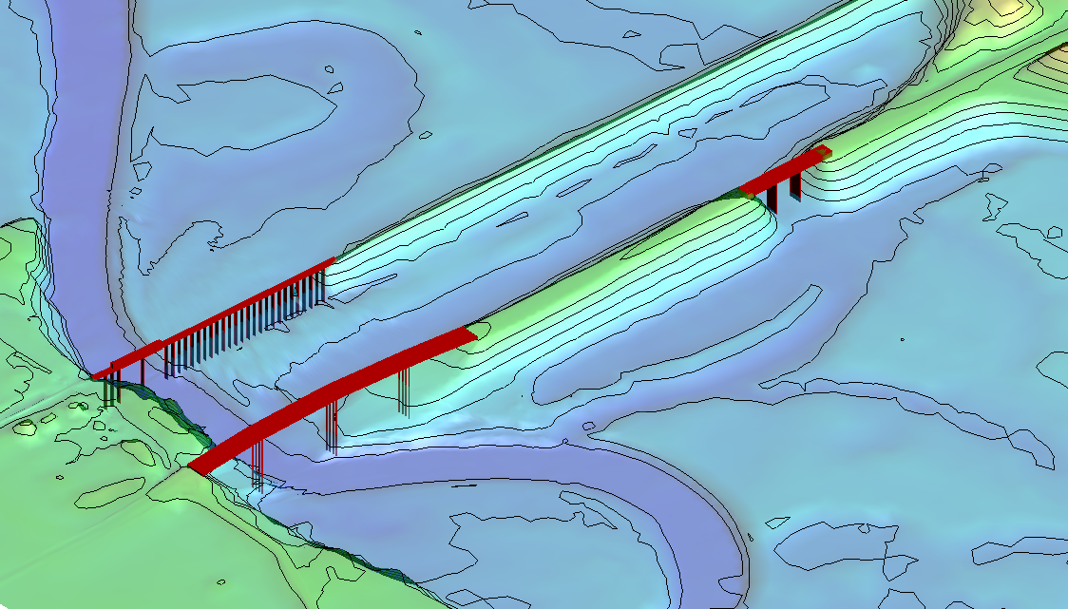
2D Mesh of the Lower Wolf River Corridor
Notes:
Once the mesh was generated, I used the newer 3D Structure option to add the two Thomas Street bridges and the downstream railroad bridge, shown here in red.

Slide 14
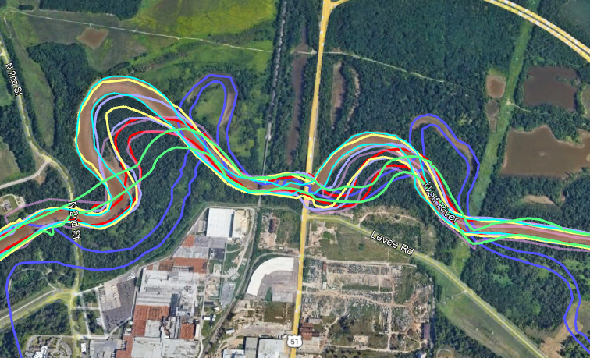
Overview of Paths of Wolf River since 1938
1938
1962
1981
1990
1997
2010
2023
Notes:
Taking a quick view back to one of the slides presented this morning on the history of the Wolf River migration, we saw a schematic of how the flow paths have changed since the late 1930s, beginning with the darker purple in 1938 to the 1962 channelization and realignment shown in light green, and then the continuous migration of the river through the 80s, 90s, and as recent as 2023 (shown in teal.)

Slide 15
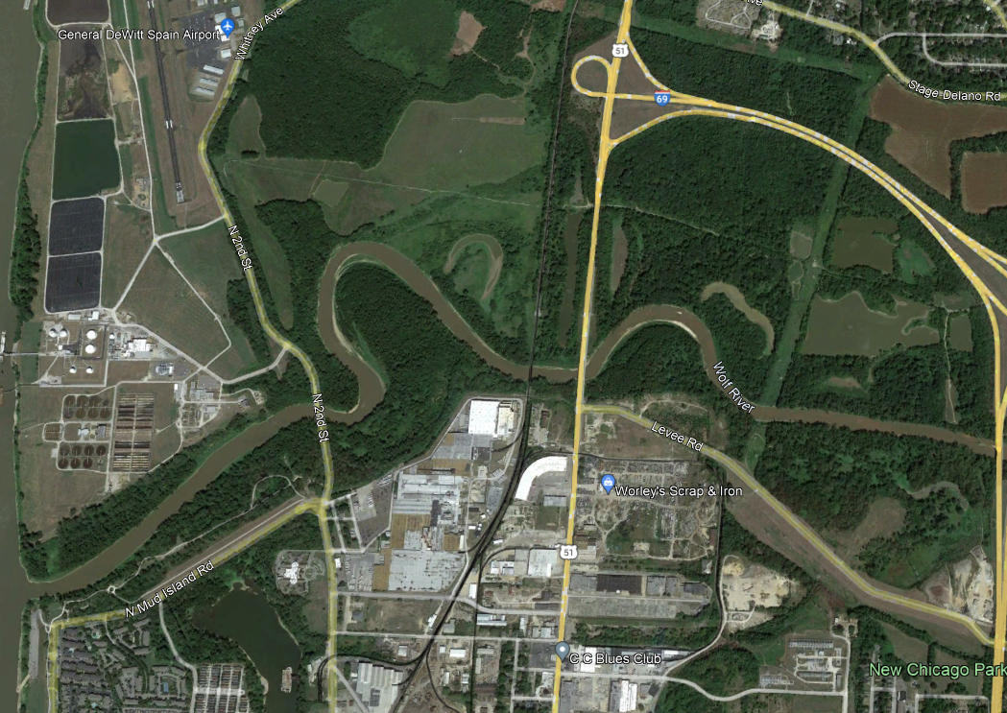
Notes:
And while a “plain ol’” aerial view can show evidence of the Wolf’s history….

Slide 16
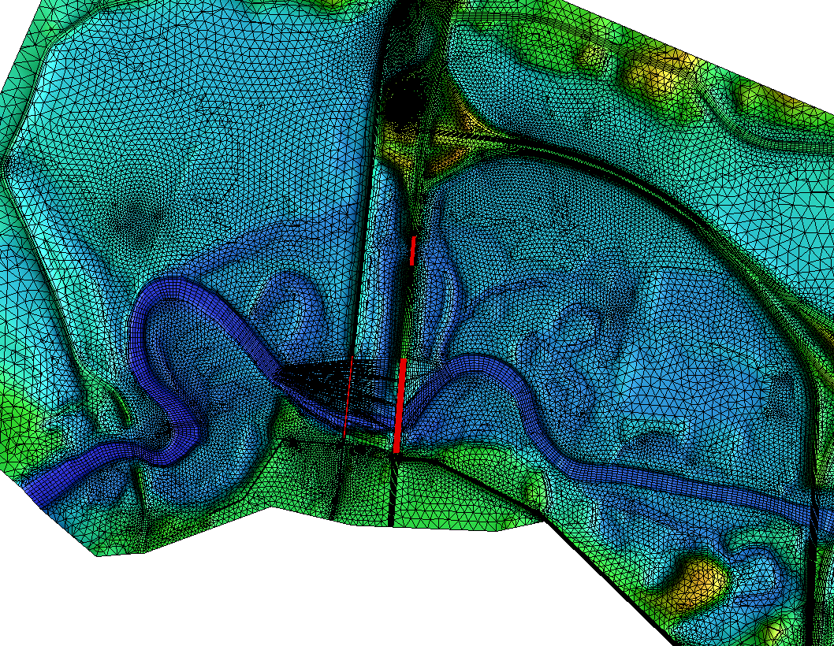
Notes:
The 2D Mesh and contours really show remnants of the scarring and how it’s still present and still very much a part of the lower Wolf River corridor today.

Slide 17
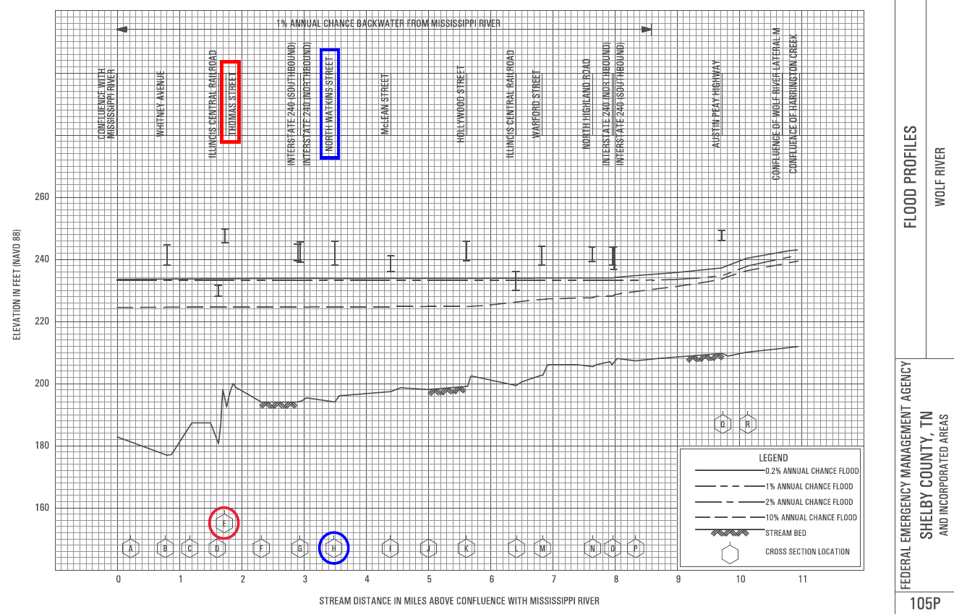
FEMA: Flood Insurance Study
Notes:
This FEMA Flood Insurance Study (keep in mind this was revised in 2013 - over a decade ago) contains the Wolf River through all of Shelby County - from the confluence with the Mississippi, extending to (and continuing through) the Fayette County line, accounting for roughly the lower 34 channel miles of the Wolf River. The backwater impacts from the Mississippi River, here in the greater Memphis area are not insignificant, with the 100YR backwater dominating the Mouth of the Wolf River for more than 8.5 miles (and nearly 6 miles of backwater impacts for a 10YR event on the Mississippi.)
Because the graphics probably aren’t clear from where you’re sitting, this profile which contains the 1st 11 miles of the Wolf River study, shows the Thomas Street crossing marked in red at channel mile 1.72. (And one more reference point - just below the upstream limit of my current 2D model is the North Watkins Street crossing, which I’ve marked here in blue at channel mile 3.49.)
I just wanted to point out the scale of our current area of focus here, with respect to the entire Shelby County Wolf River Corridor – and not pictured are an additional two other pages of the Flood Profiles. So, this is just a small snippet that we’re looking into at this point, but it seems to be the area that is undergoing the most visible change.

Slide 18
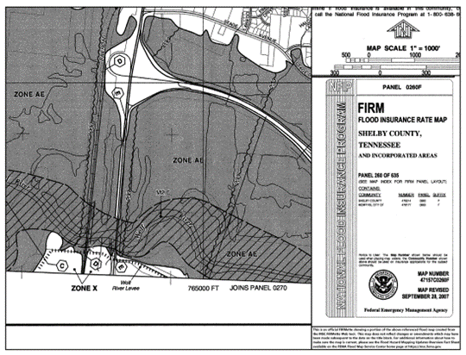
Notes:
Taking a quick look at a snippet from the old school Flood Insurance Rate Map circa 2007, we see the floodway and floodplain designated in the area near the railroad and the upstream Thomas Street Bridges. The elevations noted throughout the FIRM are listed at 233’….the 100YR backwater elevation from the Mississippi River which we saw on the profile.
What I really want to look at, though, is a notable difference between what you see here on this 2007 map and what we see as we look at a more recent aerial view with the National Flood Hazard Layer overlay from FEMA’s site.

Slide 19
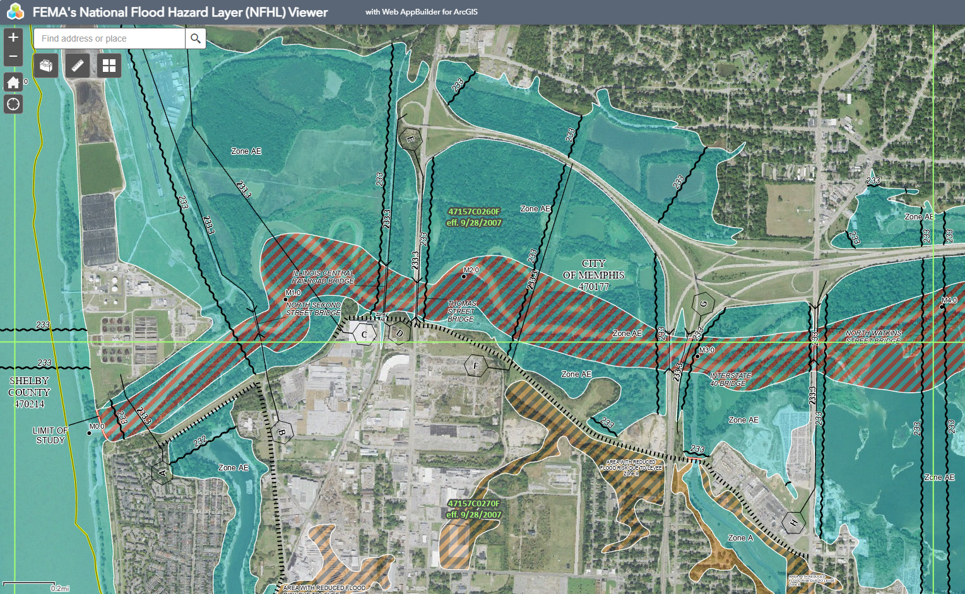
Notes:
Here is an overview of – roughly – our 2D model limits, but if we zoom more closely to the area near Thomas Street….

Slide 20
Notes:
We can plainly see that the Wolf River has meandered its way out of its own designated floodway. Just more evidence to support the earlier presentation of the Wolf’s constant and ongoing evolution.

Slide 21
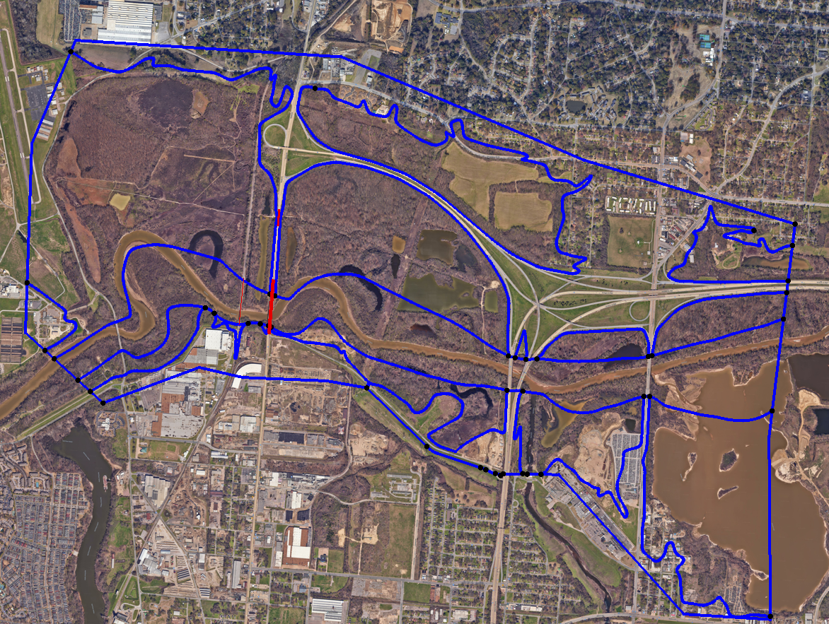
Notes:
Now, back to the model, with a map layer in SMS to show the FEMA boundaries of the floodway and floodplain, inputting the boundary conditions we have provided in the FEMA study – flows at the upstream Wolf River, this tributary stream from Cypress Creek (as some maps label it) and the known tailwater from the Mississippi, we come up with a Simulation that looks something like this….

Slide 22
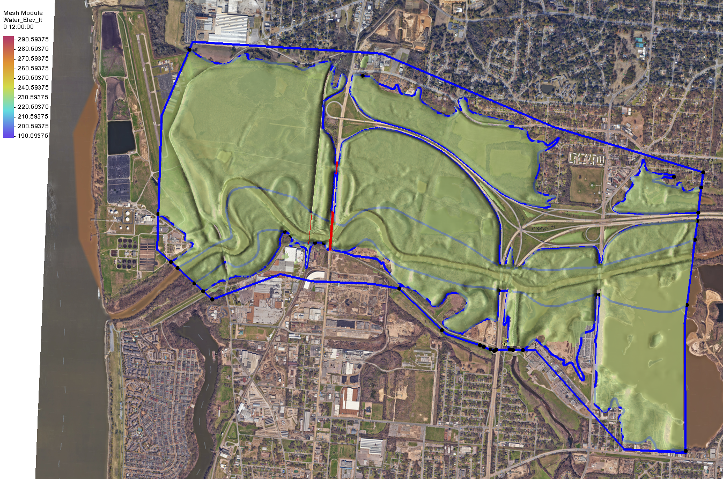
Known Tailwater Condition from Mississippi River
Elevation: 233.3’
Notes:
Here is the model, from the first time step and throughout the duration of the simulation. It’s evident, as the FIS flood profile had shown, that the entire model is completely inundated by the impacts of the Mississippi as it reaches a 100-year flood stage.
In order to see what impact the Wolf River itself could have in this corridor, we had to remove such drastic tailwater effects.

Slide 23
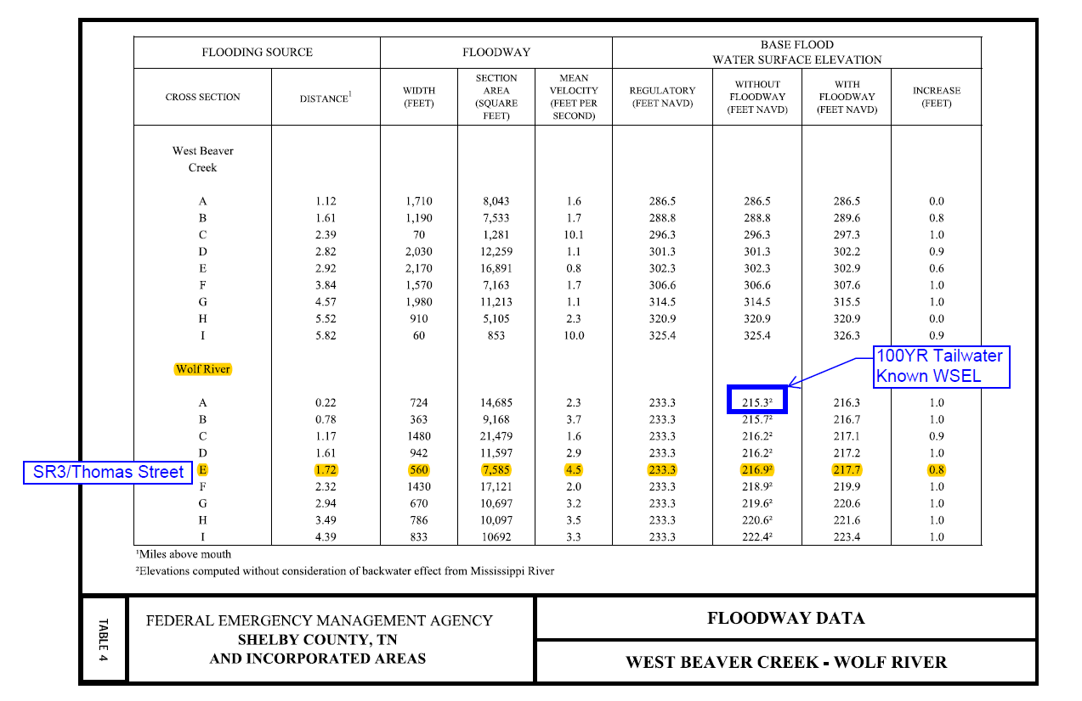
FEMA Flood Insurance Study: Wolf River Floodway Data
Notes:
Within the Floodway Data Table, we’re provided with the 100YR Base Flood Elevation without consideration of the backwater effect from the Mississippi River. Taking the value at the downstream-most cross section – XS A - and using that for our new Exit H boundary condition, we can produce a model in which flow from the Wolf River is able to travel downstream toward the confluence with the Mississippi. Now the Mississippi still has a heavy impact on the area, but it no longer COMPLETELY dominates the model flow conditions.

Slide 24
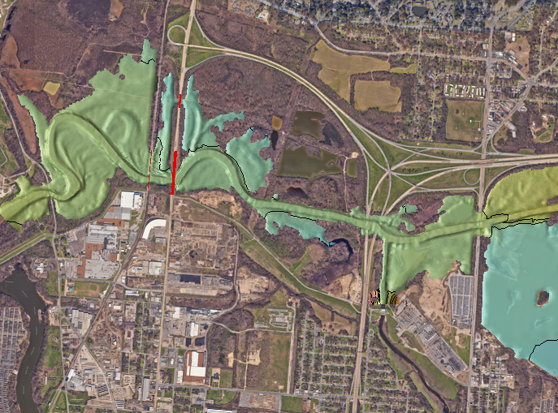
Known Base Flood Elevation, without Mississippi River Tailwater
Elevation: 215.3’
Notes:
Here, you can see a sample of the results from the model – a couple of hours into the simulation, as the flow begins making its way through the overflow structure - with the set base flood elevation.

Slide 25
Known Base Flood Elevation, without Mississippi River Tailwater
Notes:
Here is a clip of that in motion as it passes under the overflow bridge and must make the series of turns to make its way to the railroad bridge in order to reach the Mississippi, and as the flood waters continue to fill that low-lying floodplain….

Slide 26
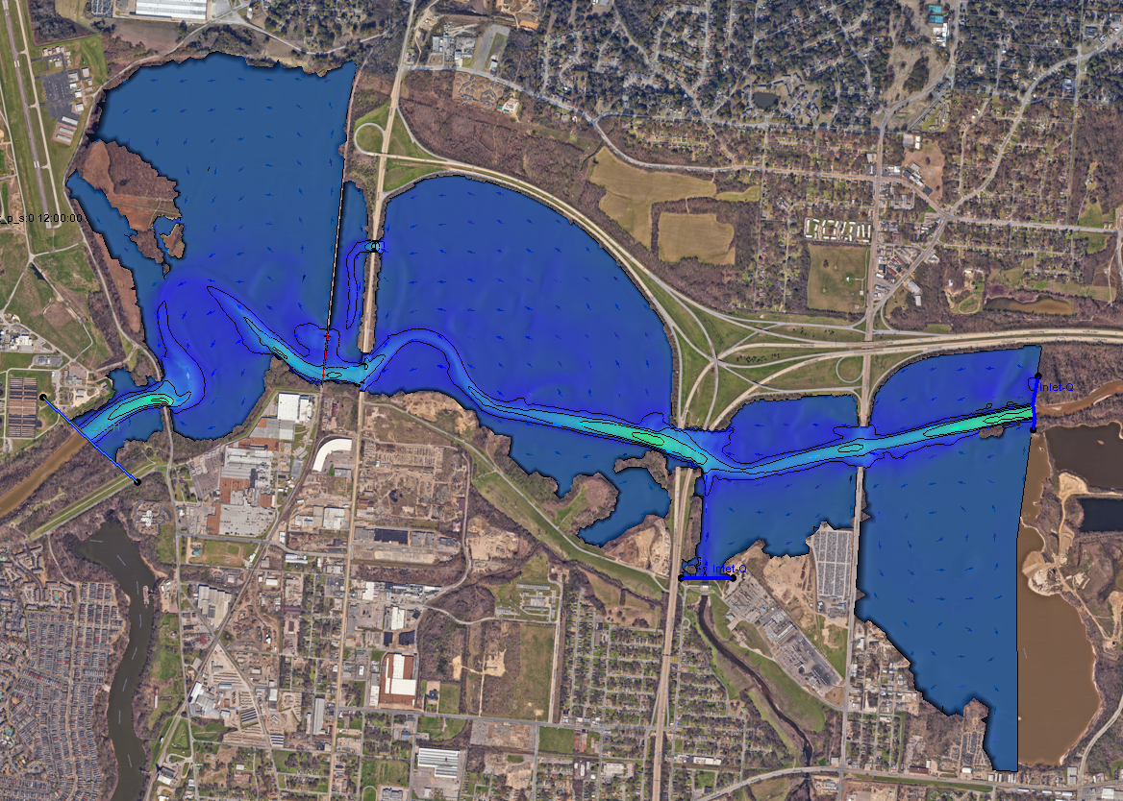
Notes:
And then just one more static image, showing some of those velocity vectors and subtle changes in velocity through the corridor as the flow reaches its peak flow elevation, toward the end of the simulation duration.

Slide 27
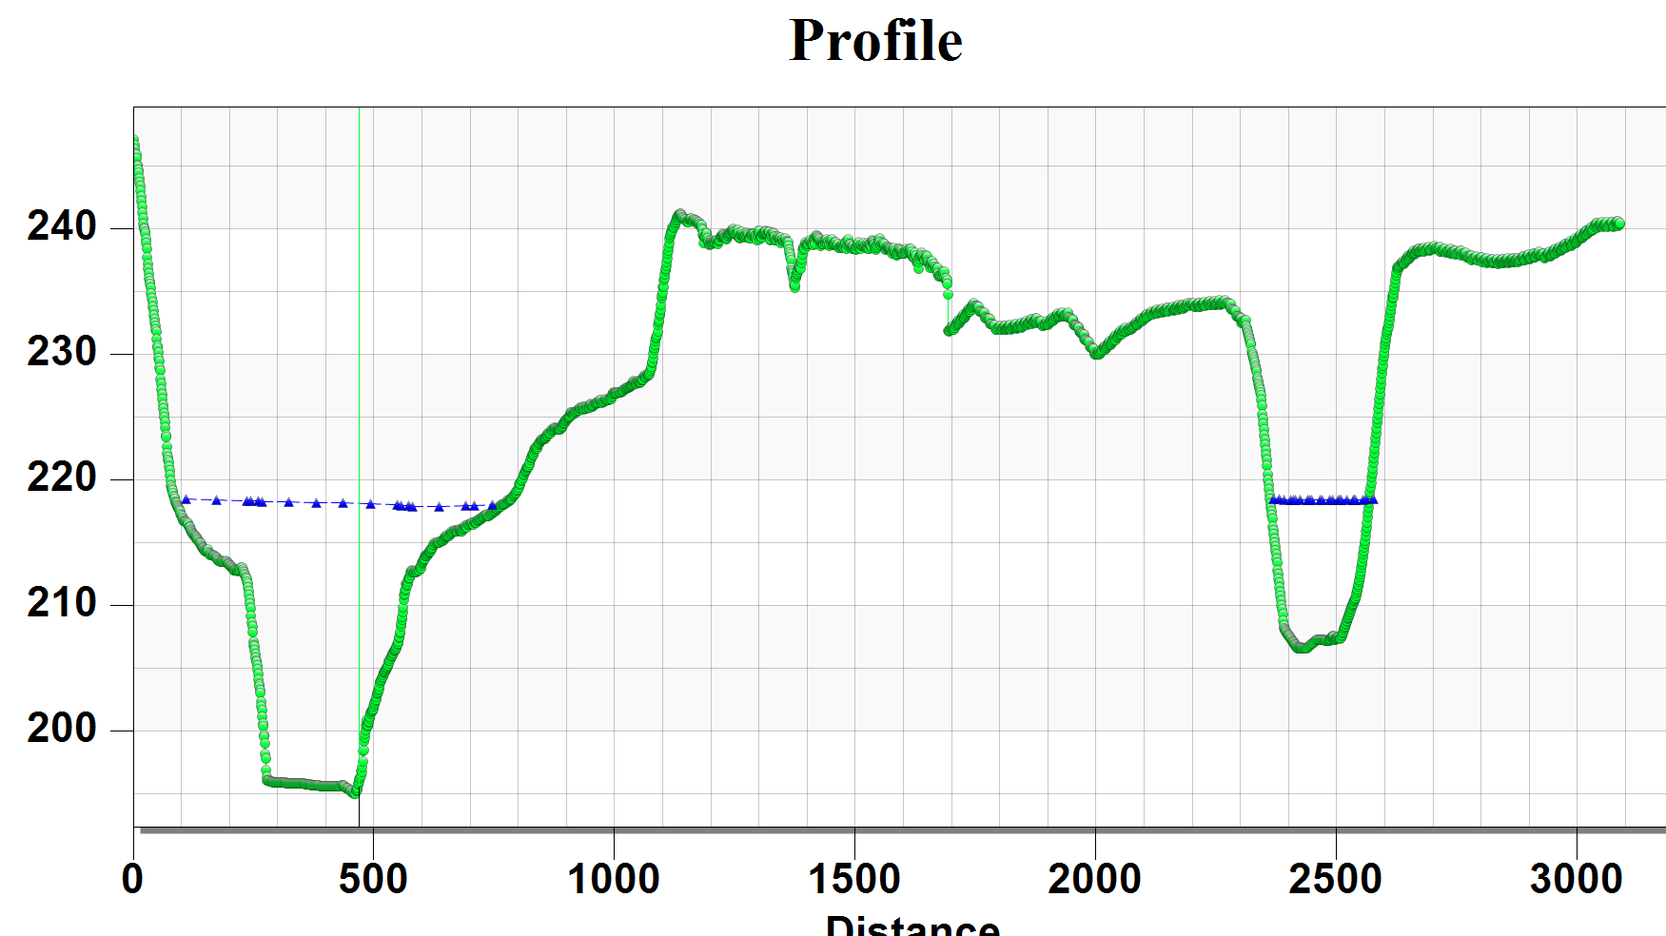
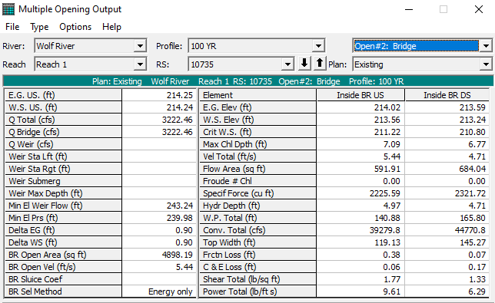
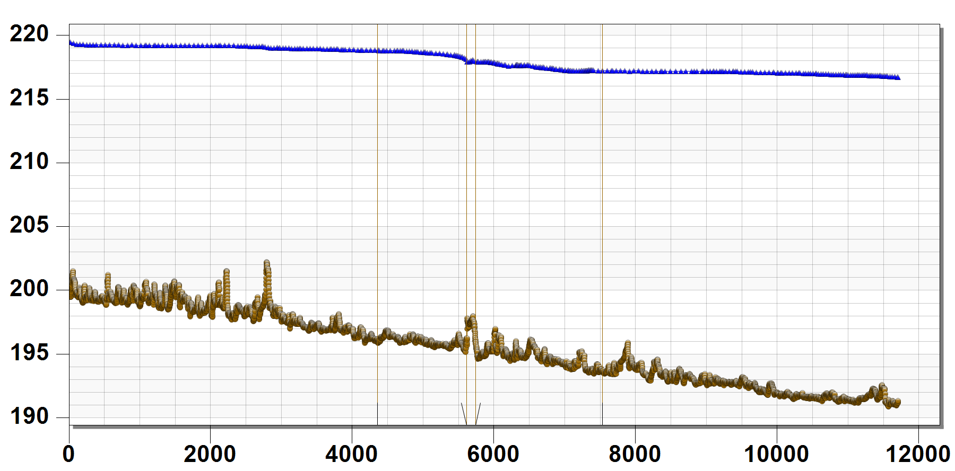
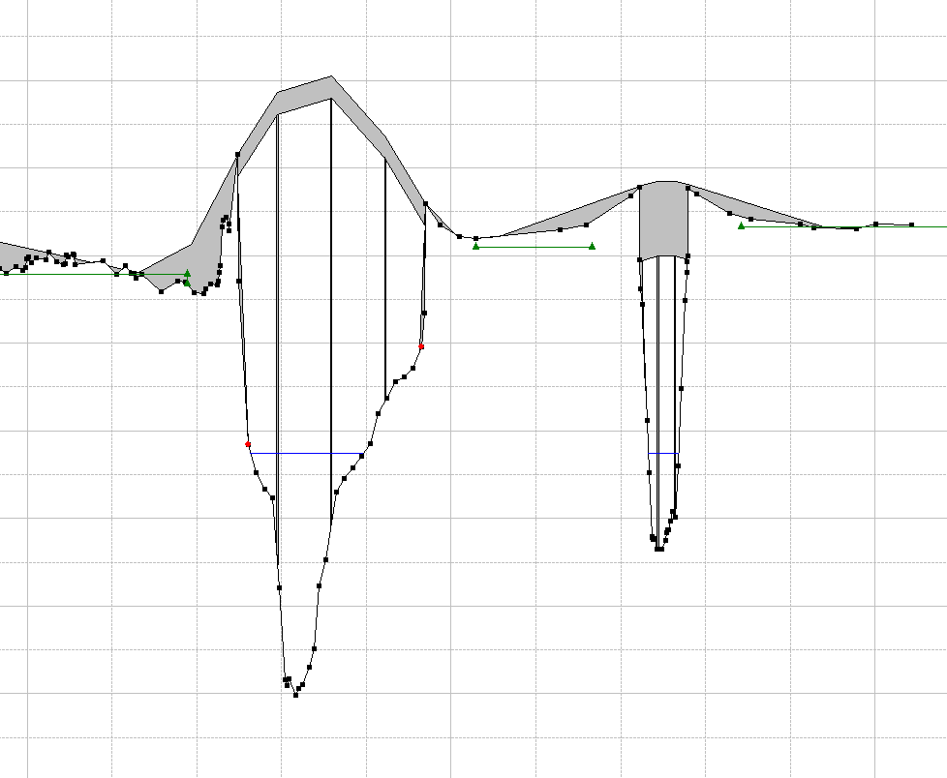
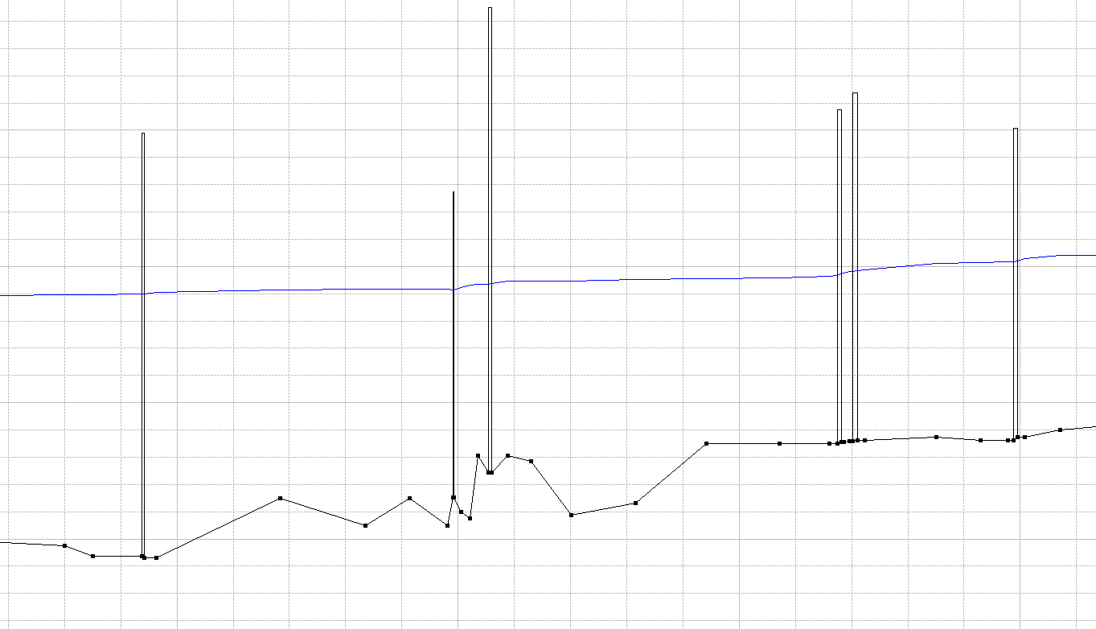
Data Comparison: 1D to 2D
Notes:
Taking a quick look back at the original HEC-RAS 1D model, we were able to see very comparable results for water surface elevations and velocities near at the bridge location. It was good to see the similarities in the output between the two modeling methods. And moving forward, it will be good to see how modifications in various input parameters produce updated results using both modeling systems.

Slide 28
Notes:
Then, finally, just to track the possible flow paths when there are no controlling tailwater impacts downstream, tailwater conditions were removed, and the flow is tracked strictly from the upstream reach of the Wolf. That’s what these last few slides will show.

Slide 29
Notes:
And then, as I’m distracting you with the video graphics, I’ll open up the floor for questions.

Slide 30
Notes:
Thank you!

