Slide 1
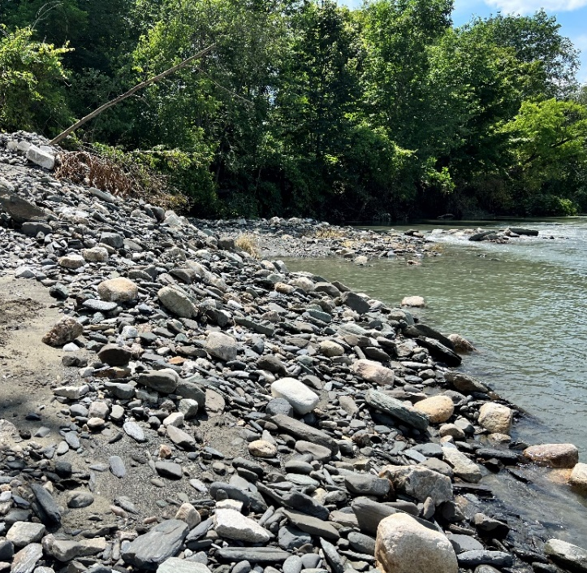
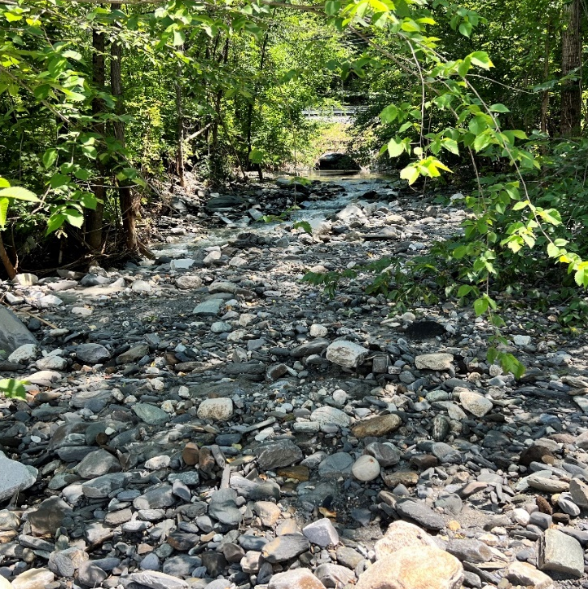
CLIMATE CHANGE ALTERING GEOMORPHIC PROCESSES IN NEW ENGLAND
National Hydraulic Engineering Conference

Slide 2
BIOGRAPHY
Nicole Buck, PE
Senior Hydraulic Specialist/Water Resources Practice Lead
Transportation
B.S. Civil Engineering & B.A. Geology, Bucknell University
M.S. Earth Sciences, Dartmouth College
24 Years Experience in Considering the Water and How it Flows
Technical Drive: Designing Infrastructure Solutions in Harmony with Water and Sediment to Improve Both the Built and Natural Environment

Slide 3
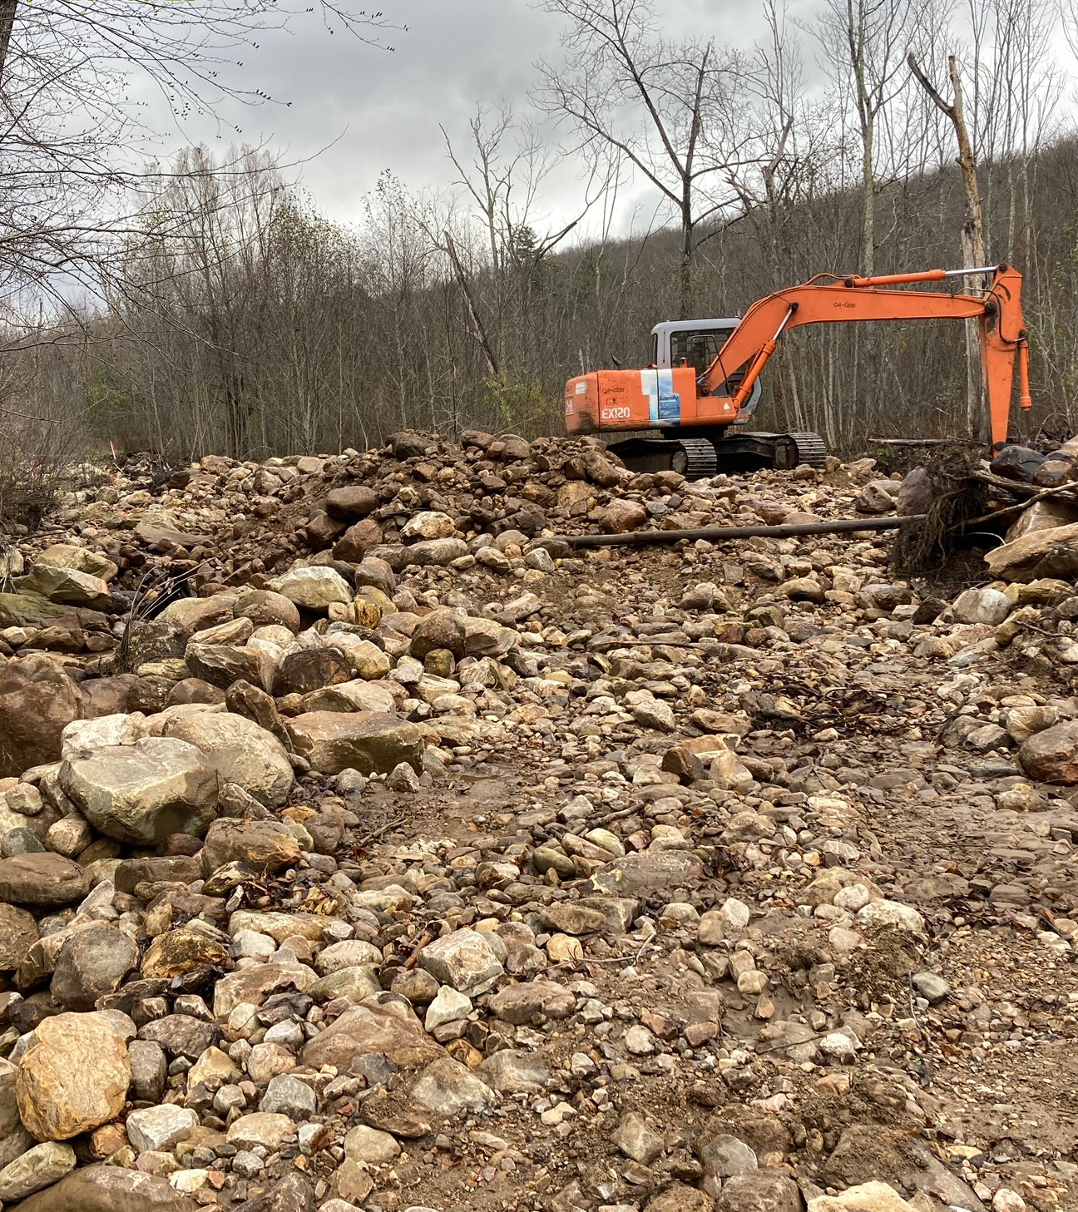
Outline
Climate and rainfall
Climate and geomorphology
Examples of fluvial change in recent years
Hidden alluvial fans
Bourn Brook Example
Big Picture
Image Courtesy of Josh Carvajal (VT ANR)

Slide 4
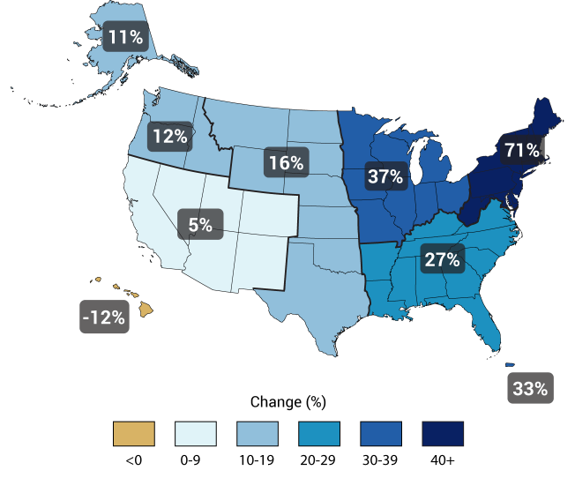
CLIMATE AND RAINFALL
Image by US Global Change Research
Third National Climate Assessment
Changes in Precipitation Percentages, Focusing on Instances of Very Heavy Rainfall from 1901 to 2012 (Heaviest 1% of all daily events)

Slide 5
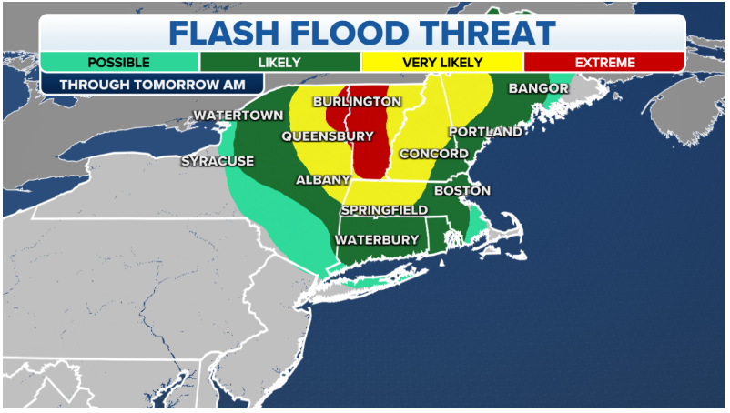
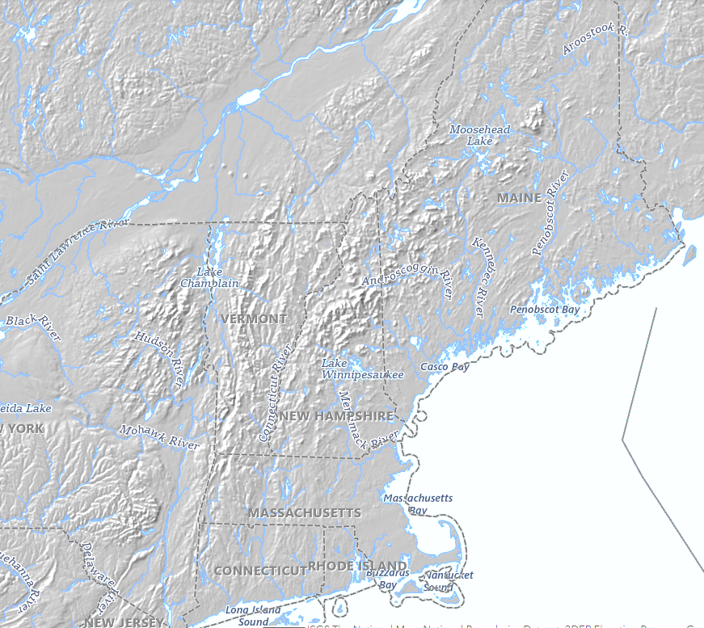
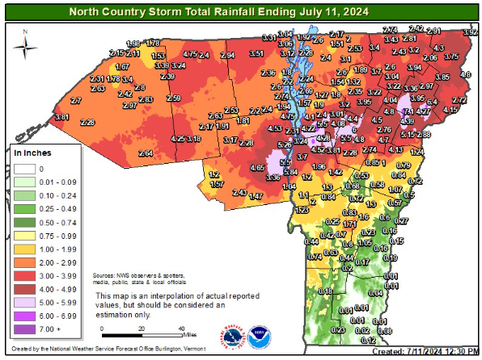
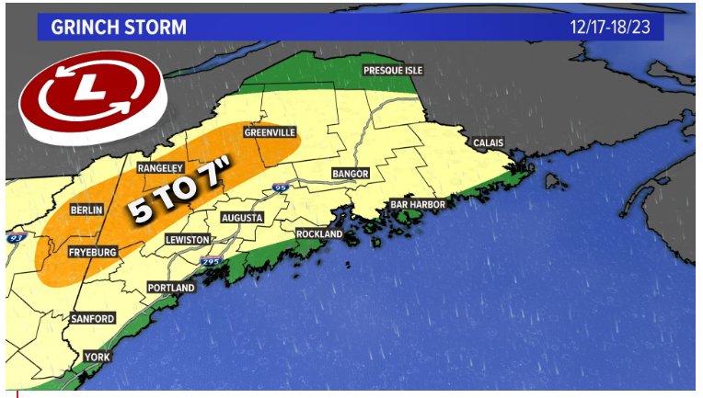
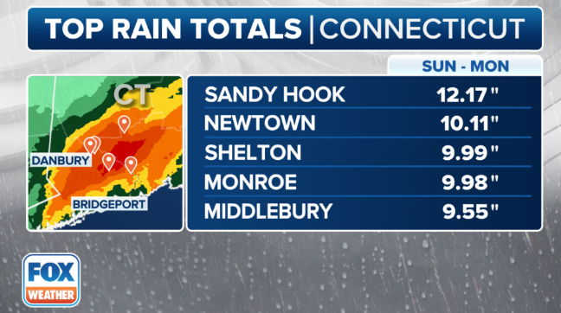
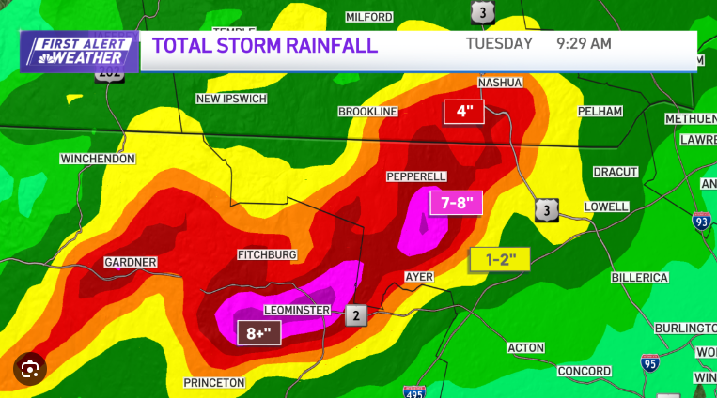
2023-2024 in New England
7/23
12/23
7/24
8/24
9/23

Slide 6
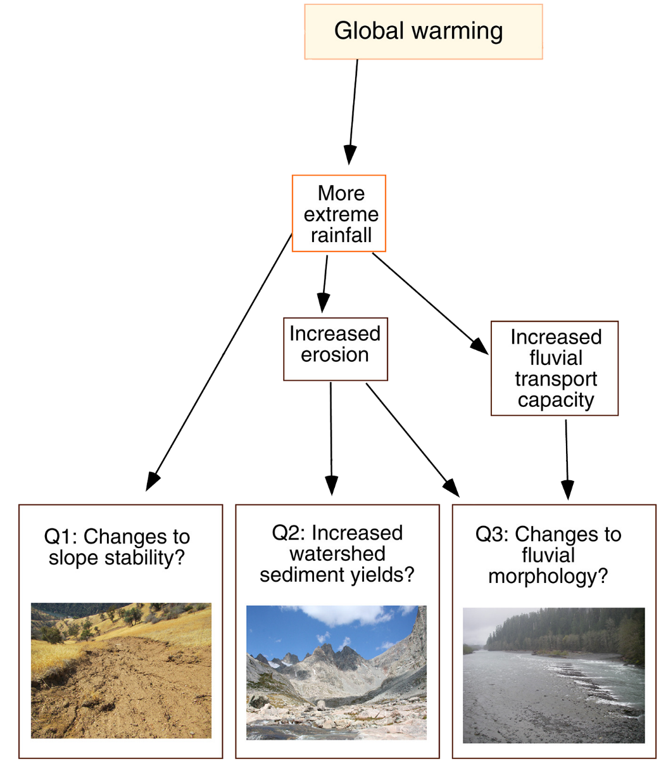
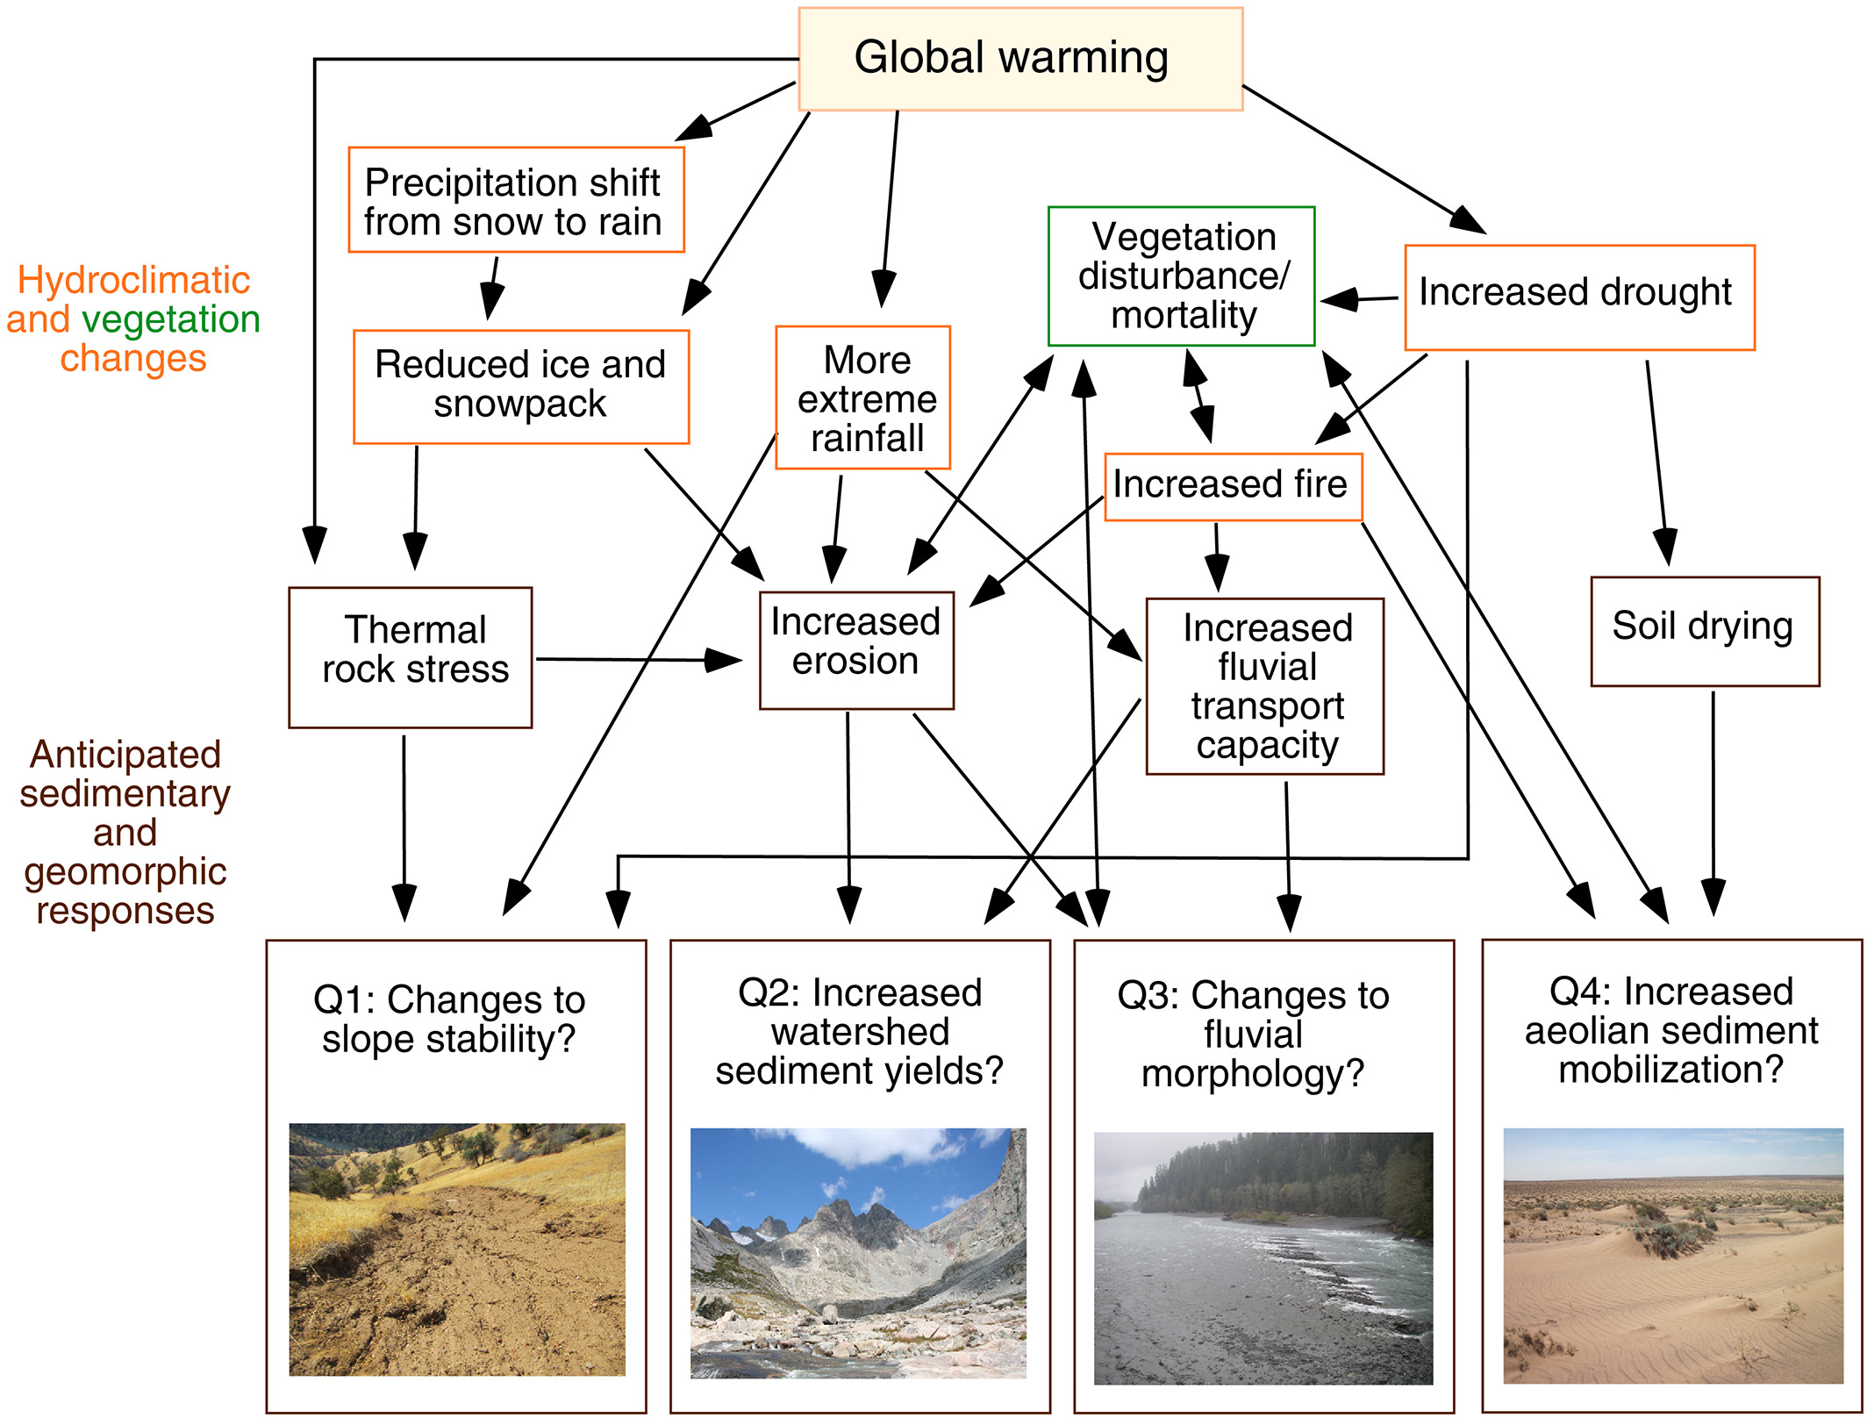
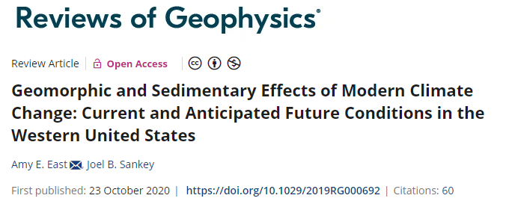
GEOMORPHIC CHANGE?

Slide 7
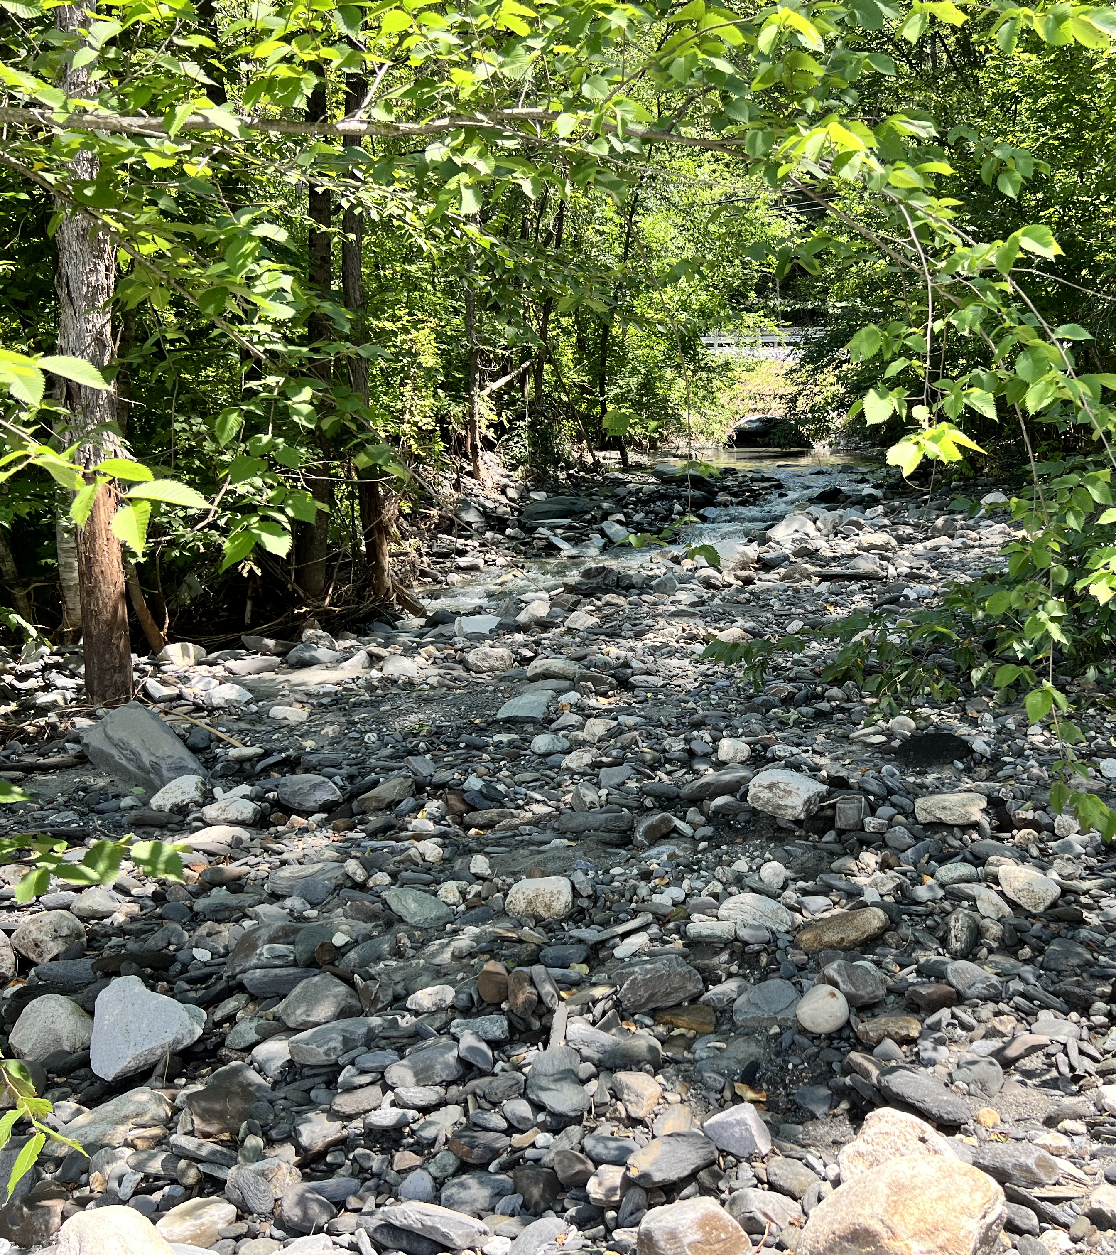
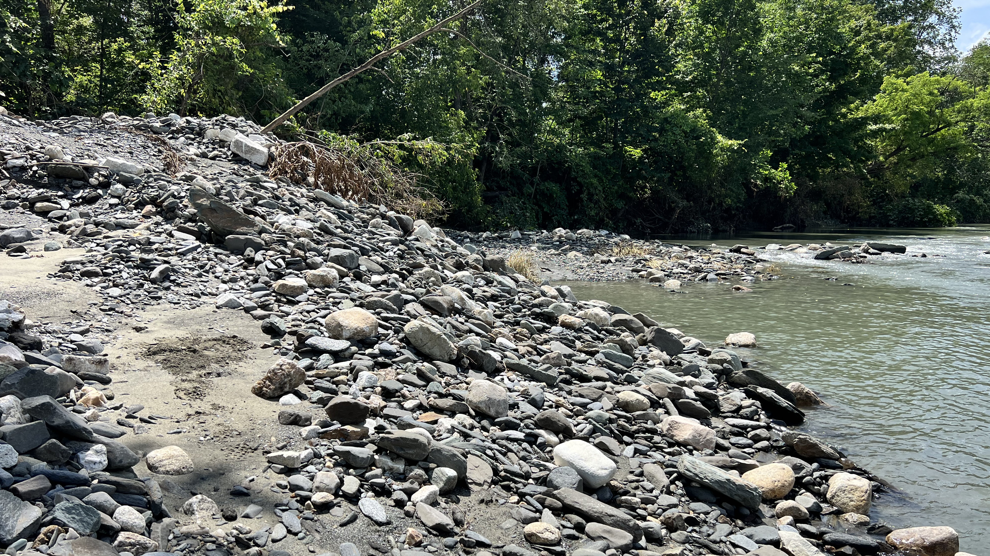
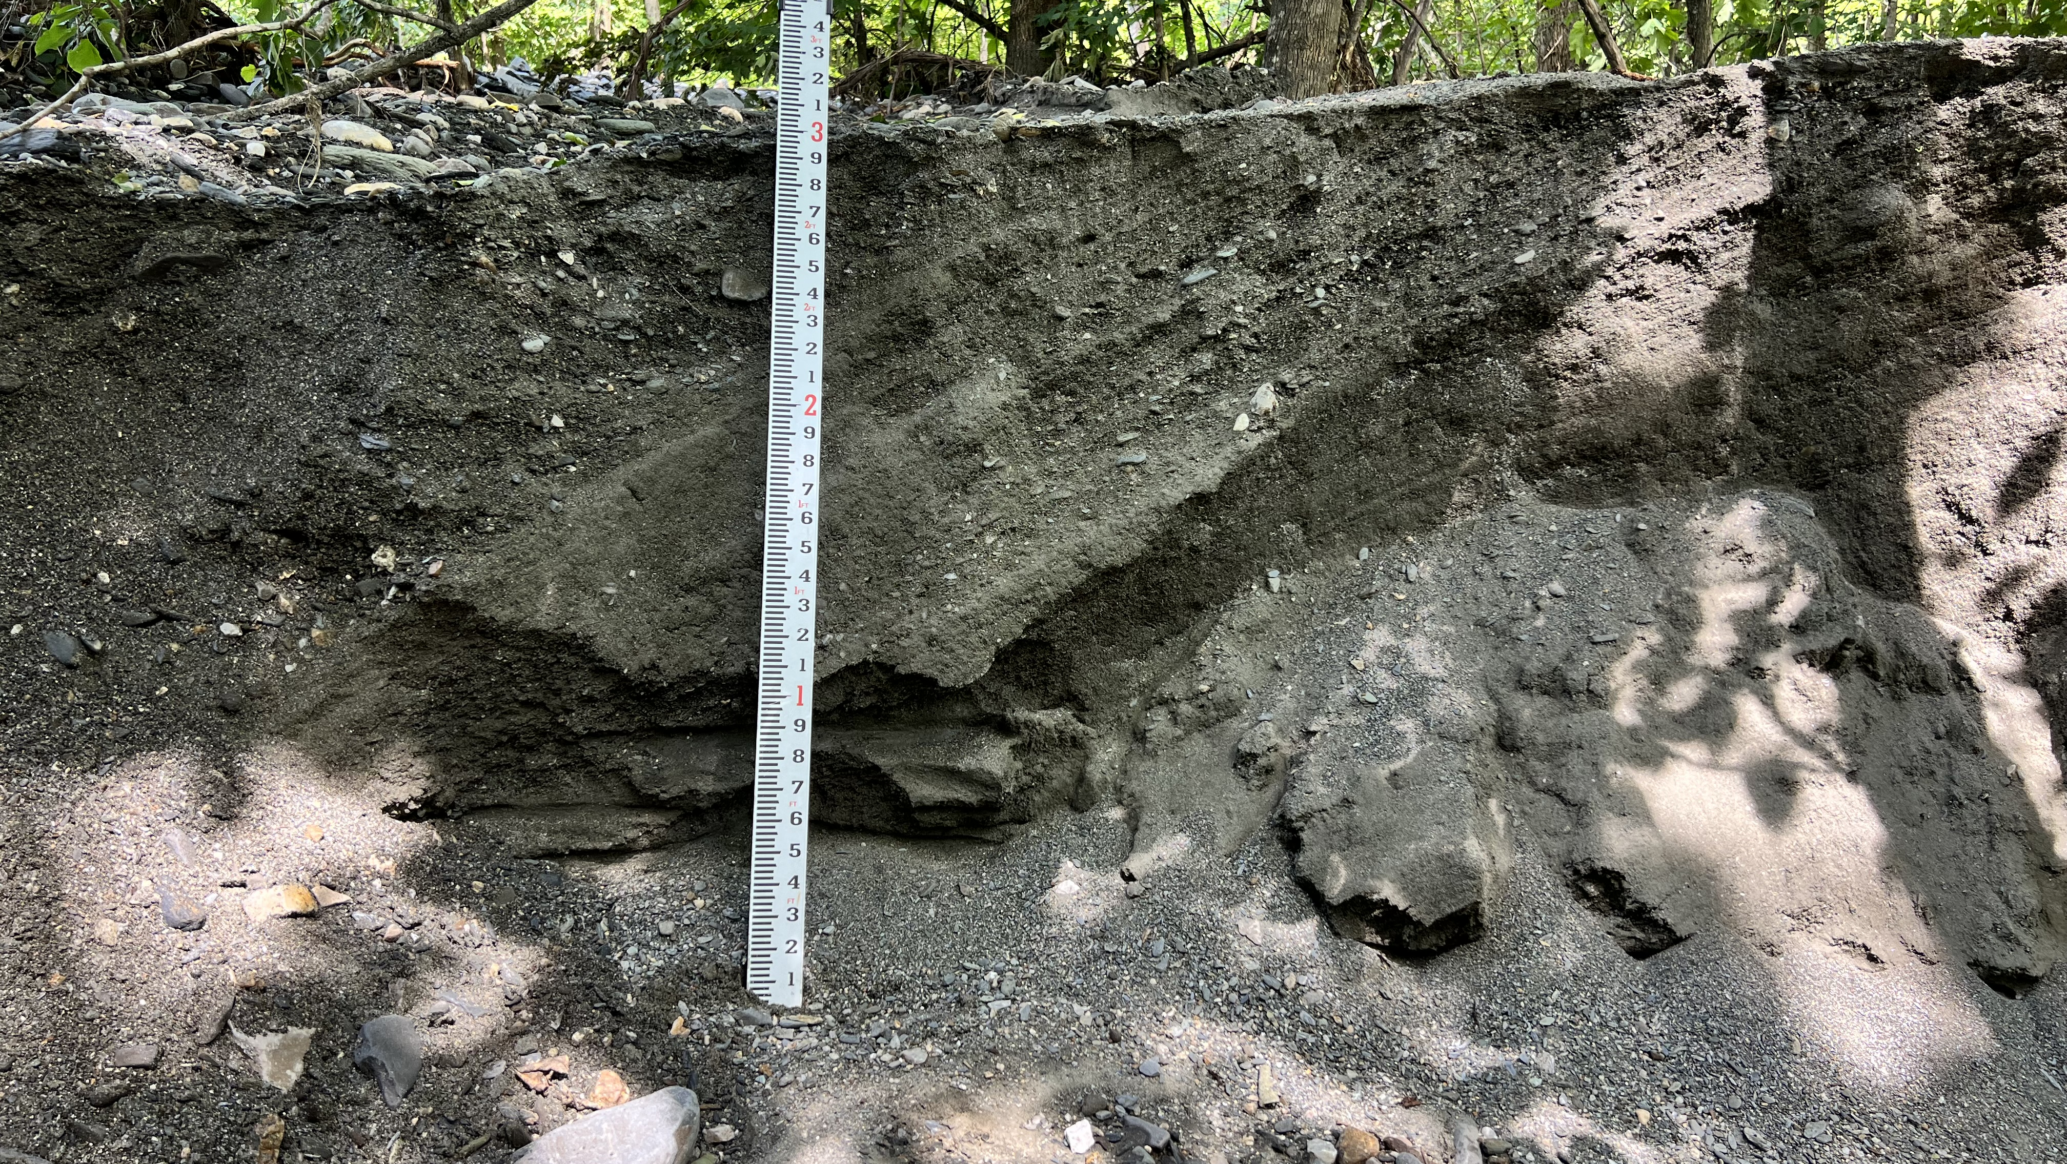
AFTER FLOODING RECEDES (BETHEL, VT) 2023

Slide 8
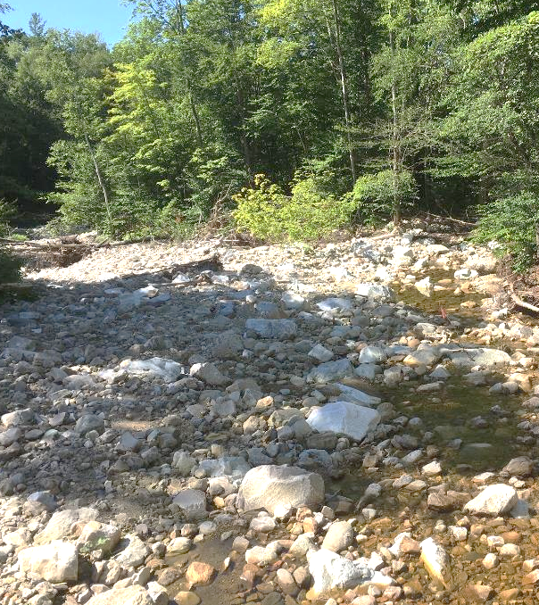
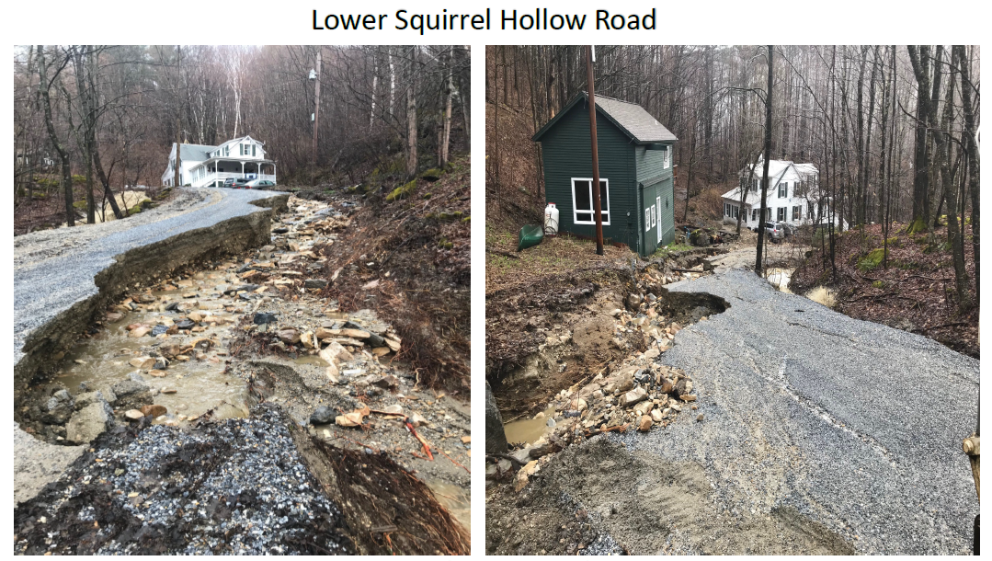
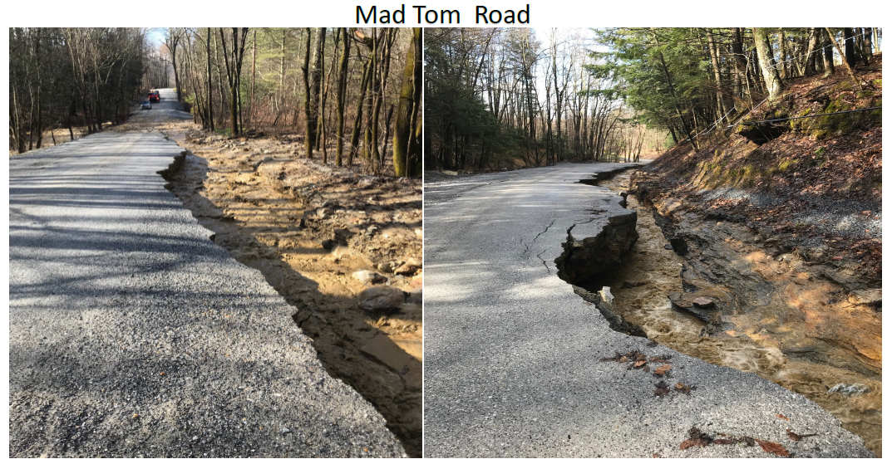
APRIL 2019: AFTER FLOODING RECEDES (DORSET, VT)
Image Courtesy of Josh Carvajal
Images Courtesy of Rob Gaiotti

Slide 9
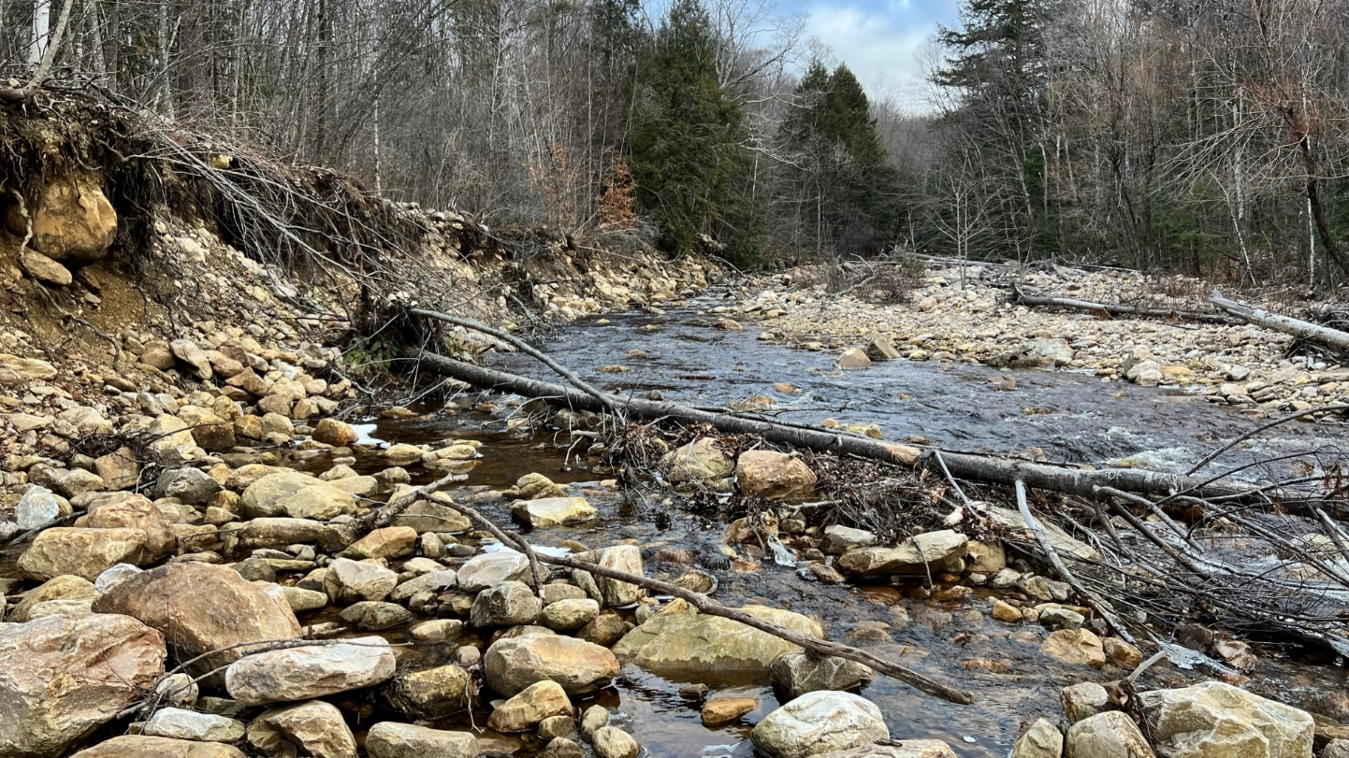
LYE BROOK – UNLIMITED INCOMING MATERIAL

Slide 10
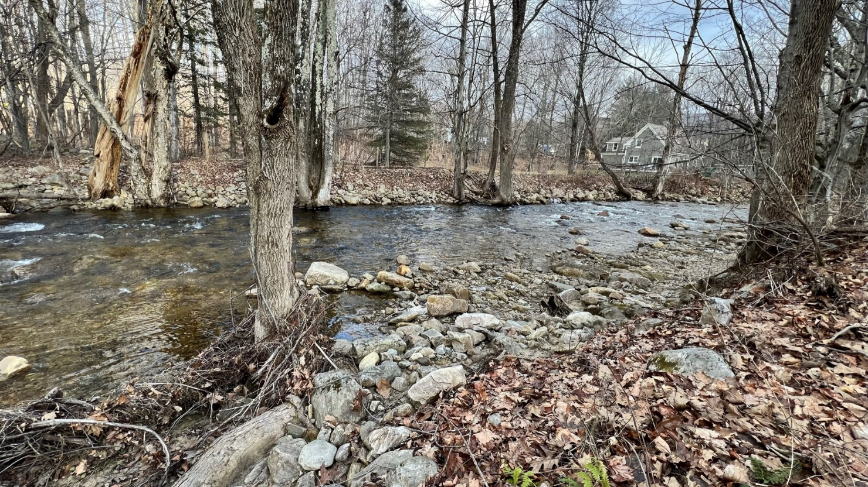
CHANNEL AGGRADATION

Slide 11
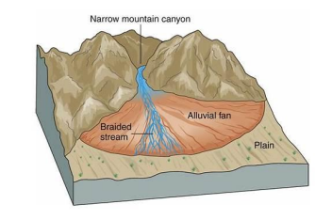
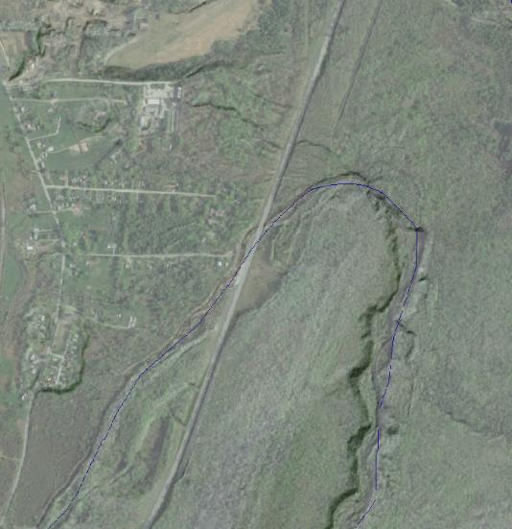
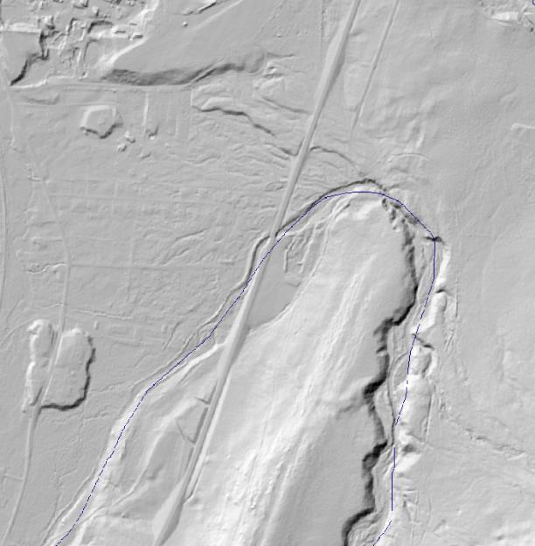
ALLUVIAL FAN GEOMORPHOLOGY
Alluvial Fan
Mountain Sediment is Transported Down Steep Streams and Deposited when the Stream Flattens Out
Streams Become Clogged with Sediment and Shift Location
Steep Stream

Slide 12
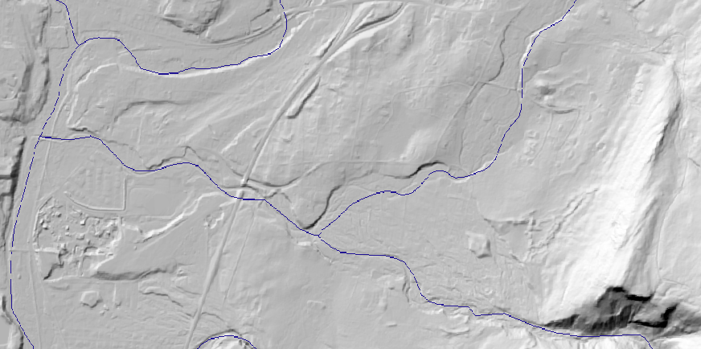
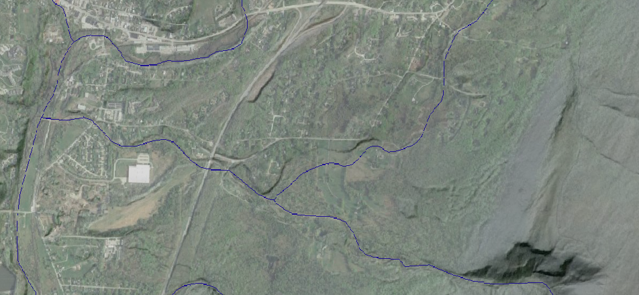
BOURN BROOK ALLUVIAL FAN
Bourn Brook
Two Active Alluvial Fans
Eastern Fan is Visible with Bourn Brook Frequently Changing where it Joins Bromley Brook

Slide 13
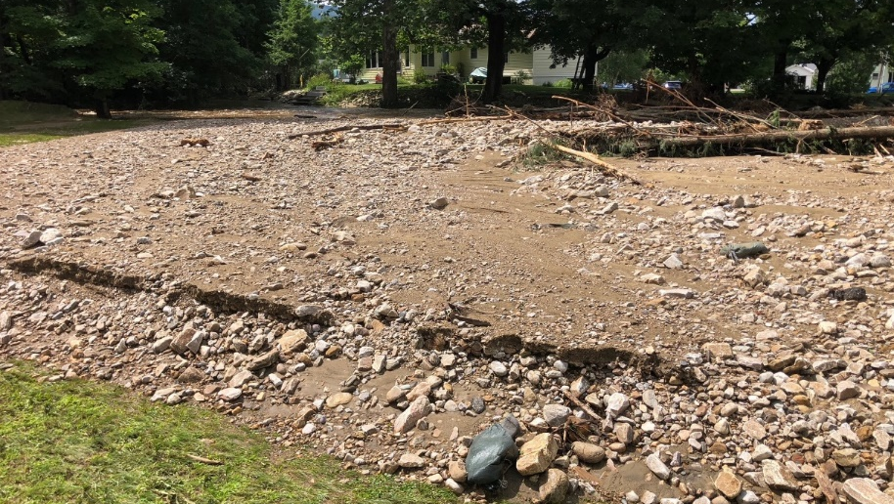
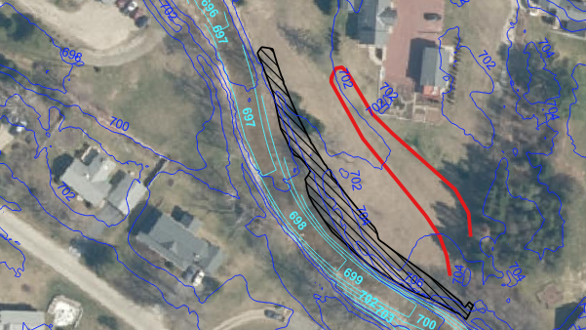
CHANNEL AGGRADATION
DEPOSITION
DEPOSITION

Slide 14
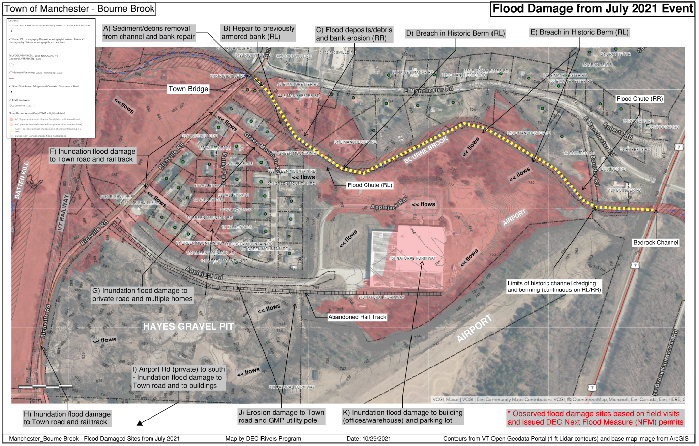
BOURN BROOK JULY 2021 DAMAGE

Slide 15
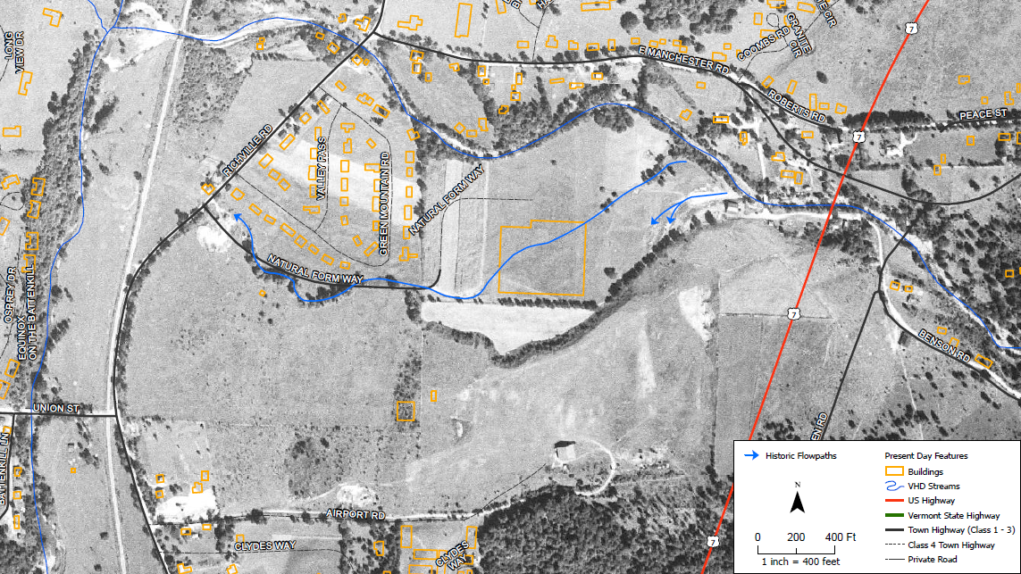
PRE-DEVELOPMENT FLOW PATHS (BOURN BROOK)
Graphic: Fitzgerald Environmental Assoc.

Slide 16
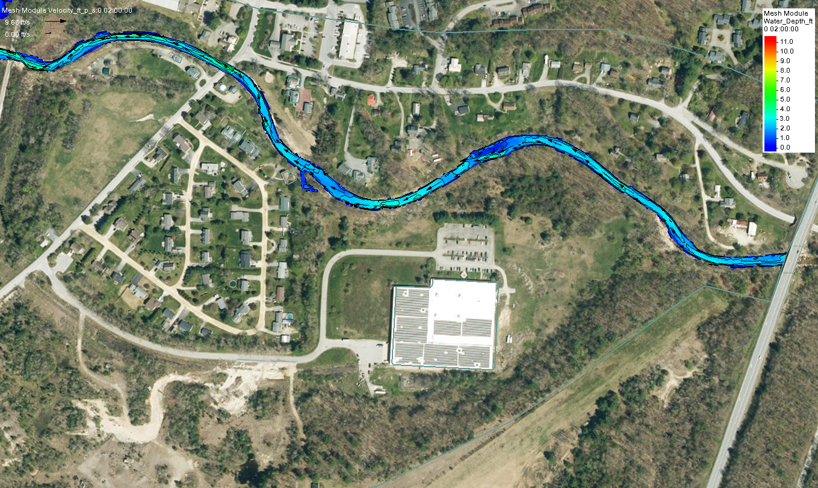
EXISTING CONDITIONS (OHW)

Slide 17
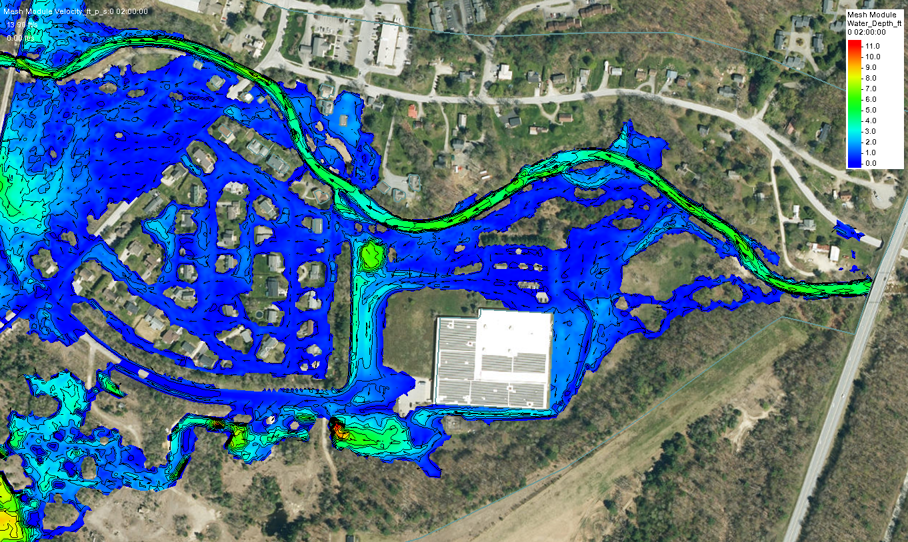
EXISTING 10-YEAR

Slide 18
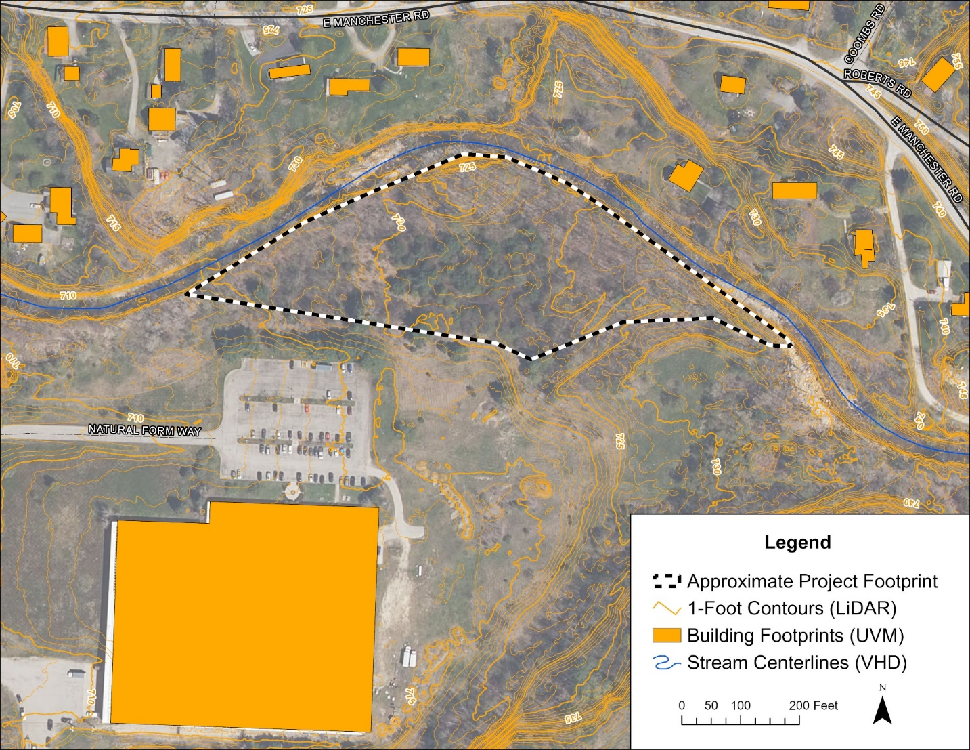
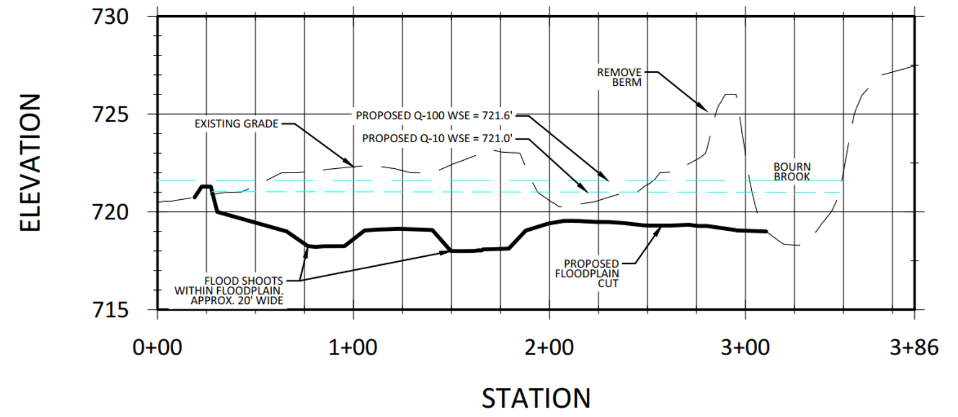
CONCEPTUAL DESIGNS
Bourn Brook - Alternative C
Berm Removal on Inside Bend
Floodplain Restoration (4 acres)

Slide 19
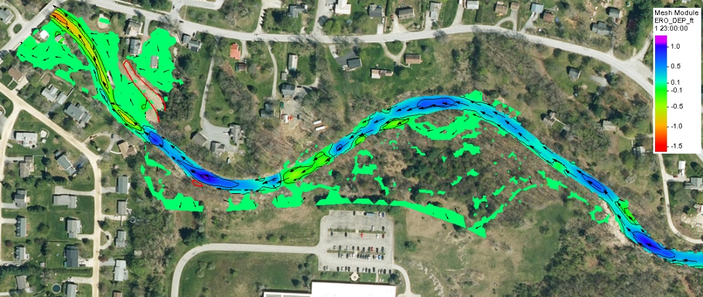
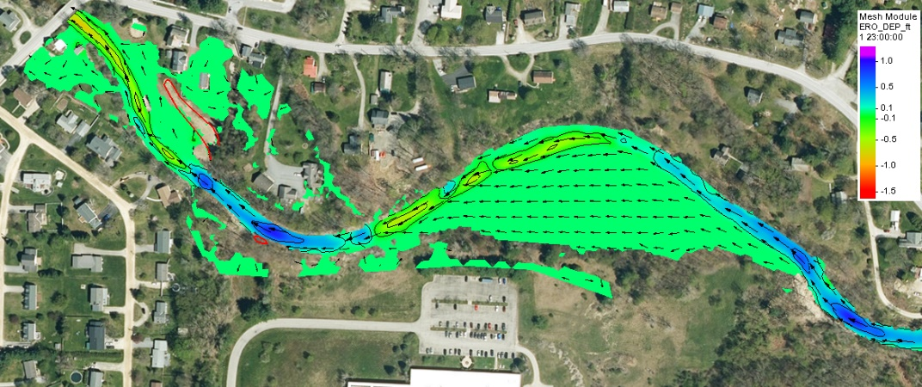
SEDIMENT TRANSPORT MODEL RESULTS
Blue – 0.5-1.0’ Erosion
Green -> minimal disposition
Yellow -> Red 0.5-1.5’ deposition
Alternative C disperses flow allowing deposition US of Residential Area.
Minimizes deposition around bridge
Existing Conditions with NRCS Work
Alternative C

Slide 20
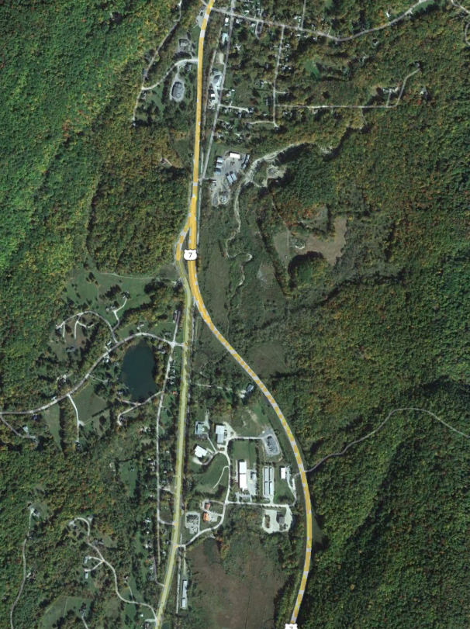
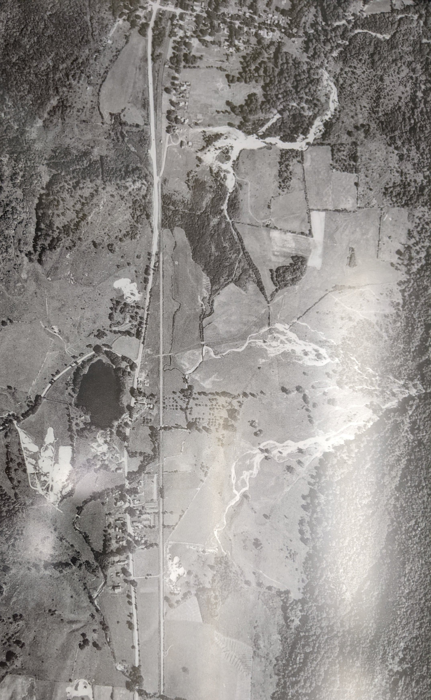
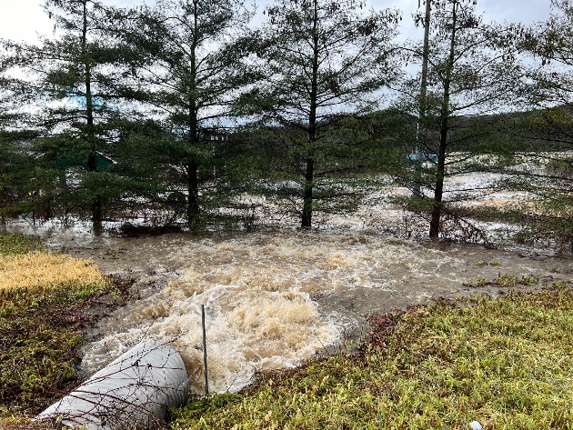
BIG PICTURE: CLIMATE CHANGE AND RESILIENCY
Incorporating Landscape Evolution Ideas into Designs is going to be Critical to Creating Resilient Solutions in the Future
Courtesy of Rob Gaiotti – Town Manager

Slide 21
Acknowledgements
Fitzgerald Environmental
Ellen O’Brien, P.E.
Dorset Town Manager – Rob Gaiotti
VT River Management Engineer – Josh Carvajal
Bennington County Regional Commission (BCRC)
Michael Batcher (retired) and Jim Henderson
Ripple Natural Resources – Matt Murawski, P.E.
VTrans for sharing their initial investigations
Vermont Rail System (VTS) – RT Boucher

Slide 22
QUESTIONS?

Slide 23
CONTACT
Nicole Buck, PE
Senior Hydraulic Specialist
nbuck@mjinc.com

