Slide 1
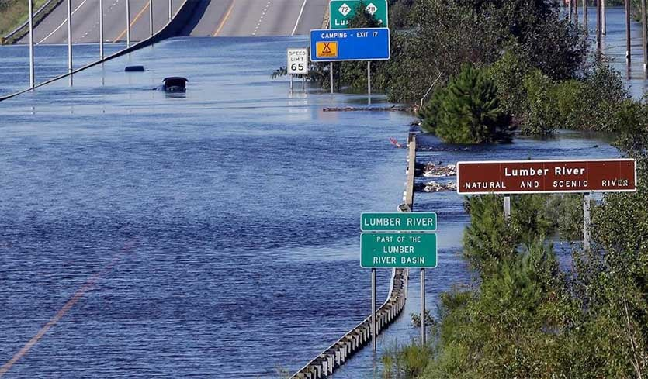




Evaluating Flood Resiliency of Interstate 95 Improvements Using 2D Rain-on-Grid Modeling Incorporating Effects of Climate Change
  Tyler R. Longberry, PE, CFM – AECOM Technical Services
  David R. Markwood, PE – Summit Design and Engineering Services
  Matt Lauffer, PE, CPM – NCDOT
  ¹Simulated Hurricane Event Rainfall by Dr. Katy Hollinger and Dr. Gary Lackmann, NCSU
  ²Future Recurrence Interval Rainfall by Dr. Jared Bowden, NCSU
Lumber River flooding at Interstate 95, Hurricane Florence (AP Photo/Gerry Broome)

Slide 2
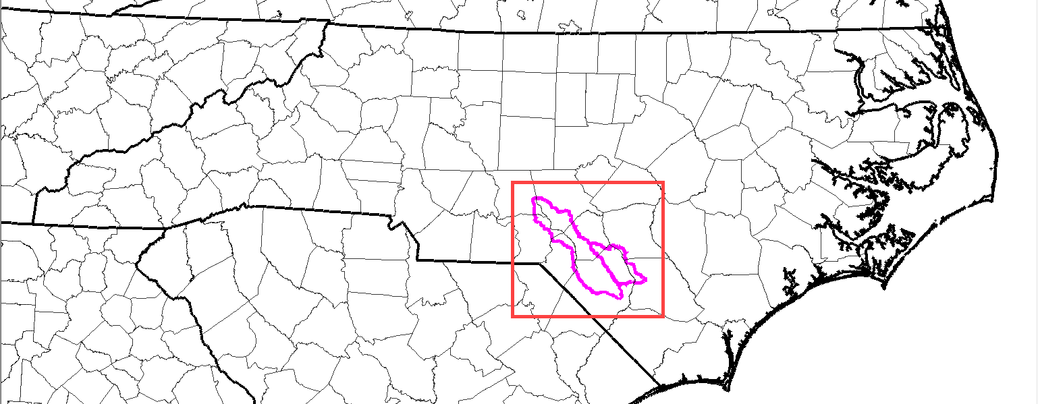
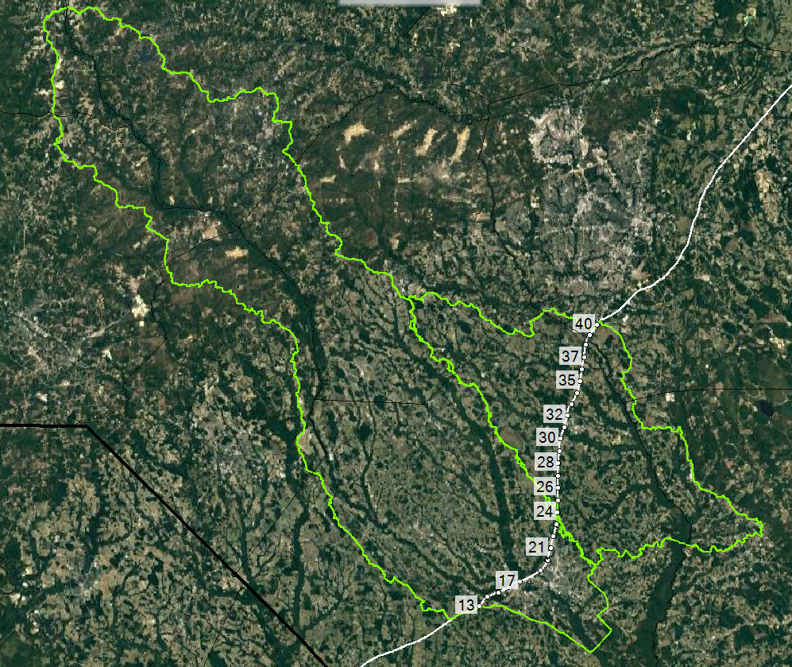
Overview of I-95 (MM13-40)

Slide 3
Overview
Objectives and Goals
Modeling Approach
  Gridded Rainfall
  2D Rain-on-Grid Rainfall-Runoff
Stress Test Evaluation
Challenges and Limitations
Future Applications

Slide 4
Objectives and Goals
Evaluate Flood Resilience of I-95 improvements using 2D Rain-on-Grid and Future Rainfall
  Demonstrate standards for identifying vulnerability of roadway overtopping during extreme events
  Demonstrate practicality and utility of using rain-on-grid for various size watersheds
Implement various sources of spatially-varied gridded rainfall in HEC-RAS
Future Applications
  Better tools to support critical infrastructure planning, design, and operations
  Flood and Operational Forecasting, “Nowcasting”
  Probabilistic, Uncertainty
  Approach a 2D Mesh Probabilistic Map Library

Slide 5
Modeling Approach
Gridded Rainfall
2D Rain-on-Grid Runoff
  2D Mesh development
  Terrain – I-95 improvements
  Bridges and Culvert – I-95 improvements
  Infiltration
Stress Test evaluation

Slide 6
Gridded Rainfall Sources
Observed – NOAA Multi-Radar Multi-Sensor Quantitative Precipitation Estimate (MRMS QPE)
Simulated – WRF simulated hurricanes¹
  NCAR’s Weather Research and Forecasting (WRF) model – simulated observed hurricanes
  WRF with Pseudo-Global Warming (WRF-PGW) – simulated future hurricanes
  WRF-PGW Shifted – shifted to align maximum rainfall on area of interest
Recurrence Interval
  NOAA Atlas 14 with Future Ratios – incorporating downscaled climate change data through 2100²
  ¹Katy Hollinger, Gary Lackmann, NCSU ²Jared Bowden, NCSU

Slide 7
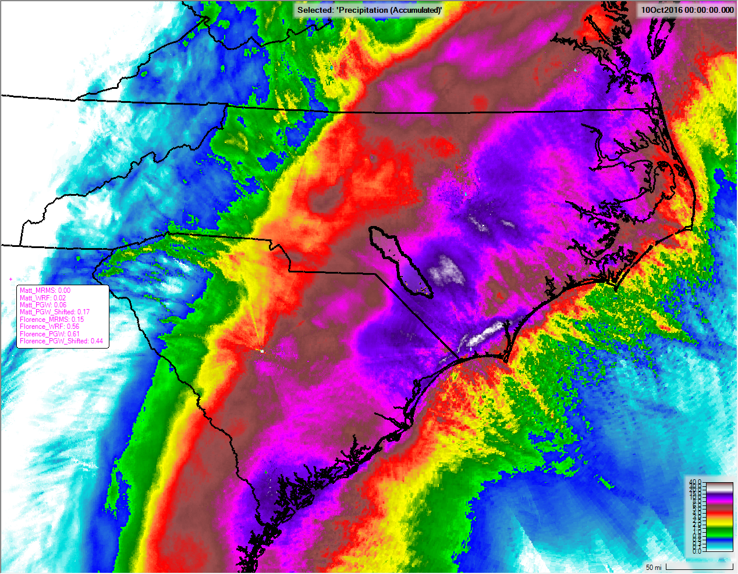
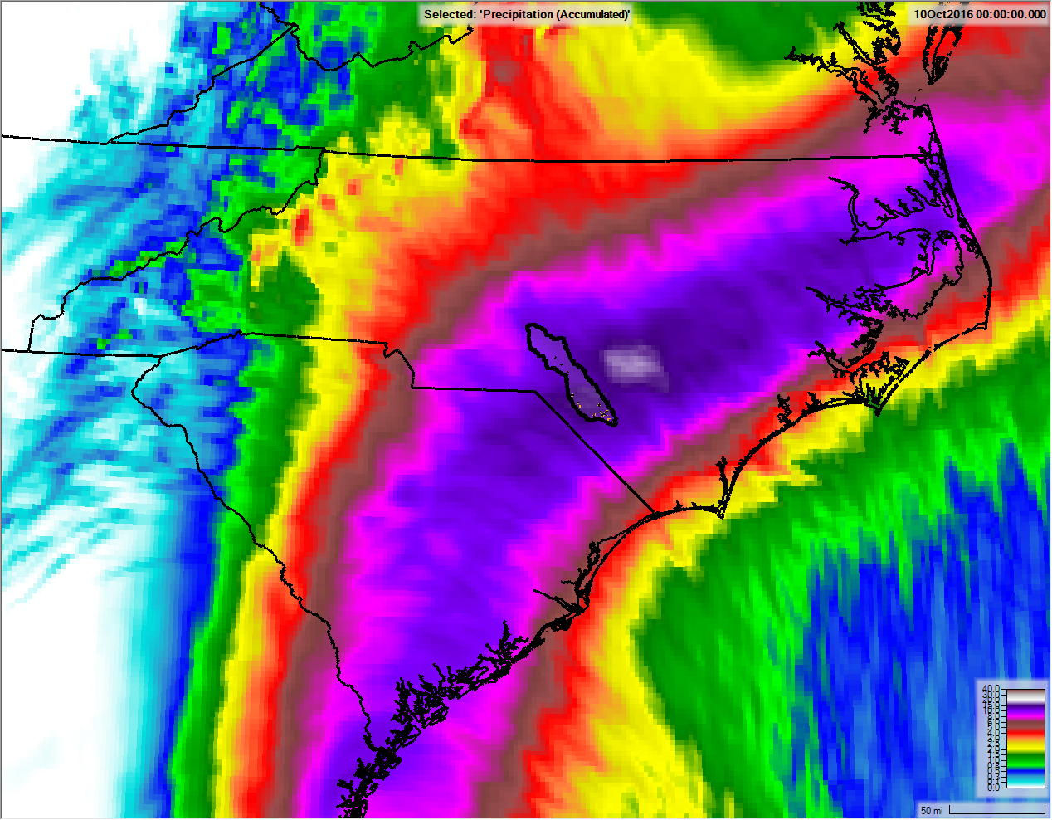

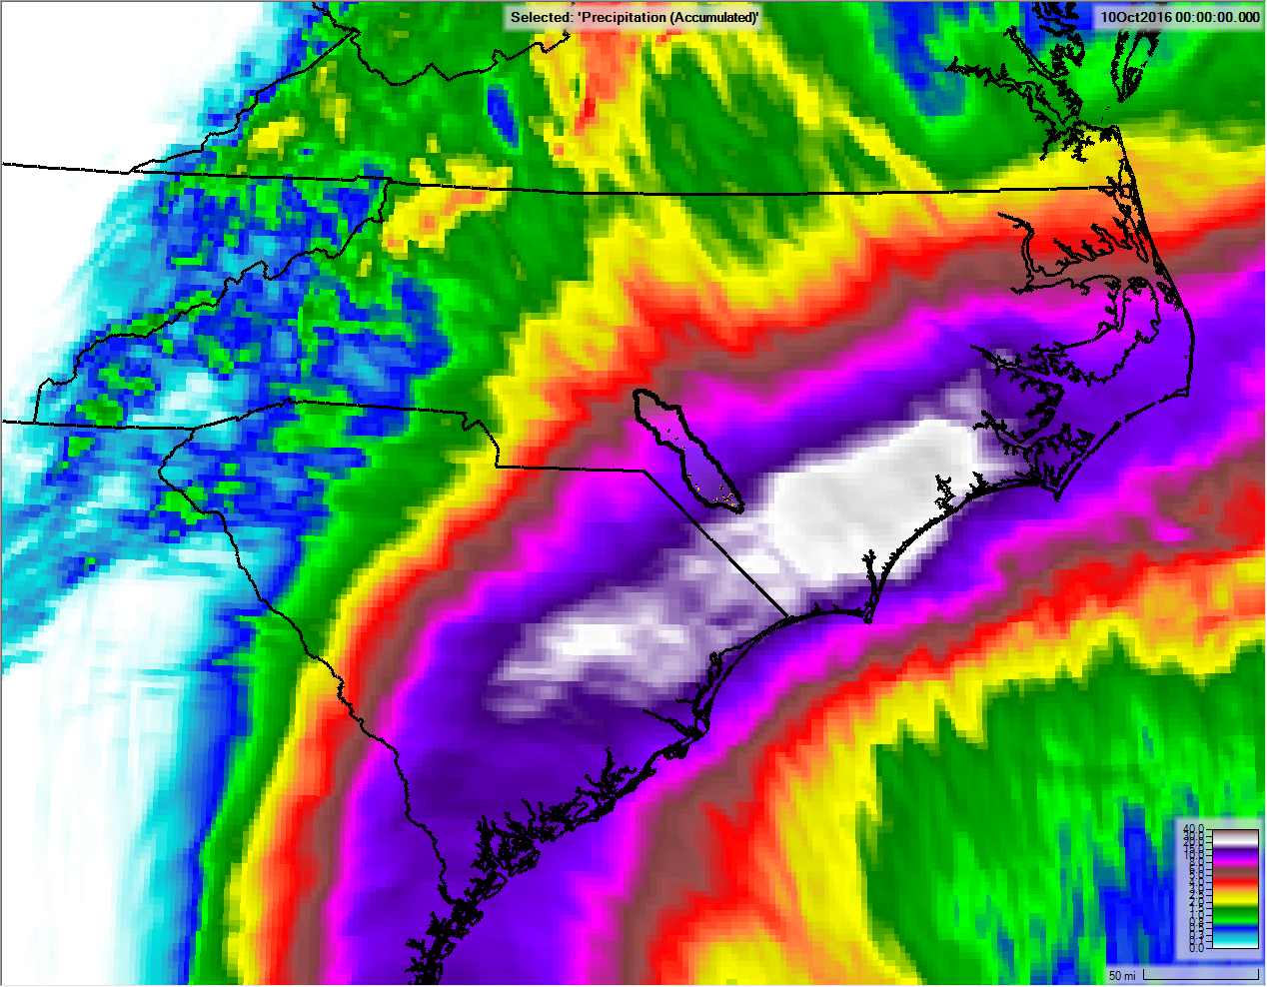
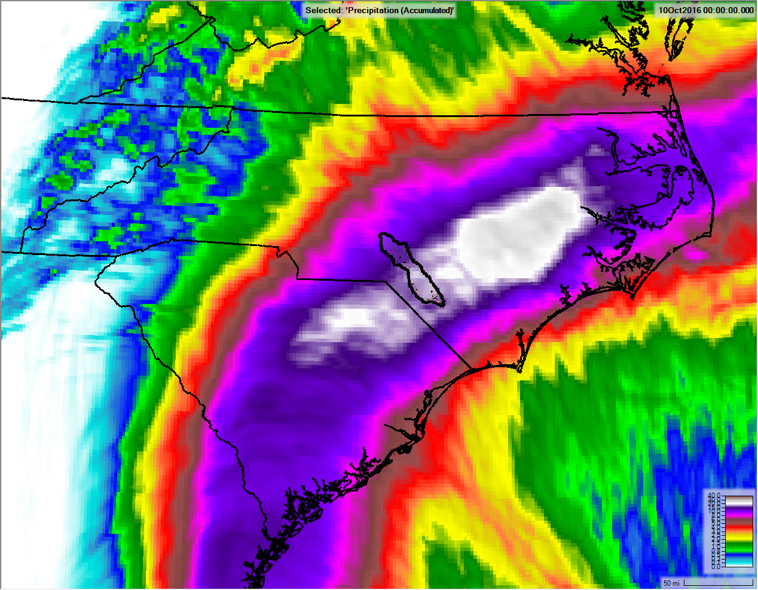
Hurricane Matthew (October 2016)
MRMS
WRF
WRF PGW Shifted
WRF PGW

Slide 8
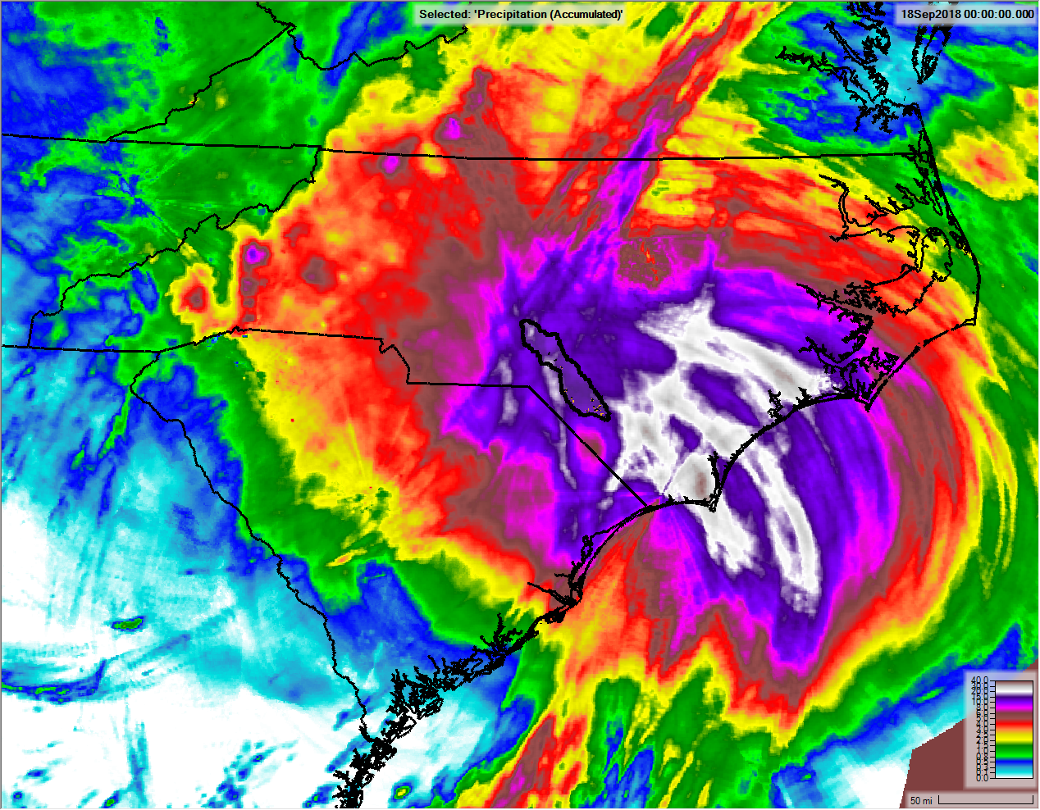
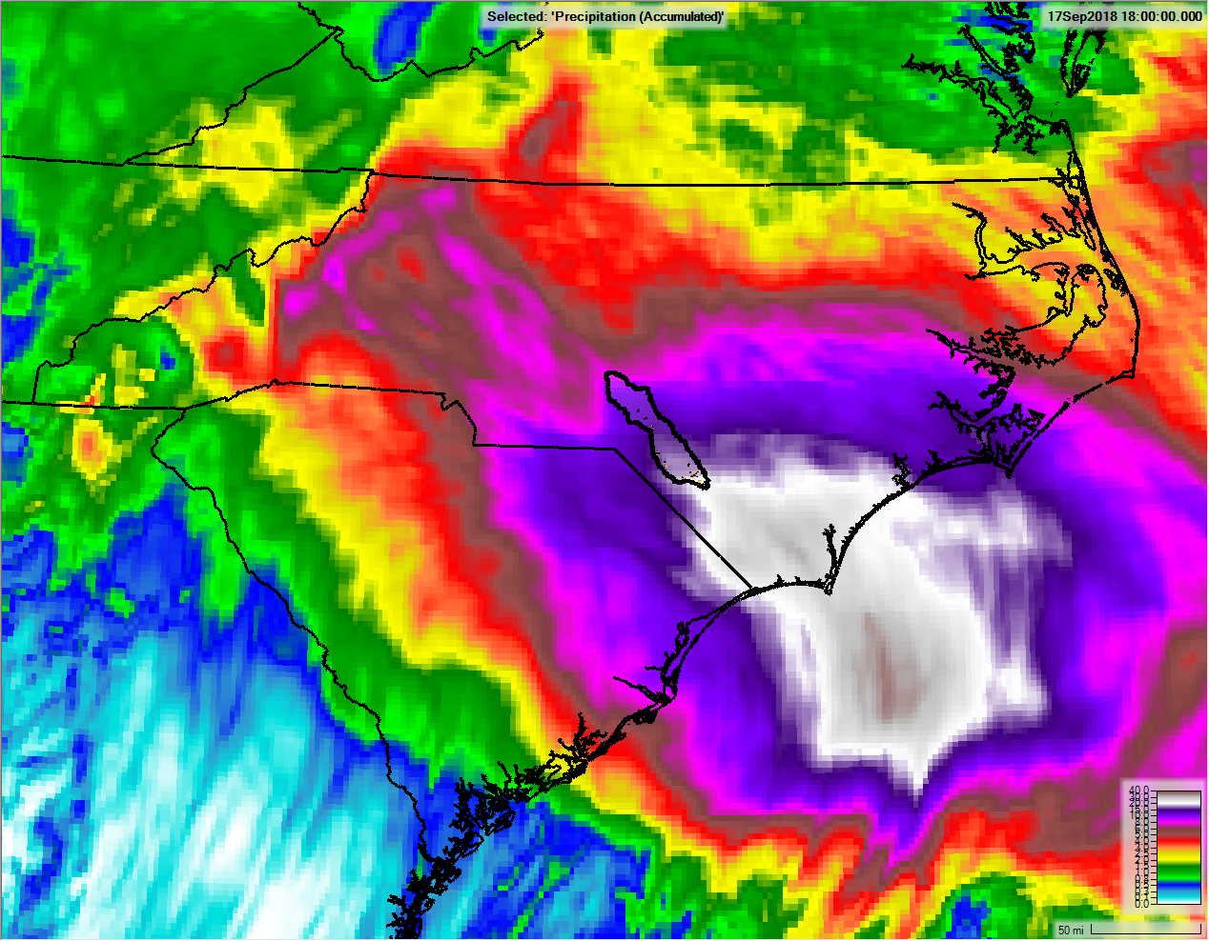
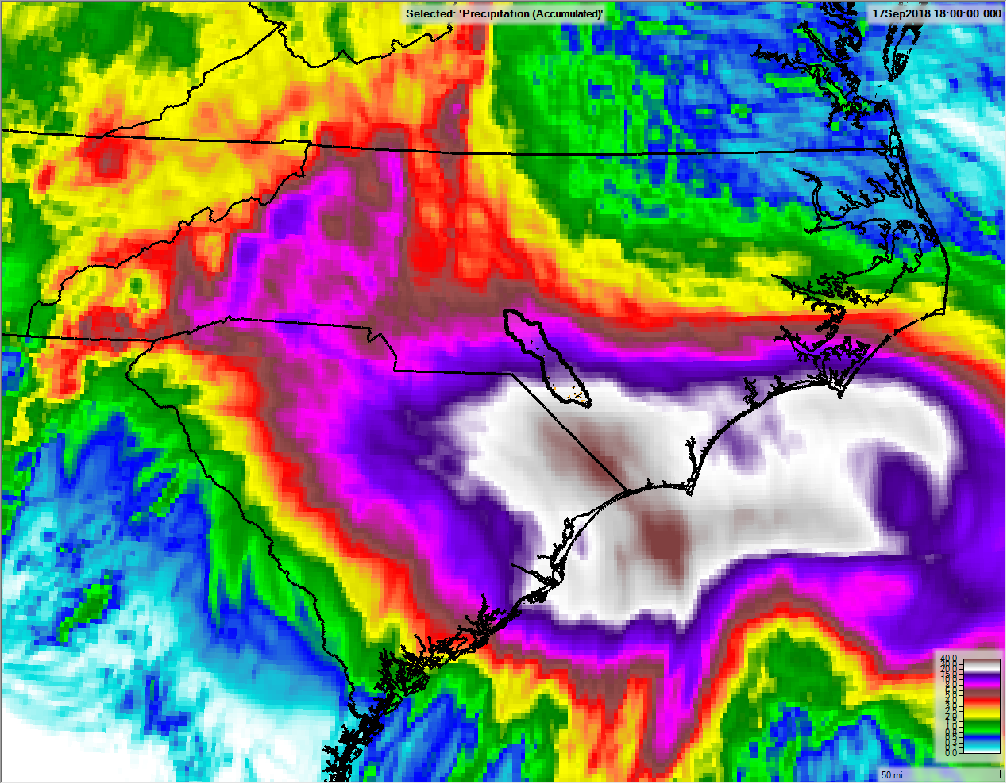
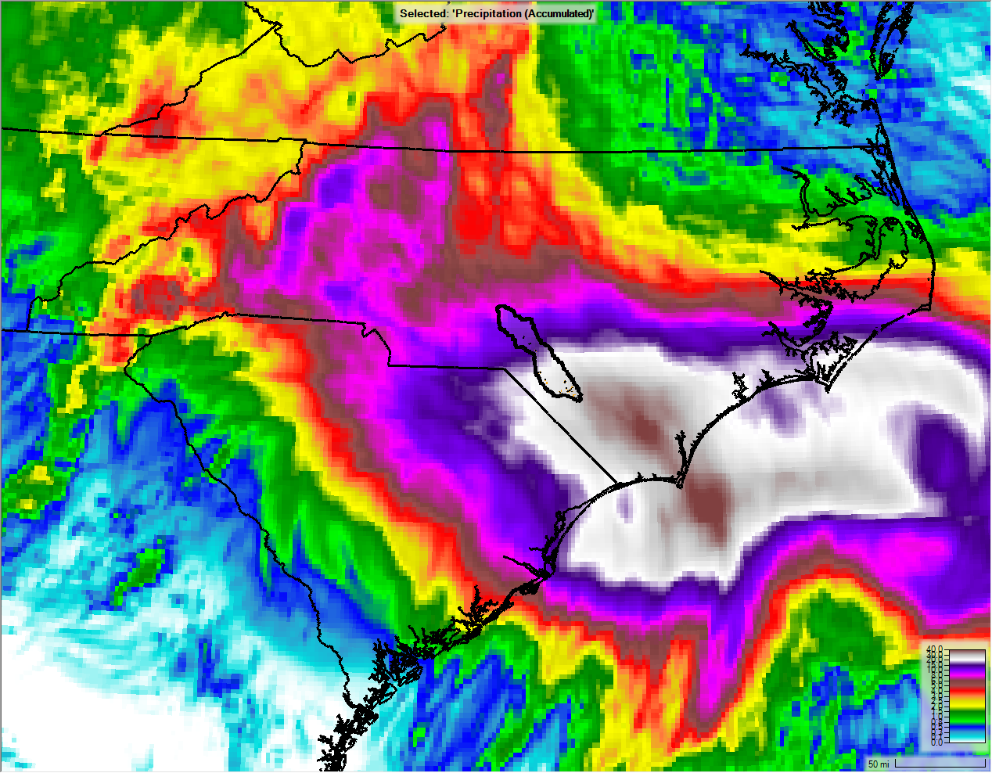
Hurricane Florence (September 2018)
MRMS
WRF
WRF PGW Shifted
WRF PGW

Slide 9
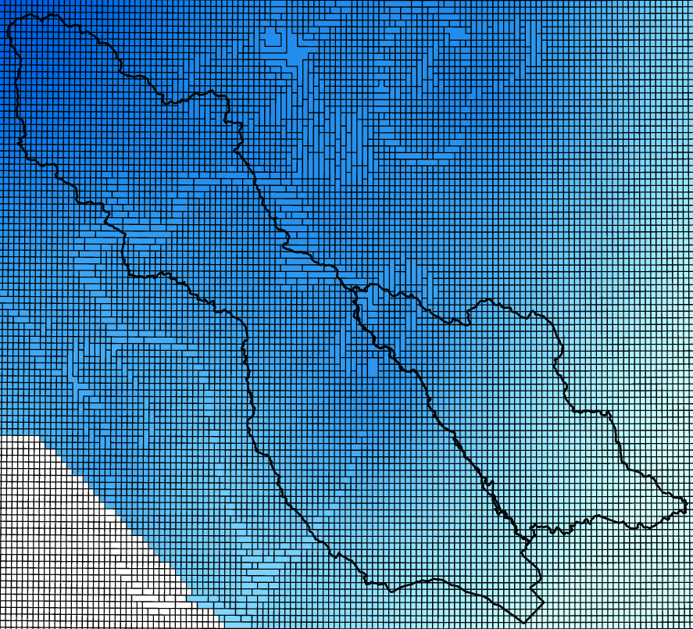
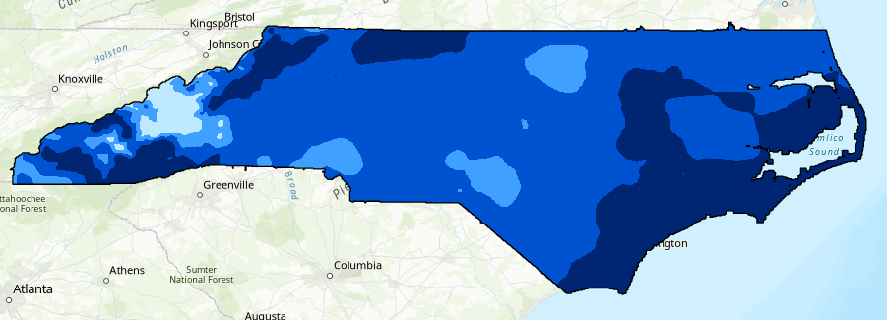
Gridded Rainfall Sources (cont’d)
NOAA Atlas 14 Recurrence Interval Gridded Rainfall
  Recurrence Interval (2pct, 1pct, 05pct, 02pct, 01pct)
  NRCS Nested Temporal Distribution
  Future Rainfall Ratios², LOCA RCP8.5 through end of century (2100)
  ²Jared Bowden, NCSU

Slide 10
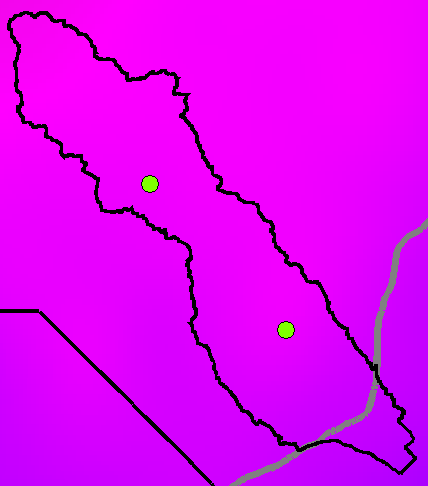
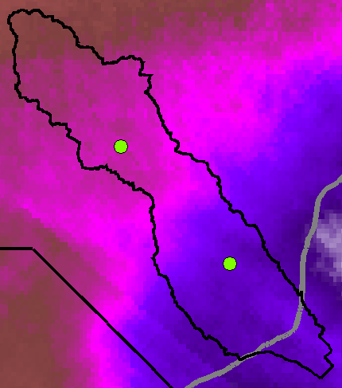
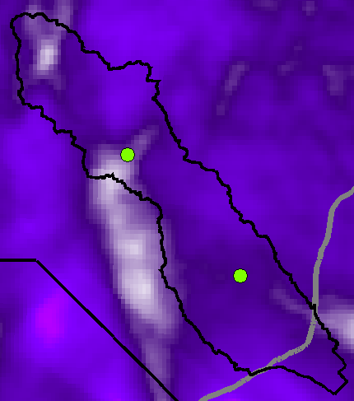
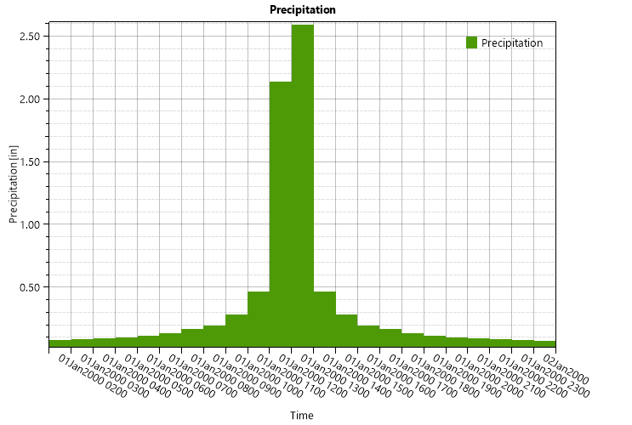
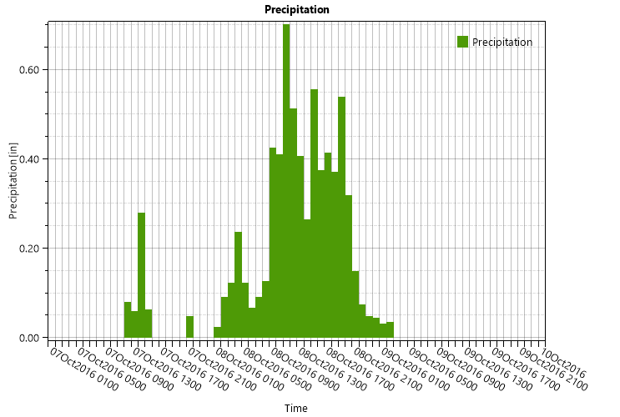
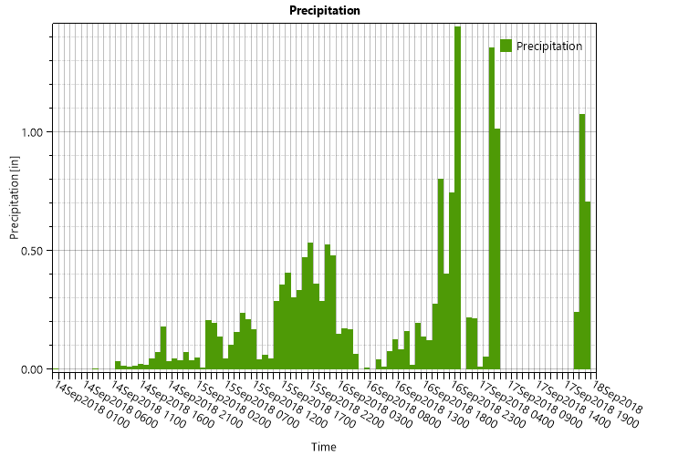

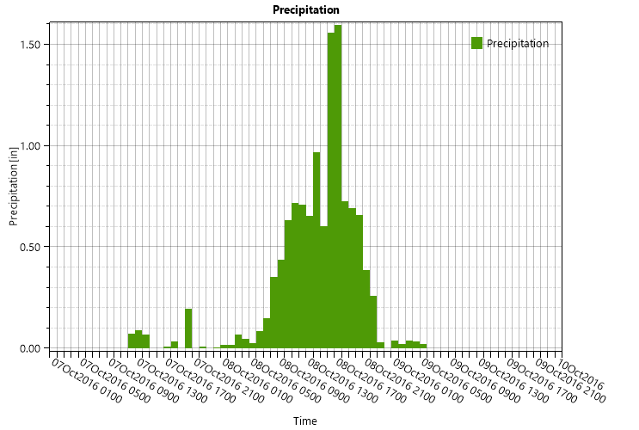
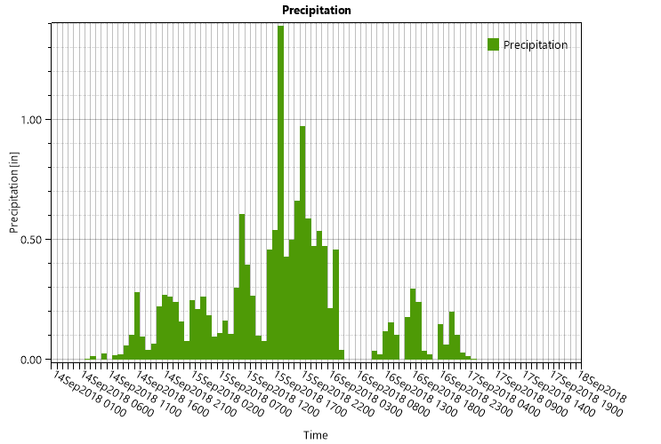
Gridded Rainfall Sources (cont’d)
Atlas 14 100-Year 24-Hr
Hurricane Matthew
Hurricane Florence

Slide 11
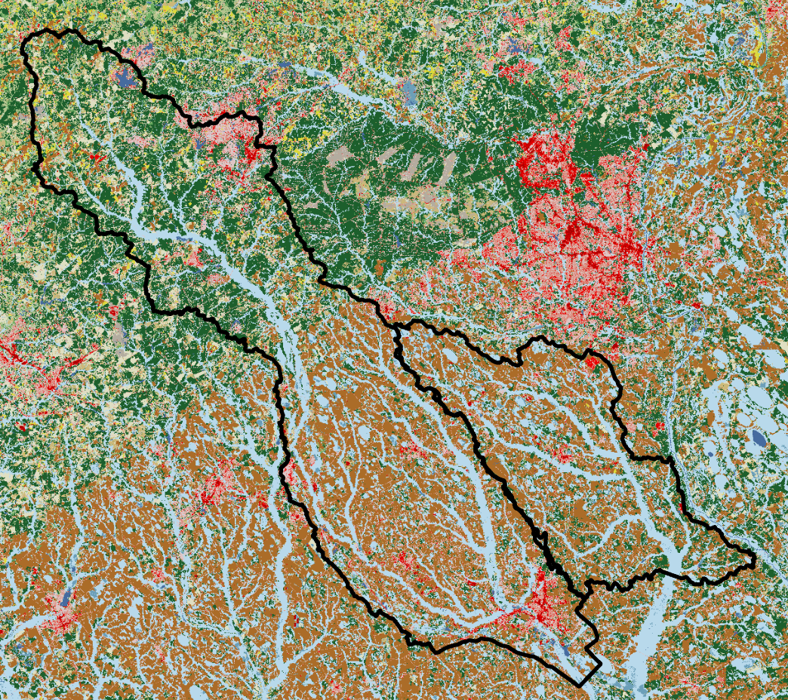
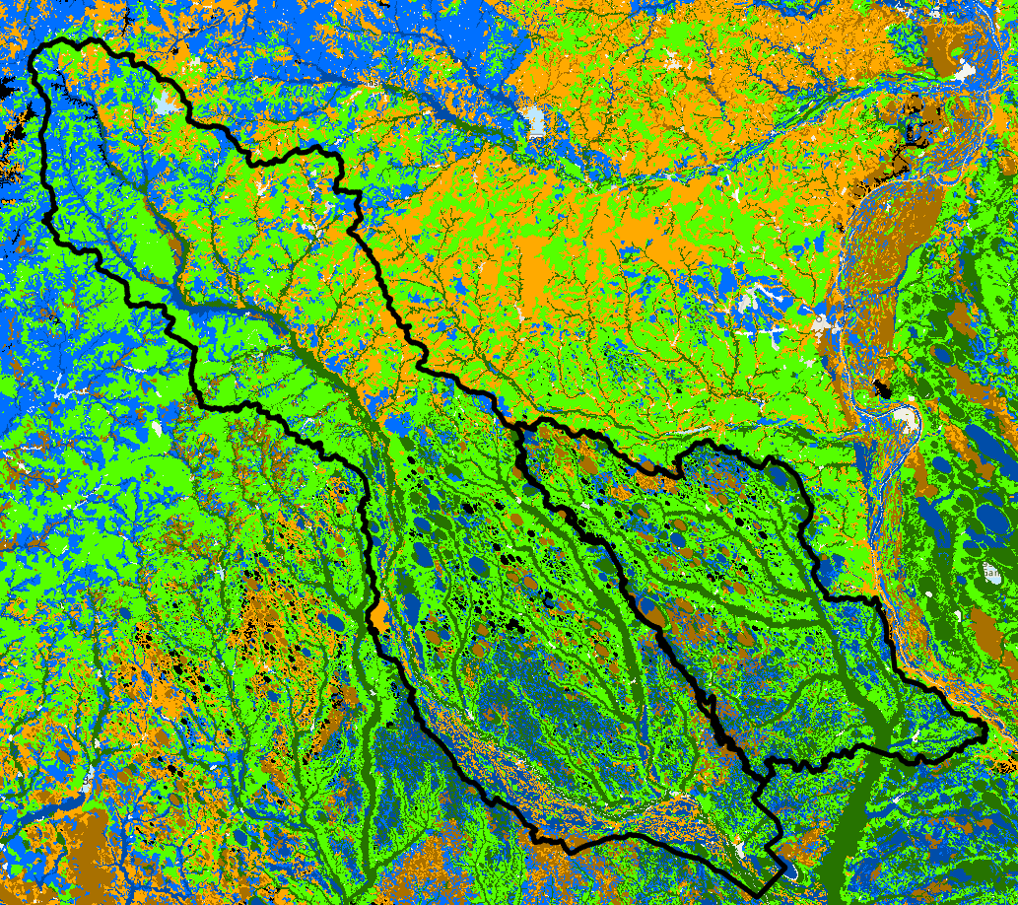
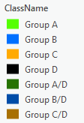
Rainfall-Runoff – Land Cover (Manning's n, %Imp), Soils

Slide 12
I-95 (MM 13-22)
~745 sq. mi.
Modeled Structures
  10 Bridges
  5 Culverts
I-95 (MM 23-40)
~275 sq. mi.
Modeled Structures
  2 Bridges
  10 Culverts

Slide 13
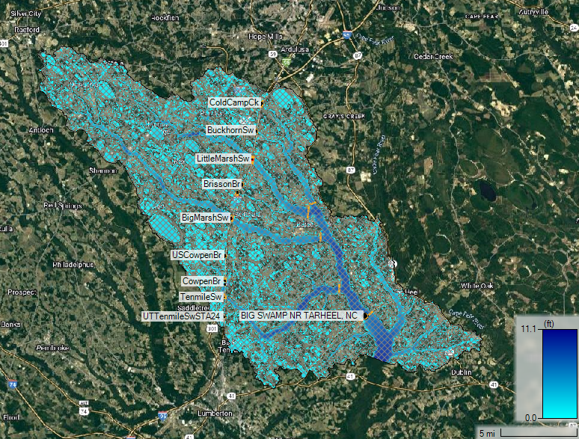
I-95 (MM 23-40)
NE of Lumberton, NC
2 HUC10’s
  Gallberry Swamp
  Upper Big Swamp
~275sqmi
Modeled Structures
  2 Bridges
  10 Culverts
USGS Gage

Slide 14
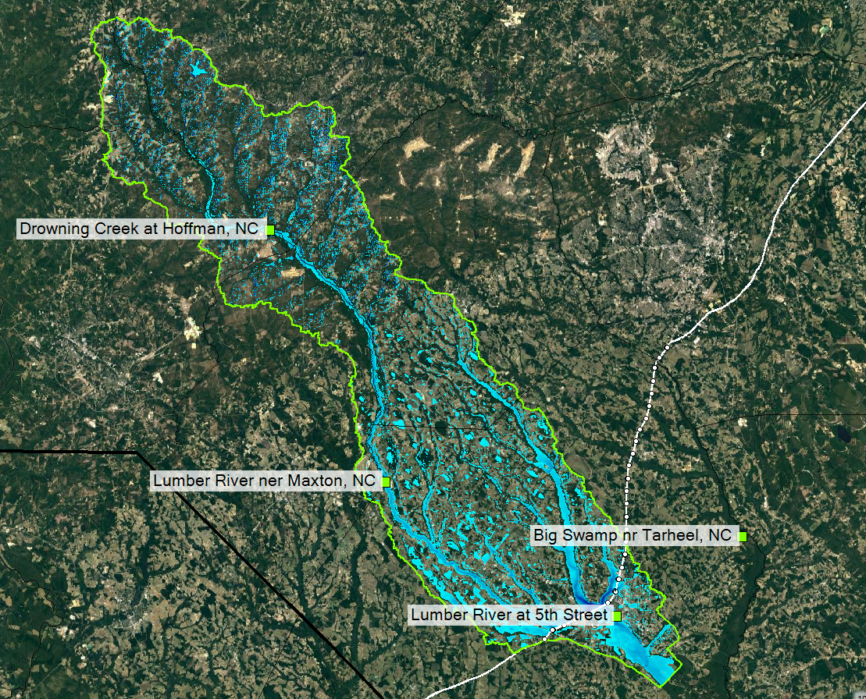
I-95 (MM 13-22)
Lumberton, NC
~745sqmi
Modeled Structures
  10 Bridges
  5 Culverts

Slide 15
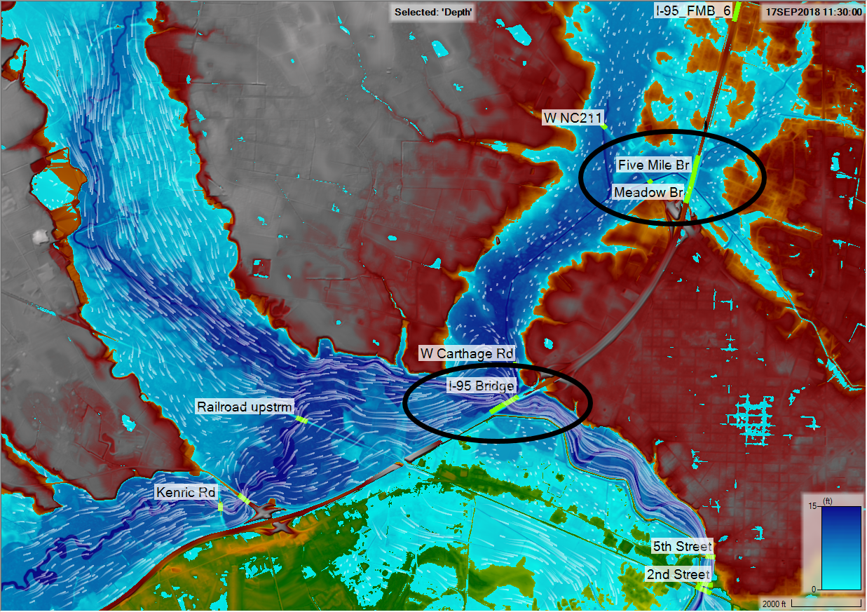
I-95 (MM 13-22)
Lumberton, NC
~745sqmi
I-95 Structures
  Lumber River bridge
  Five Mile/Meadow Br Culverts

Slide 16
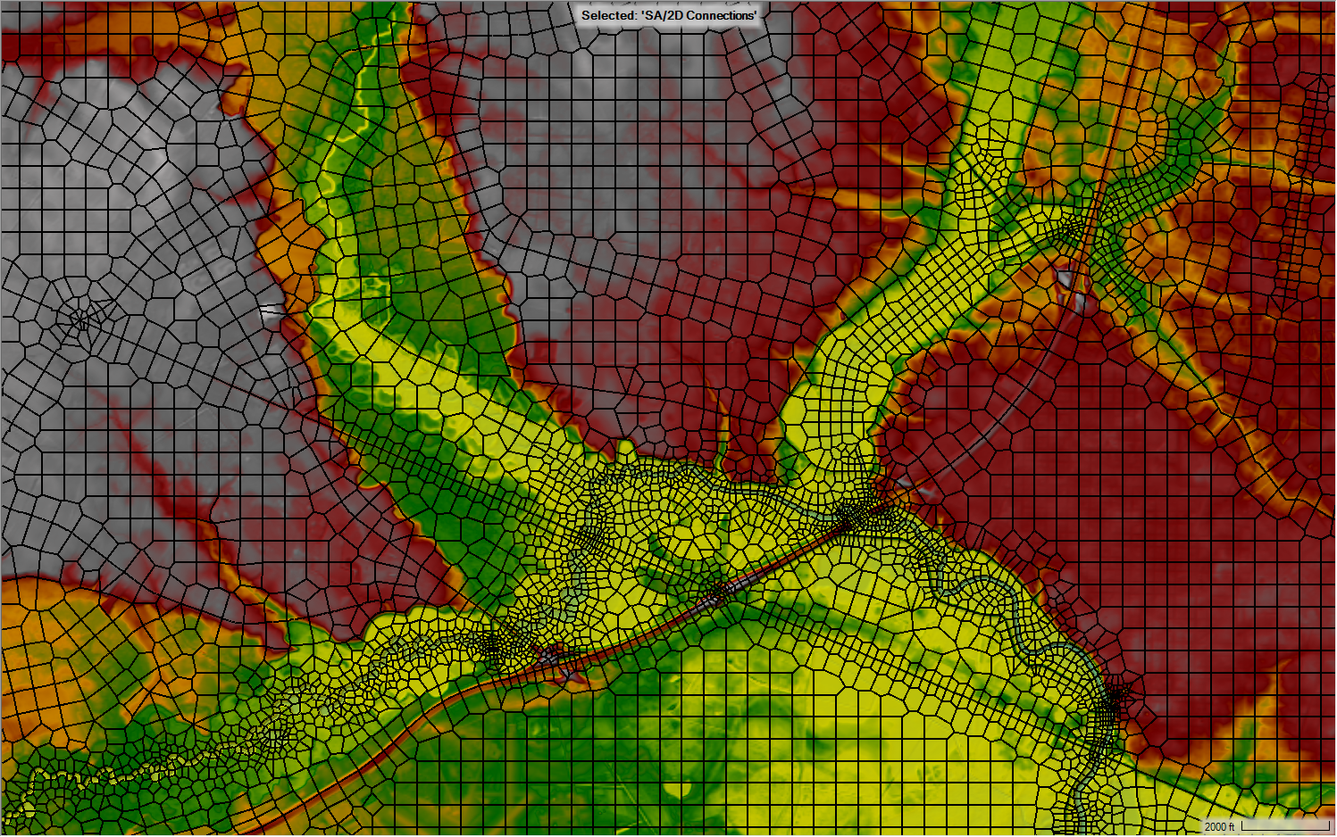
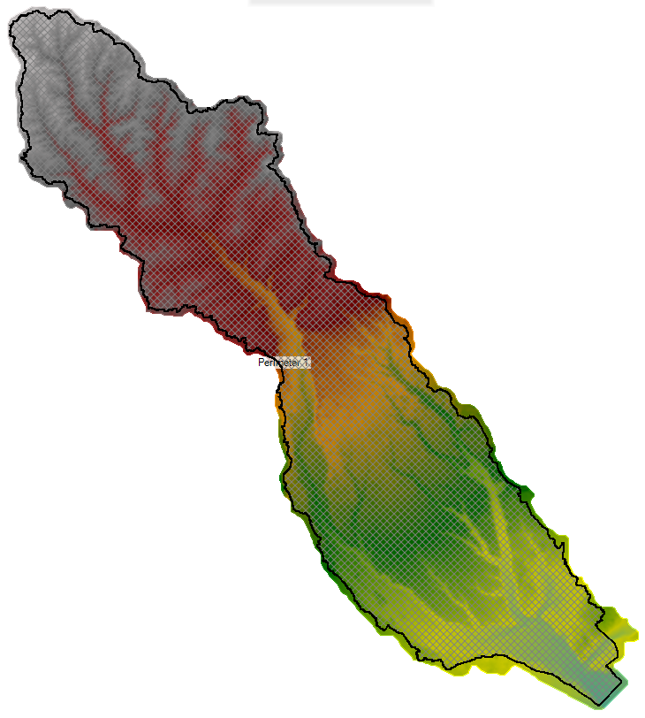
2D Mesh Development
Big Swamp
  300’ nominal mesh
  breaklines
Lumber River
  500’ nominal mesh
  breaklines
Balancing for Utility
  Large watershed rain-on-grid models with specific areas of interest

Slide 17
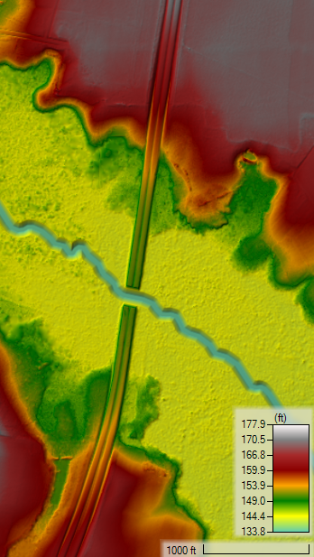
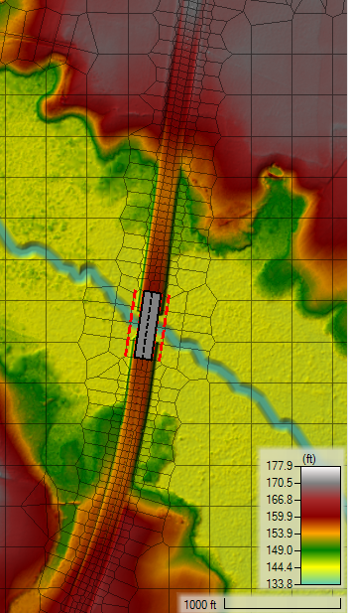
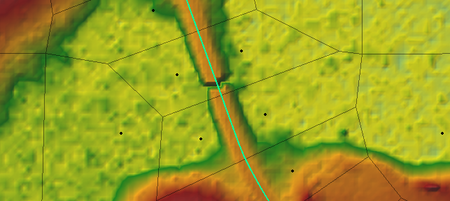
Big Swamp Terrains
Existing DEM (left)
  NC LiDAR
Proposed DEM (right)
  Roadway DTM mosaic
Approximated channel bathymetry in vicinity of hydraulic structures
Culvert ‘burns’ applied to study area abroad for hydraulic connectivity through

Slide 18
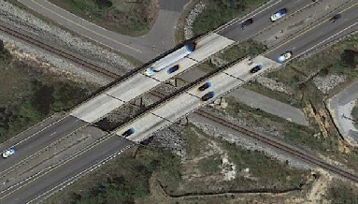
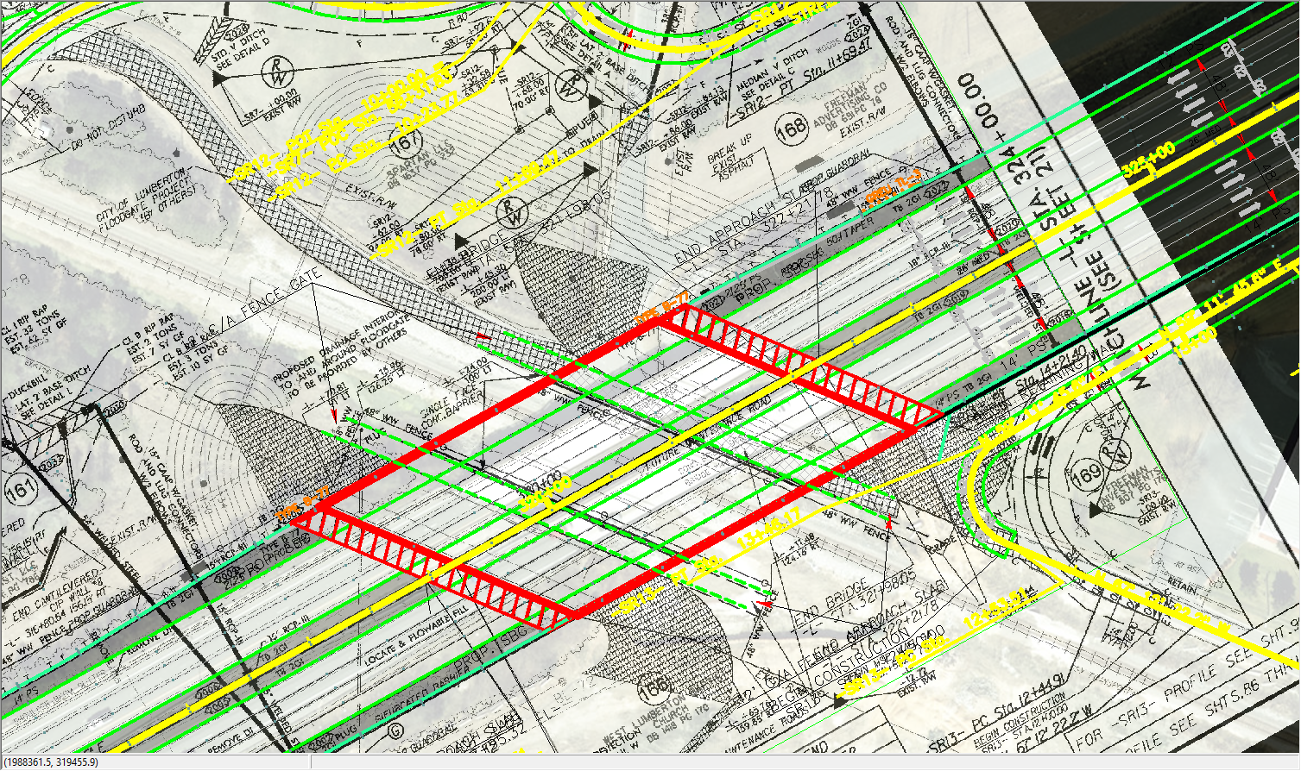
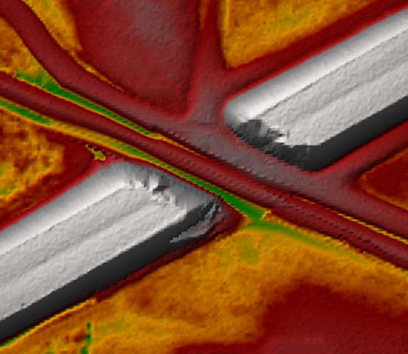
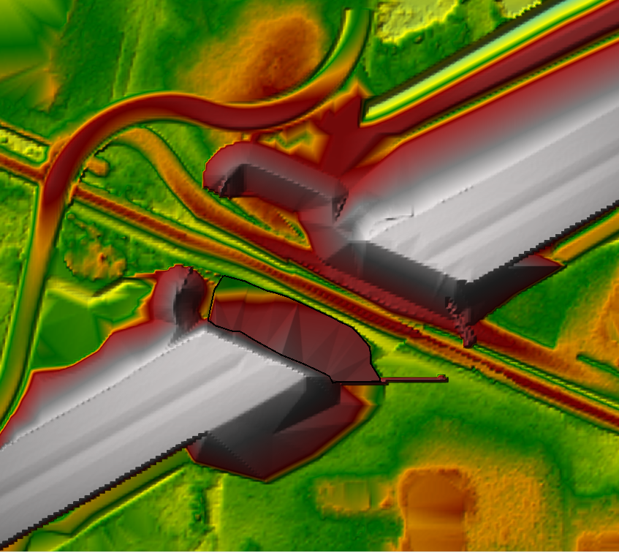
Lumber River Terrain
Existing (left)
  QL2 LiDAR 5’
  Bathymetry from NCDOT I-6064 modeling
Proposed (right)
  I-6064 Proposed Roadway
  Floodwall Embankments
Cell Face Alignment and burns for hydro-connectivity

Slide 19
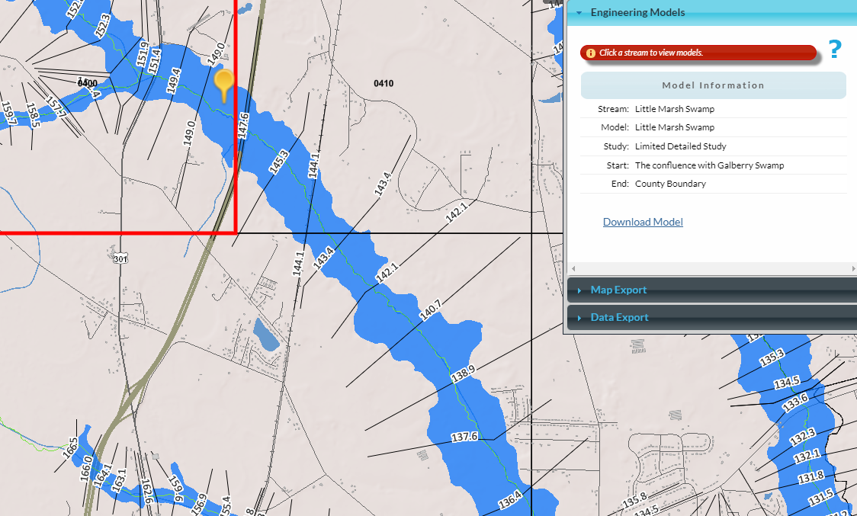
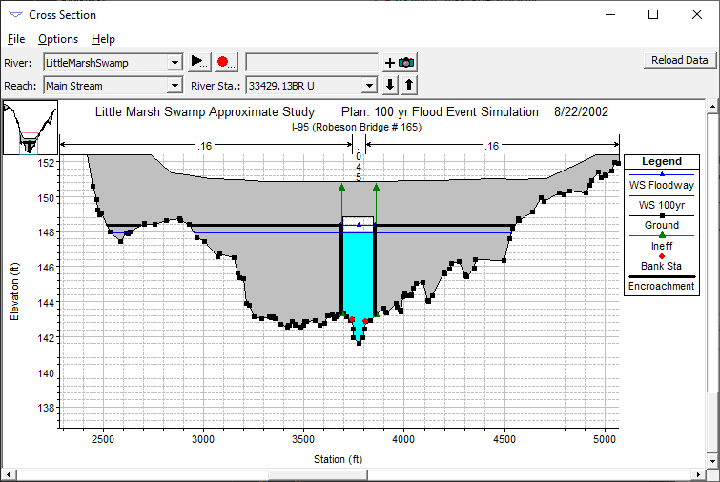
Existing Conditions
Big Swamp – leveraged FEMA Effective 1D HEC-RAS modeling for existing structures
Lumber River – leveraged NCDOT I-6064 2D rain-on-grid for existing/proposed structures

Slide 20
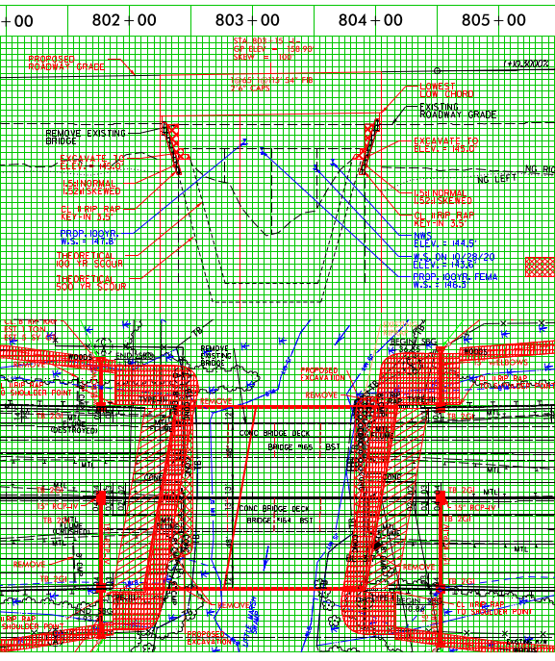
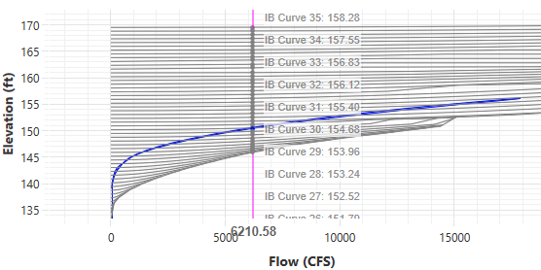
Structure Incorporation

Slide 21
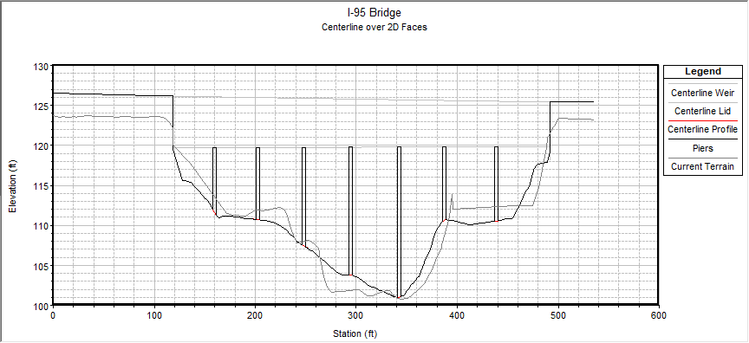
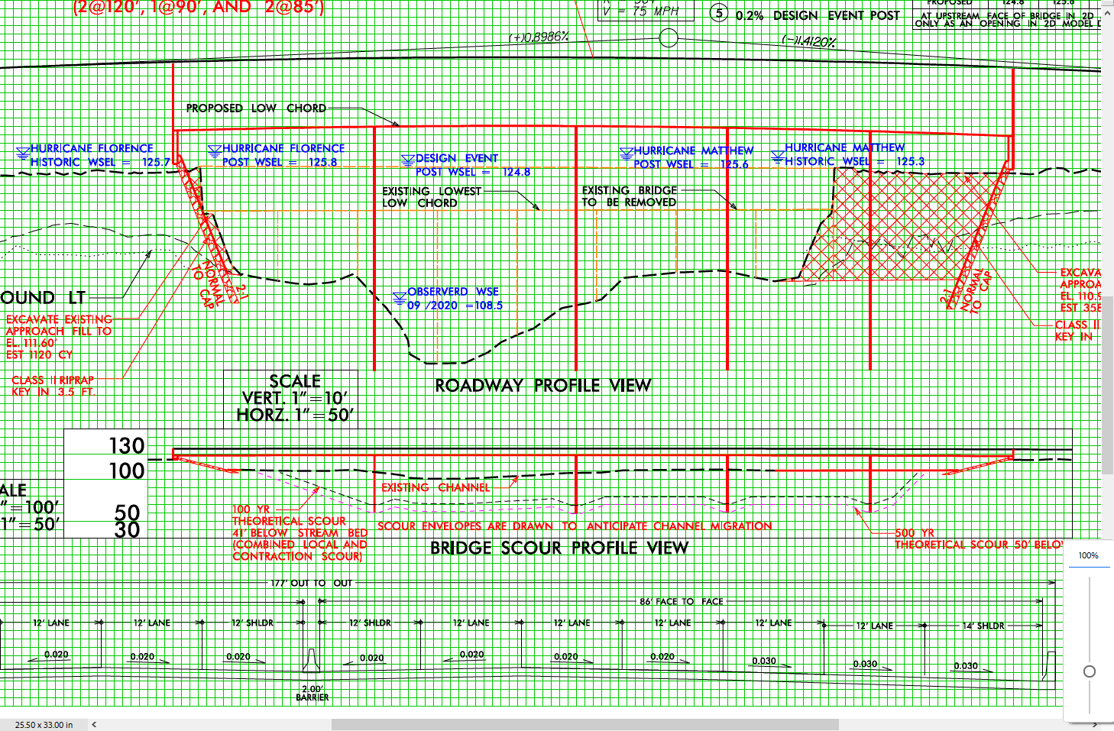
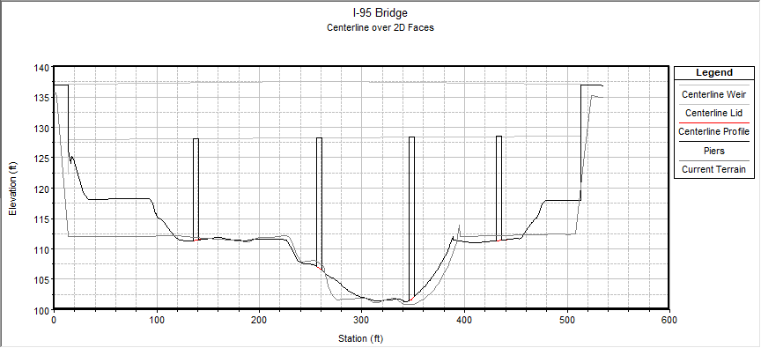
Structure Incorporation
HEC-RAS applies 1D Bridge Htab curves at 2D Cells associated with the bridge centerline (2D modeling outside of the bridge centerline cells)
Piers incorporated in Bridge geometry
  In geometry or terrain
Existing
Proposed

Slide 22
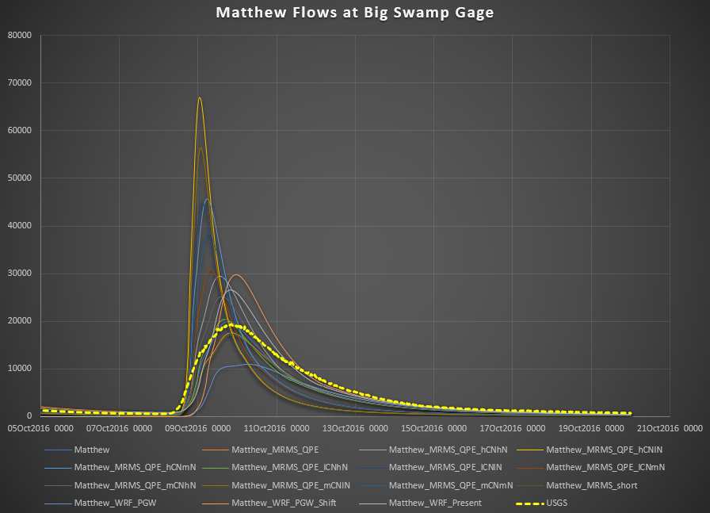
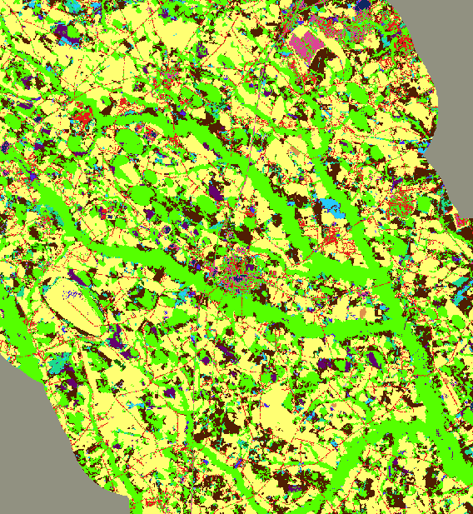
Big Swamp Calibration
Matthew & Florence
Limited observation areas other than USGS Gage
Predominantly cultivated crops and woody wetlands landcover through the Big Swamp drainage area
Calibrated with matrix of runs with varied CN & Manning’s n

Slide 23
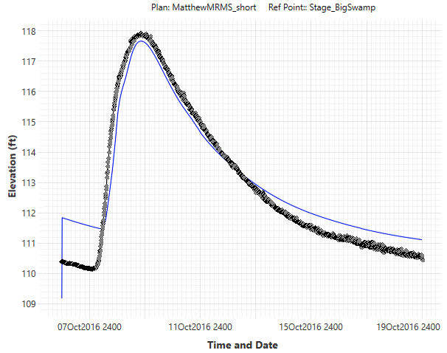
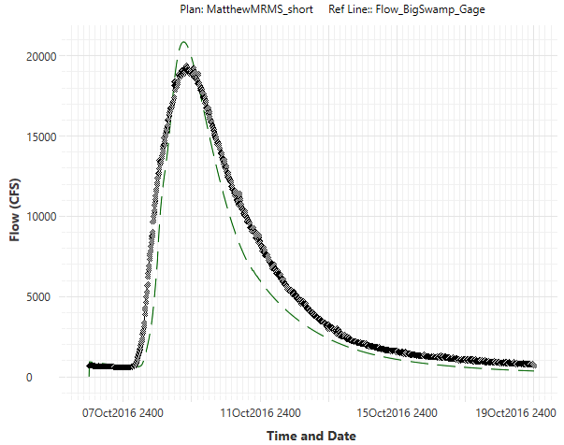


Hurricane Matthew
USGS 02134480 Big Swamp nr Tar Heel, NC

Slide 24
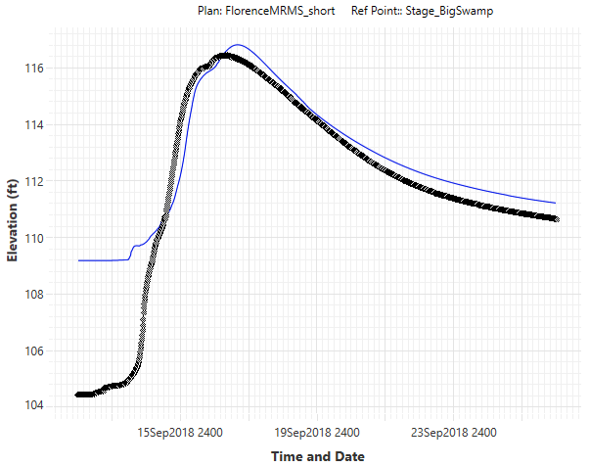
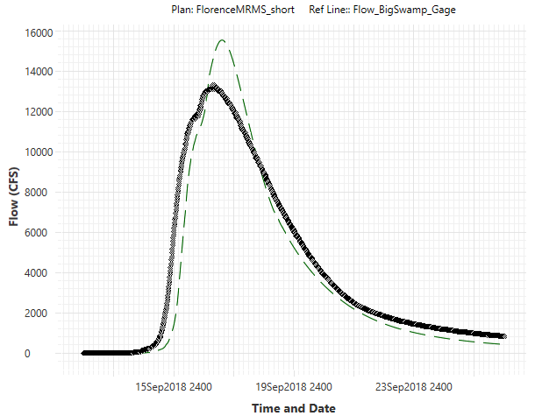


Hurricane Florence
USGS 02134480 Big Swamp nr Tar Heel, NC

Slide 25
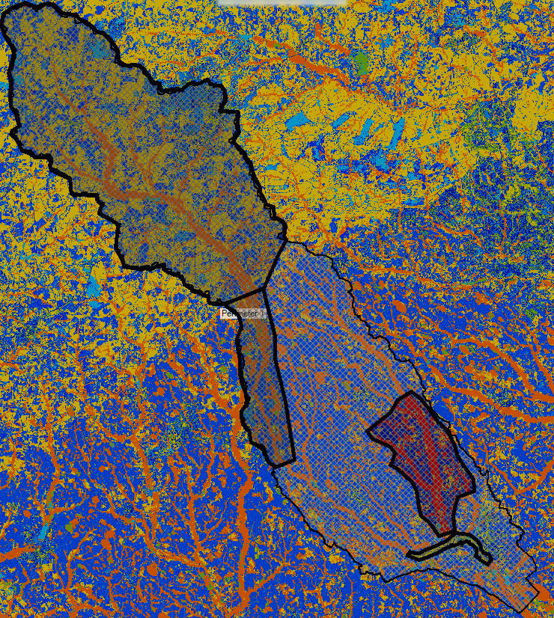
Lumber River Watershed Calibration
Sandhills
  Forested, Woody Wetlands
Coastal Plan
  Cultivated Crops, Woody Wetlands
Calibrated by modeling:
1) Calibration Regions
  Curve Number and Initial Abstraction
  Minimum Infiltration
  % Imperviousness of Land Cover
  Manning’s n of Land Cover
  2) VFW Road and I-95 overtopping

Slide 26


Lumber River Watershed Calibration
Challenges
  745 square mile rain-on-grid model
  Sandhills and Coastal Plain Hydrologic Regions
  Timing / Watershed Orientation / Double-Hump
  VFW Road
  I-95 bridge and roadway overtopping
  QL2 LiDAR (was flown during high water)

Slide 27




Hurricane Matthew (October 2016)
USGS 02131470 Lumber River at Lumberton, NC

Slide 28


Hurricane Florence (September 2018)
USGS 02131470 Lumber River at Lumberton, NC

Slide 29

High Water Marks – Hurricane Matthew

Slide 30

High Water Marks – Hurricane Florence

Slide 31

RAS Model Comparison Tool
Existing and Future
Pre and Post

Slide 32


Another 2D Advantage
Two culverts in close proximity
Headwater/Tailwater interaction during high flow events

Slide 33



Filtering Results
Early rainfall ponding
  Quickly drain but show up in Maximum WSEL products
Velocity at Peak Flow

Slide 34

Stress Test
A comprehensive look at all aspects along the corridor within the model
Identify vulnerabilities at each hydraulic structure
Identify vulnerabilities at non-structure locations
Determine whether designs meet a desired freeboard or level of service

Slide 35



Matthew MRMS and WRF

Slide 36



Matthew PGW Overtopping
(MRMS – Blue ; PGW – Orange)

Slide 37

Example of Individual Structure Results

Slide 38


WSEL at Hydraulic Structures

Slide 39




Stress Test

Slide 40



Tropical Storm Debby - Early August 2024
QPF for instant forecasted runs (6-hour increments)
MRMS QPE for hindcasting
Lesser event than Matthew (117.9’) & Florence (116.5’)

Slide 41


Update FIMAN and RAFT Online Applications
"A resilient North Carolina is a state where our communities, economies, and ecosystems are better able to rebound, positively adapt to, and thrive amid changing conditions and challenges, including disasters and climate change; to maintain and improve quality of life, healthy growth, and durable systems; and to conserve resources for present and future generations."
— NC Climate Risk and Resilience Plan, Executive Summary

Slide 42
Challenges and Limitations
  Rainfall-Runoff
    Recurrence Interval Rainfall doesn't equal Recurrence Interval Runoff
    Synthetic Rainfall doesn’t reflect observed extreme events
    Minor variations in Rainfall produce significant variations in modeled Runoff
    Curve Number method
      Event-Dependence, Duration-Dependence
      Antecedent Runoff Conditions, starting conditions
  Balancing for Utility
  Large watershed rain-on-grid modeling
  Cell Size, Time Step, Accuracy, Computation Time/Expense, Application

Slide 43
Future Applications
  Critical infrastructure planning, design, and operations support
  Flood and operational forecasting, nowcasting
  Probabilistic, quantify uncertainty
  approach a 2D Mesh Probabilistic Map Library using deep learning

Slide 44
Future Applications
  approach a 2D Mesh Probabilistic Map Library using deep learning
  `
  Optimize for computation time
  Develop 2D Mesh Probabilistic Flood Map Library System
  - Forecasted and Observed Rainfall
  - 2D Modeled and Observed Runoff (simple sensing)
  - Feedback loop
  - Forecasted Runoff on a 2D Mesh
  - Enhance Modeled and Observed Runoff (enhanced sensing) and implement deep learning
  3) 2D model improved and utilized until replaced with 2D Mesh Probabilistic Map Library for forecasting runoff

Slide 45
Thank you! Questions?
  Tyler.Longberry@aecom.com
  David.Markwood@summitde.com
  MSLauffer@ncdot.gov

