Slide 1
New Inland Flooding Design Standards and Procedures for Resilience and Sustainability in the Face of Climate Change
Roger Kilgore, PE, BC.WRE
Kilgore Consulting and Management
Brenda Dix
ICF International
National Hydraulic Engineers Conference
August 27-30, 2024
Biloxi, MS

Slide 2
NCHRP Project 15-80 Design Guide and Standards for Resilience
Our motivation in billions of dollars and numbers of natural disasters
Project Objectives:
Briefly summarize how extreme weather events, long-term climate changes, and climate resilience impact transportation project delivery, infrastructure life-cycles, and asset management practices.
Identify current and projected future climate variables to be considered during the design of transportation projects to increase resilience.
Develop recommendations for updating design processes that include consideration of extreme weather events and increase resilience to climate impacts.
Develop a project delivery climate change resilience design guide.

Slide 3
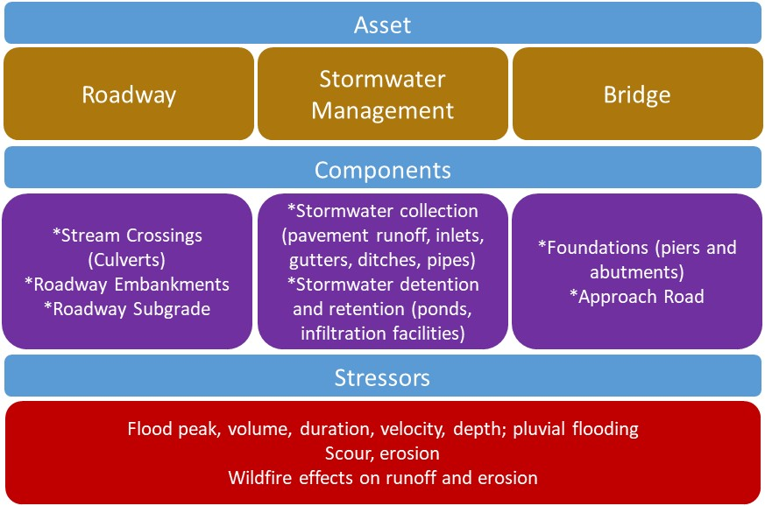
Assets, Components, and Stressors for Inland Flooding

Slide 4
Project Delivery Framework for Resilient Infrastructure

Slide 5
Climate Risk Screening and Levels of Analysis

Slide 6
Climate Risk Screening: Criticality and Equity
Risk Factor | Low Risk | Moderate Risk | High Risk
Criticality | Functional class: local Alternative routes: yes | Functional class: collector, minor arterial Alternative routes: yes, but less capacity | Functional class: major arterial, interstate, evacuation route Alternative routes: no, or with much less capacity.
Equity | Impacted residences/ businesses are less than 10 percent disadvantaged communities. | Impacted residences/ businesses are 10 to 50 percent disadvantaged communities. | Impacted residences/ businesses are over 50 percent disadvantaged communities.

Slide 7
Climate Risk Screening: Exposure Potential & Sensitivity
Risk Factor | Low Risk | Moderate Risk | High Risk
Exposure Potential: Roadways | Location: no significant drainageways Service life: < 30 years History of flooding: None History of repetitive damages/repairs: None | Location: crosses significant floodplain(s) Service life: 30-75 years History of flooding: Nuisance History of repetitive damages/repairs: Typical | Location: parallel and within significant floodplains Service life: > 75 years History of flooding: Notable History of repetitive damages/repairs: Notable
Exposure Potential: Bridges | Freeboard: > 4 ft Navigation permit: no Navigability: no Waterway or floodway width: < 50 ft Bridge length: < 100 ft | Freeboard: 2-4 ft Navigation permit: yes Navigability: yes Waterway or floodway width: 50 – 150 ft Bridge length: 100–250 ft | Freeboard: < 2 ft Navigation permit: yes Navigability: yes Waterway or floodway width: > 150 ft Bridge length: > 250 ft
Sensitivity: Bridges | Scour rating: N, 8-9 | Scour rating: 5-7 | Scour rating: 0-4, U
Notes:
Scour rating from NBI (Item 113), not the new SNBI.

Slide 8
Climate Risk Screening: Site-specific Adjustments
Risk Factor | Low Risk | Moderate Risk | High Risk
Sensitivity | No or short-term impairment | Damage-related impairments within specified costs and durations | Full-loss impairments
Baseline Adaptive Capacity (e.g., NBS, operational plans) | Adaptive features/ plans are already in place and offer a high level of protection | Adaptive features/ plans are already in place and offer a moderate level of protection | Adaptive features/ plans are not in place
Notes:
Result is a risk screening rating: low, moderate,, or high.

Slide 9
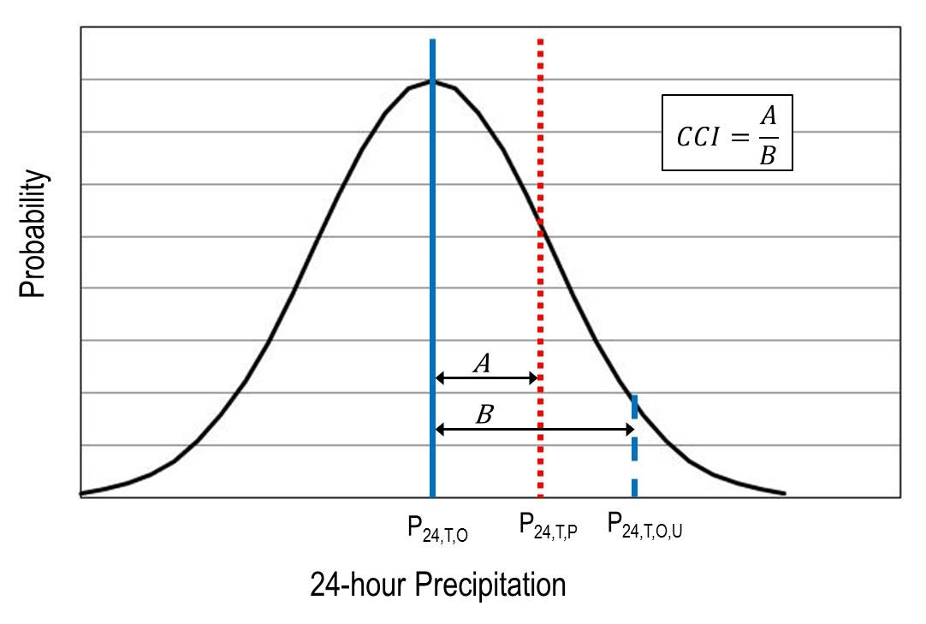
Climate Change Indicator (Potential Future Exposure)
How different is the future projected to be from the past?
Example for Denver CO
(T = 100-year)
NOAA Atlas 14 provides:
Projections from downscaled GCMs:
Notes:
Projections from ensemble of 14 downscaled GCMs from LOCA (CMIP5).

Slide 10
Selection of Level of Analysis for Inland Flooding
For the example:
Risk Evaluation Level | Climate Change Indicator
 | ≤ 0.6 |  | ≥ 0.6
Low | Level 1 |  | Level 2
Moderate | Level 2 |  | Level 3
High | Level 3 |  | Level 4

Slide 11
Levels of Analysis Not all Projects Require the Same Attention
Historical discharges
Historical discharges/confidence limits
Projected discharges/confidence limits
Projected discharges/confidence limits with expanded evaluation

Slide 12
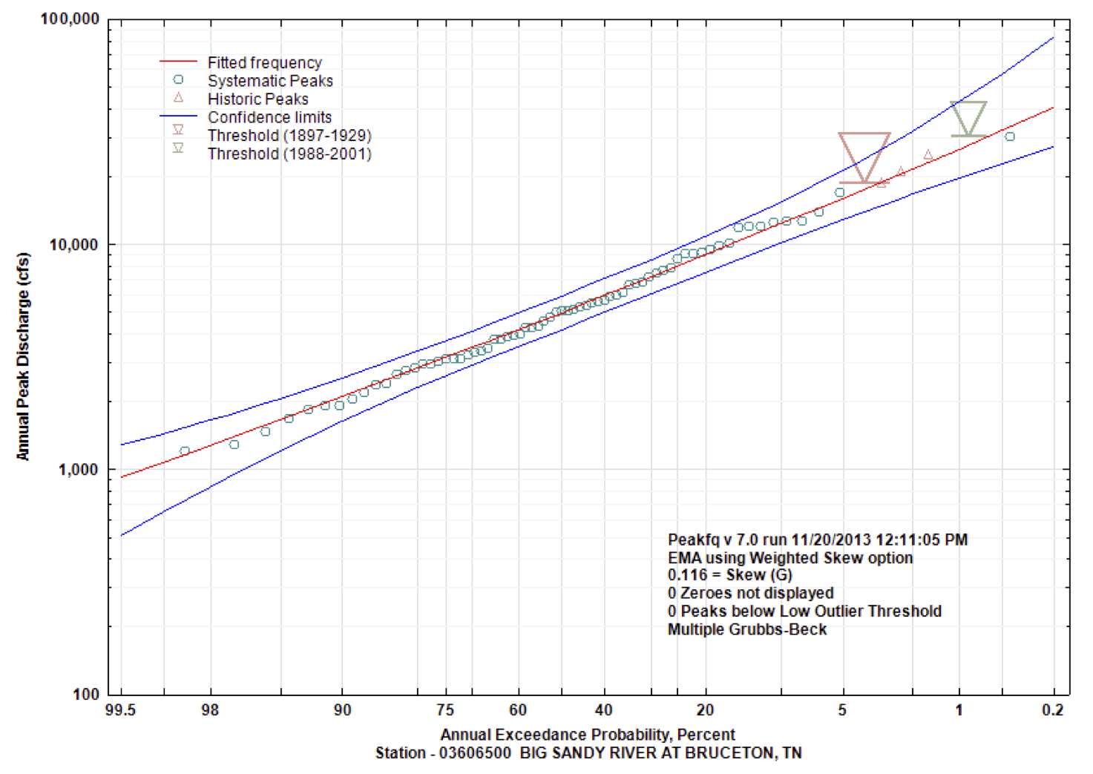
Confidence Limits: Insight into Variability
Upper CL (95%)
Best estimate
Lower CL (5%)
90% confidence interval

Slide 13
Levels of Analysis
Historical discharges
Historical discharges/confidence limits
Projected discharges/confidence limits
Projected discharges/confidence limits with expanded evaluation
For the example

Slide 14
New Resilient Design Standards

Slide 15
Resilient Design Standards – Check Condition
Standard Historical Design Condition | Next AEP Minimum Check Condition | UCL Minimum Check Condition
0.5 AEP (2-year) | 0.2 AEP (5-year) | 0.5 AEP (2-year) UCL
0.2 AEP (5-year) | 0.1 AEP (10-year) | 0.2 AEP (5-year) UCL
0.1 AEP (10-year) | 0.04 AEP (25-year) | 0.1 AEP (10-year) UCL
0.04 AEP (25-year) | 0.02 AEP (50-year) | 0.04 AEP (25-year) UCL
0.02 AEP (50-year) | 0.01 AEP (100-year) | 0.02 AEP (50-year) UCL
0.01 AEP (100-year) | 0.005 AEP (200-year) | 0.01 AEP (100-year) UCL
0.005 AEP (200-year) | 0.002 AEP (500-year) | 0.005 AEP (200-year) UCL

Slide 16
Design Standard Climate Recommendations - Example Design Condition AEP = 0.04
Level of Analysis
Check Condition
Check Condition Outcome Threshold
Level 1
None unless specified in existing standards
None unless specified in existing standards
0.02 AEP flow (historical)
Level 2
No impairment (criteria exceedance only)
0.04 AEP flow UCL (historical)
0.02 AEP flow (projected)
Moderate (tolerable) impairment
Level 3
0.04 AEP flow UCL (projected)
0.02 AEP flow (projected)
Level 4
No impairment (criteria exceedance only)
0.04 AEP flow UCL (projected)
Notes:
For levels 3 and 4, if projected values are lower than historical values, use the historical values.

Slide 17
Service Life and Upper Confidence Limit
Hydrologic Service Life (years) | Confidence Interval | Upper Confidence Limit
Less than 30 | 38% | 69%
Between 30 and 75 | 68% | 84%
Greater than 75 | 90% | 95%

Slide 18
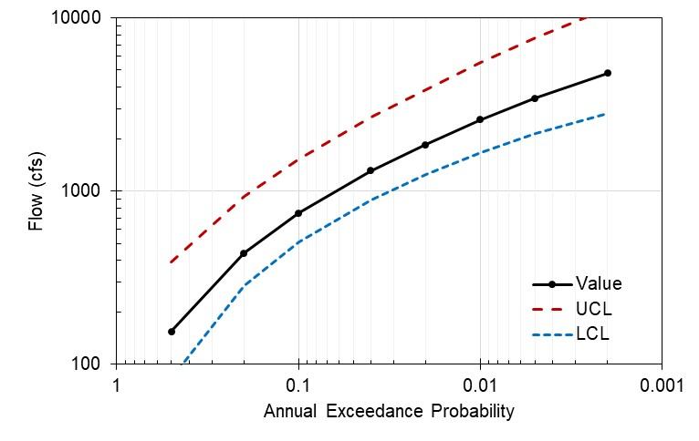
Example Resilient Design Criteria for AEP = 0.04 (Level 2)
2600
1900
1300
Level 2 Analysis
Design flow: 1300 cfs
Check flow (next AEP): 1900 cfs
Check flow (UCL): 2600 cfs
Recall:
0.04
Notes:
UCL will not always be greater. Depends on the confidence interval chosen and shape of the FFQ.

Slide 19
Design Standard Update Recommendations
AASHTO’s LRFD Bridge Design Specifications, 9th Edition (2020)
AASHTO’s Guide Specifications for Bridges Vulnerable to Coastal Storms (2008)
AASHTO’s Drainage Manual (currently under development)
AASHTO’s Mechanistic-Empirical Pavement Design Guide: A Manual of Practice, 3rd Edition (2020)
FHWA’s HEC-17 Highways in the River Environment – Floodplains, Extreme Events, Risk, and Resilience
FHWA’s HEC-25 Highways in the Coastal Environment

Slide 20
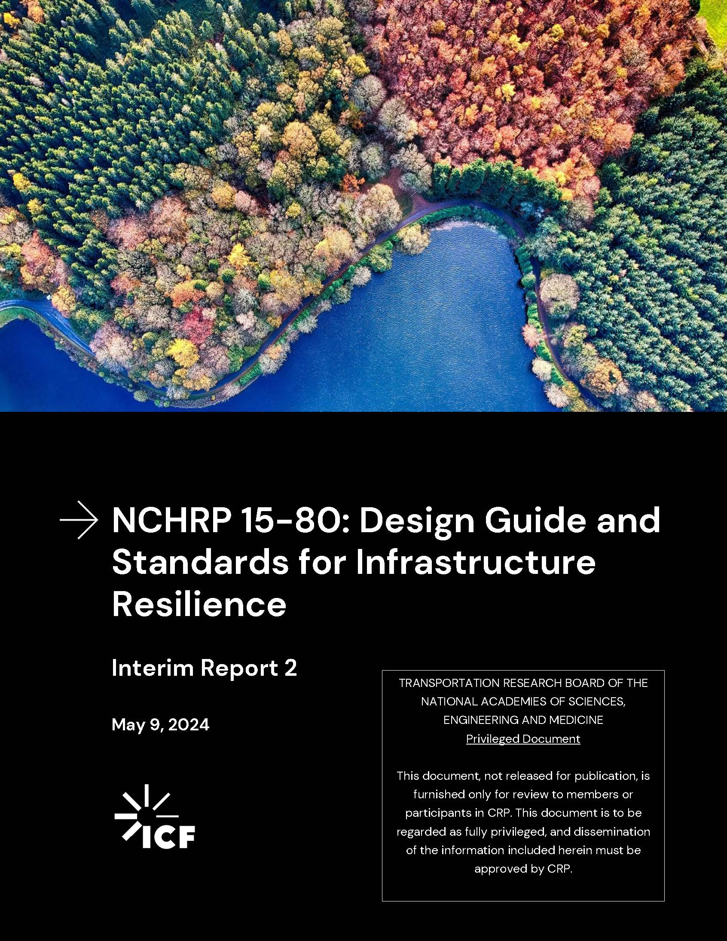
Primary Deliverables
Resilience Design Guide
Design Standards Updates
Inland flooding
Temperature (bridges and pavements)
Sea level rise and coastal storm surge
Project Final Report
Anticipated project completion: March 2025

Slide 21
Thank you!

